Slide 1
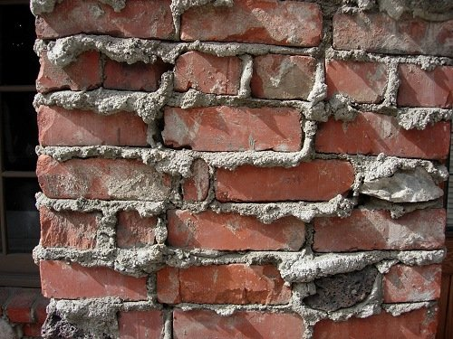
Academic language: Just another brick in the Word Wall
The language necessary to succeed in school, particularly the sciences
Falls into two major categories
Content specific vocabulary = “brick” words
Transportable vocabulary (used in multiple disciplines) = “mortar” words
Sometimes the mortar words get messy.

Slide 2
academic vocabulary – Tiered language
Academic words can be considered in three tiers to help deepen and refine our understanding of academic vocabulary and help us decide which words to “front load.”
Tier 1
Tier 2
Tier 3
Notes:
Sandi
Slide 15 - 25
11 mins
Beck & McKeown 1985 – 3 Tiers

Slide 3
Tier 1: The most basic words - Survival English
Examples
table
hamburger
walk
dance
happy
red
homework
These words tend to be simple nouns, verb, and adjectives.
These words should be front loaded.
Notes:
Sandi
Slide 15 - 25
11 mins
Survival English
Isabel Beck Bringing Words to Life and others including Kate Kinsella, Robert Marsano, and Doug Fisher, Nancy Frey

Slide 4
Tier 3: Low frequency words specific to a discipline
Examples
Gondwana
vertebrate
ionic bonding
genetic drift
transcription
photon
Some people call these the brick words
In science, these words should NOT be front loaded.
Notes:
Sandi
Slide 15 - 25
11 mins
In English class words might include:
Genre
Onomatopoeia
Metaphor
Simile

Slide 5
Tier 2: High frequency words found across a variety of disciplines
Examples
conduct
classify
monitor
investigate
declaration
reaction
analyze
element
Some people call these the mortar words
In science, these words CAN be front loaded.
Notes:
Sandi
Slide 15 - 25
11 mins
These words can mean different things in different classes:
For example
What’s expected when you conduct a science experiment is very different fro how a character in a novel conducts themselves, and even more dissimilar to what conduct means in a music class
An element of a novel is very different than an element in a chemistry class
Criteria for identifying Tier II Words
Importance and utility: Is it a word that students are likely to meet often in the world?
Instructional potential: How does the word relate to other words, to ideas that students know or have been learning?
Conceptual understanding: Does the word provide access to an important concept?

Slide 6
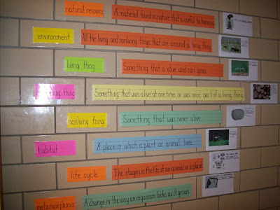
The word wall
Priorities? Strategies?
High frequency words: Tier 2
Discipline specific words: Tier 3

Slide 7
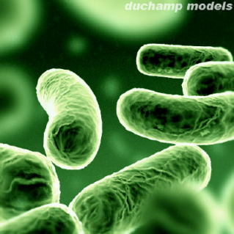
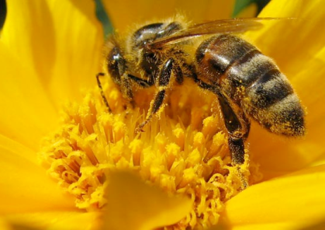
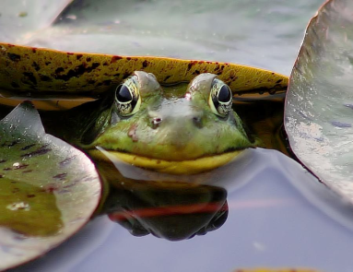
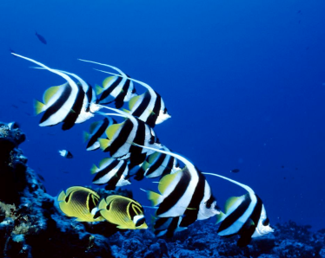
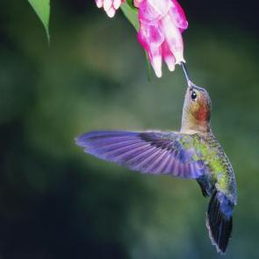
1.1 EVIDENCE of evolution
IMSS BIOLOGY ~ SUMMER 2012
Notes:
1.1

Slide 8
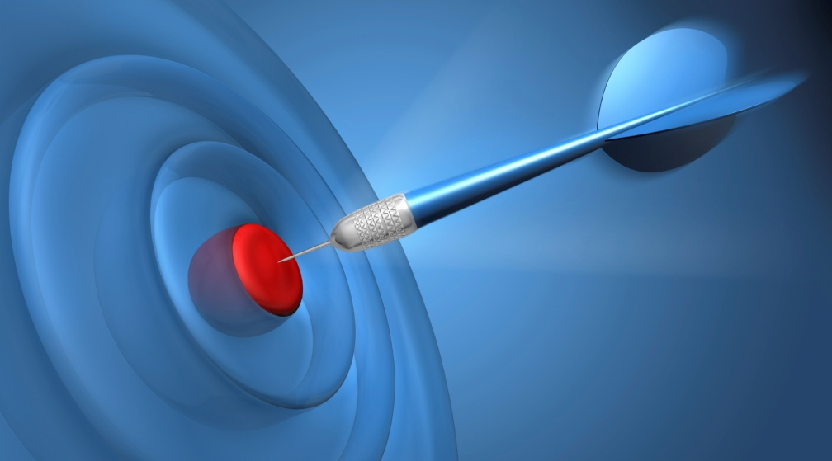
LEARNING TARGETS
To be able to differentiate biological evolution from other meanings of evolution.
To understand that biological evolution involves descent with modification (and other contributions of Charles Darwin).
To explain and give different types of evidence for the key concept of biological evolution: all life shares a common ancestor.
To identify homologous structures in a variety of organisms and to distinguish between homologous and analogous structures.

Slide 9
Understanding Evolution
Website from Museum of Paleontology, UC Berkeley
http://evolution.berkeley.edu/evolibrary/home.php
Evolution 101
Teaching Materials
Resource Library
Conceptual Framework http://evolution.berkeley.edu/evolibrary/teach/framework.php

Slide 10
Evolution is the unifying principle of biology.
We study biology to determine the commonalities of life, in order to more clearly understand its diversity.
Understanding evolution opens the door to such clarity.

Slide 11
What are meanings and contexts of the word, evolution?
How do we distinguish evolution from biological evolution?

Slide 12
Defining BIOLOGICAL evolution
Biological evolution is descent with modification; all life on Earth shares a common ancestor.
Not just change over time
Must involve descent through genetic inheritance
Encompasses both
Microevolution: small-scale evolution or changes in gene frequency in a population from one generation to the next
Macroevolution: large-scale evolution or descent of different species from a common ancestor over many generations
Allows us to understand the history of life

Slide 13
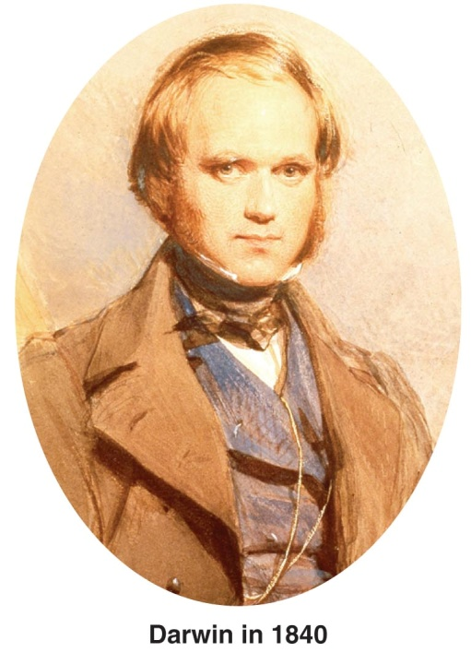
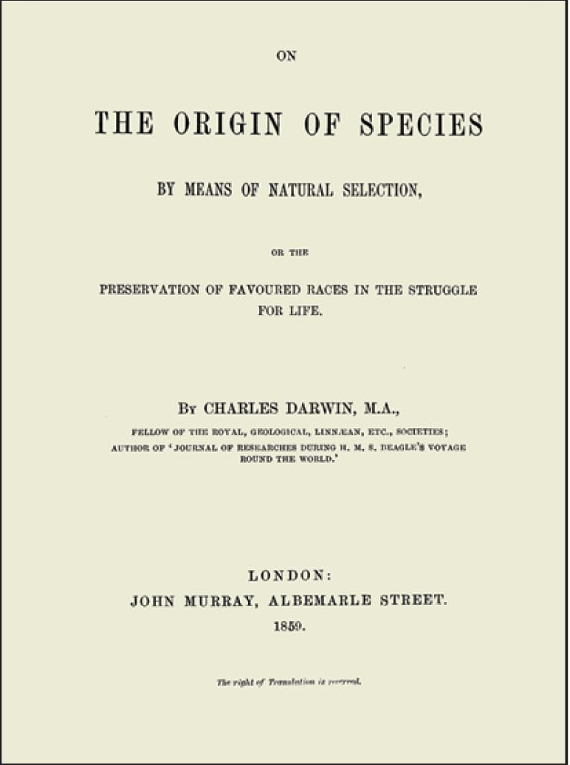
He is the man
Charles Darwin published On the Origin of Species by Means of Natural Selection (1859)
Darwin’s main concepts
Life evolves
Change occurs as result of “descent with modification” via natural selection
Organisms descended from ancestral species

Slide 14
Lines of Evidence – Overview
Biological evolution leaves observable signs.
We will examine some of the many lines of evidence in support of evolution
The fossil record
Comparative anatomy
Comparative embryology
Biogeography
Molecular biology

Slide 15
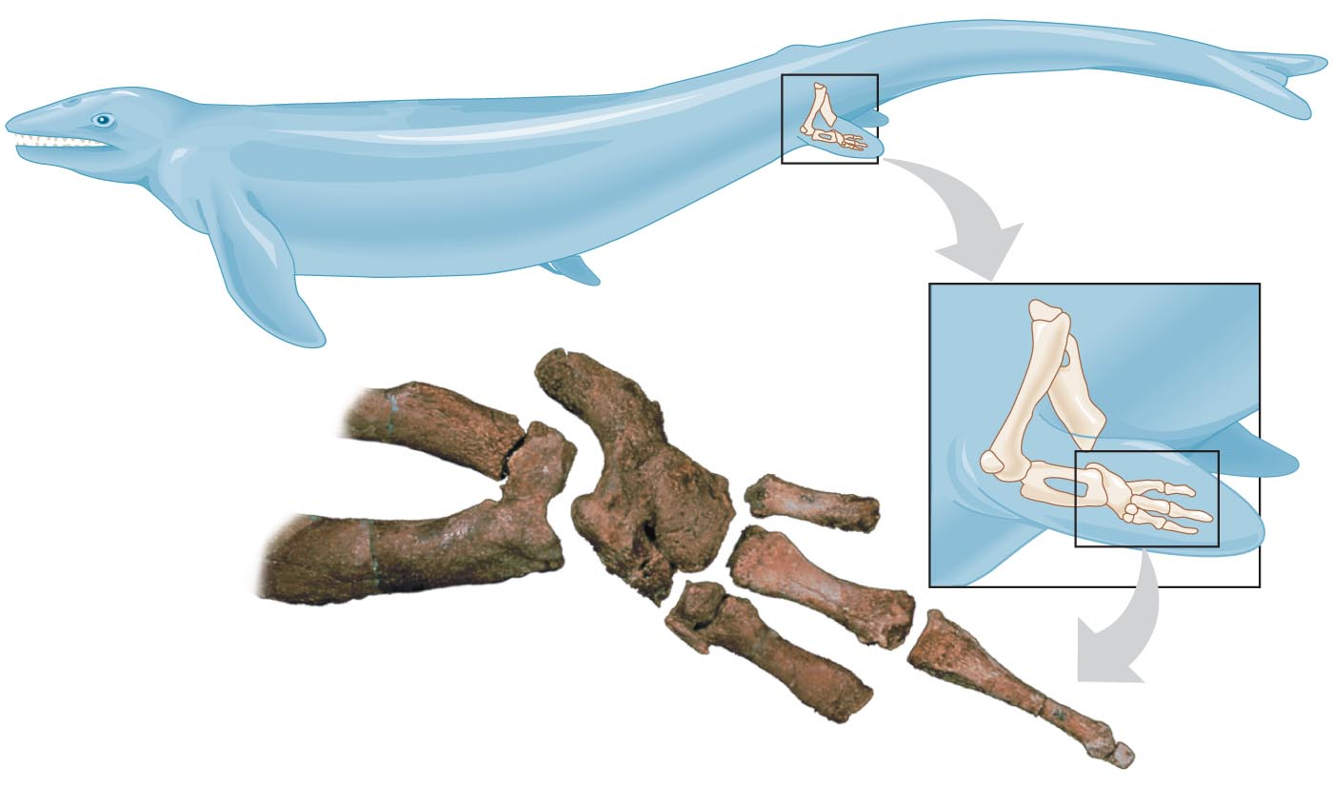
The Fossil Record
Fossils
Imprints or remains of organisms that provide snapshots of the past
Evidence for evolutionary links between past & present forms (“missing links,” or transitional forms)
E.g. Discovery of fossilized hind limb bones of a whale ancestor = evidence that whales evolved from land-dwelling tetrapods (four-legged vertebrates)
Fig. 13.6

Slide 16
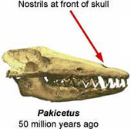
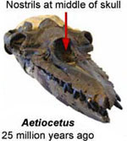
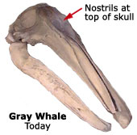
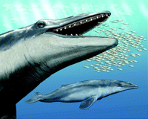
The Fossil Record (cont’d.)
Transitional forms
Intermediates between ancestral forms & present-day descendants
Evidence for modification from a common ancestor over time
E.g. Pakicetid mammals were early ancestors to modern whales
Fig. 13.6

Slide 17
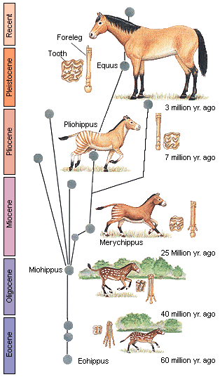
The Fossil Record (cont’d.)
The classic example of evolutionary change over time: horse evolution
One of best-studied fossil record
Complex lineage of > 34 genera
Environmental changes from tropical woodlands to grasslands correspond with form-function changes
Reduction in # toes
Increase in body size, longer limbs
Changes in tooth morphology
Faster locomotion over greater distances
Dietary shifts from leaves, shrubs to grasses
Fig. 13.6
Notes:
The early ancestors of the modern horse walked on several spread-out toes, an accommodation to life spent walking on the soft, moist grounds of primeval forests. As grass species began to appear and flourish, the equids' diets shifted from foliage to grasses, leading to larger and more durable teeth. At the same time, as the steppes began to appear, the horse's predecessors needed to be capable of greater speeds in order to outrun predators. This was attained through the lengthening of limbs and the lifting of some toes from the ground in such a way that the weight of the body was gradually placed on one of the longest toes, the third.

Slide 18
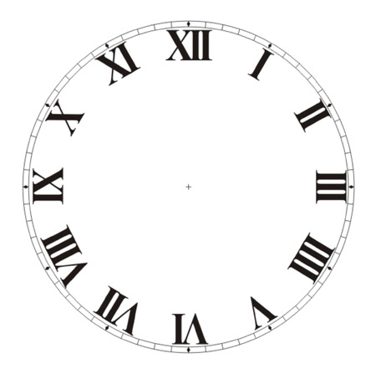
ACTIVITY
THE GREAT FOSSIL FIND
Form teams of two.
40 min.

Slide 19
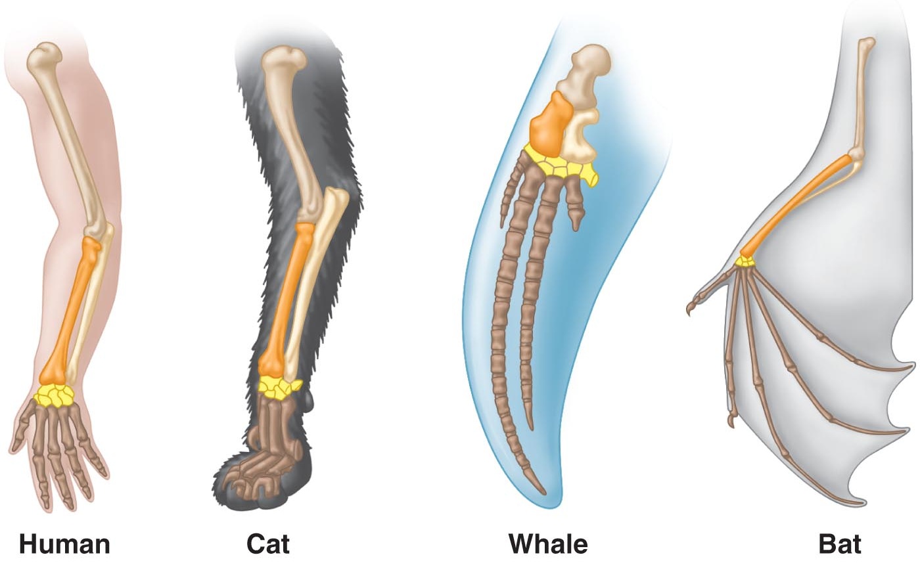
Comparative Anatomy
Comparison of body structure (morphology) between different species
Evidence for descent with modification
Homology
Similarity in structures due to common ancestry
E.g. forelimbs of mammals are homologous structures
that are constructed from the same skeletal components and are variations on a common anatomical theme.

Slide 20
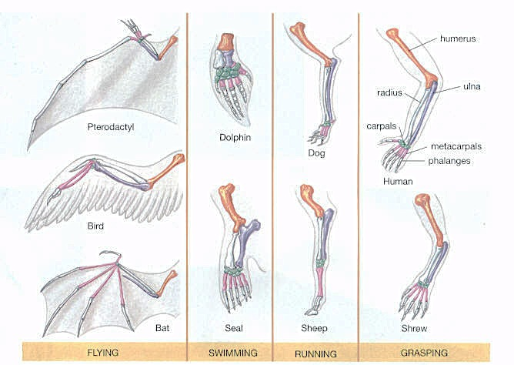
Comparative Anatomy (cont’d.)
Forelimbs of tetrapods (the four-limbed vertebrates)
Differ in form, corresponding to different functions
All share same set of bones - humerus, radius, and ulna

Slide 21
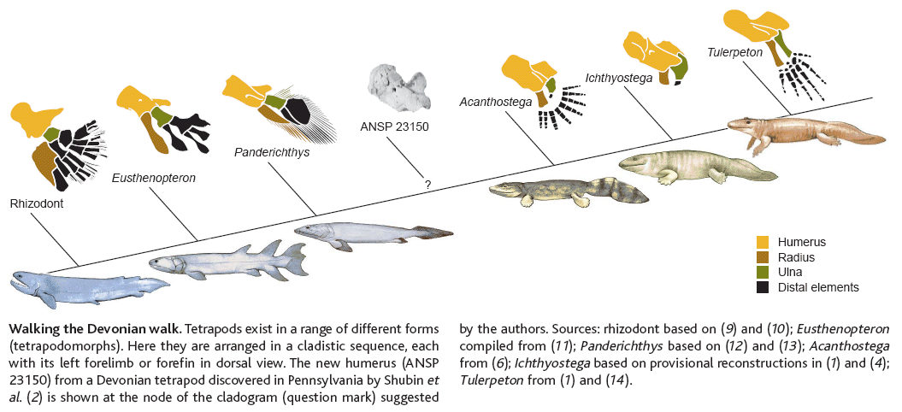
Comparative Anatomy (cont’d.)
Forelimbs of tetrapods (the four-limbed vertebrates)
Same sets of bones seen in fossils of common ancestors and transitional forms
These are same bones seen in fossils of extinct transitional animal, Eusthenopteron
mygeologypage.ucdavis.edu/cowen/historyoflife/ch08images.html

Slide 22
Vertebrate forelimb bones are homologous – bones of the forelimbs are the same
Vertebrate wings are analogous – similar function but evolved independently

Slide 23
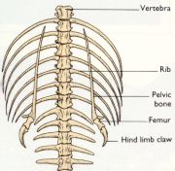
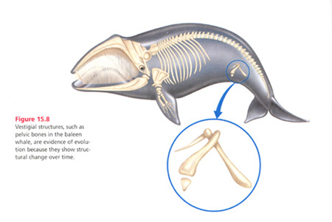
Comparative Anatomy (cont’d.)
Vestigial structures
Remnants of features that served important functions in an organism’s ancestors
Now have only marginal, if any, function
E.g. snake pelvic bones
E.g. whale pelvic bones

Slide 24
Comparative Embryology
All vertebrate embryos follow a common developmental path due to common ancestry.
All have a set of very similar genes that define their basic body plan.
As they grow, distinctions become more apparent.
The study of this development can yield insights into the process of evolution.
Activity to support this concept – Comparative Embryology: The Vertebrate Body from PBS Evolution http://www.pbs.org/wgbh/evolution/library/04/2/l_042_03.html

Slide 25
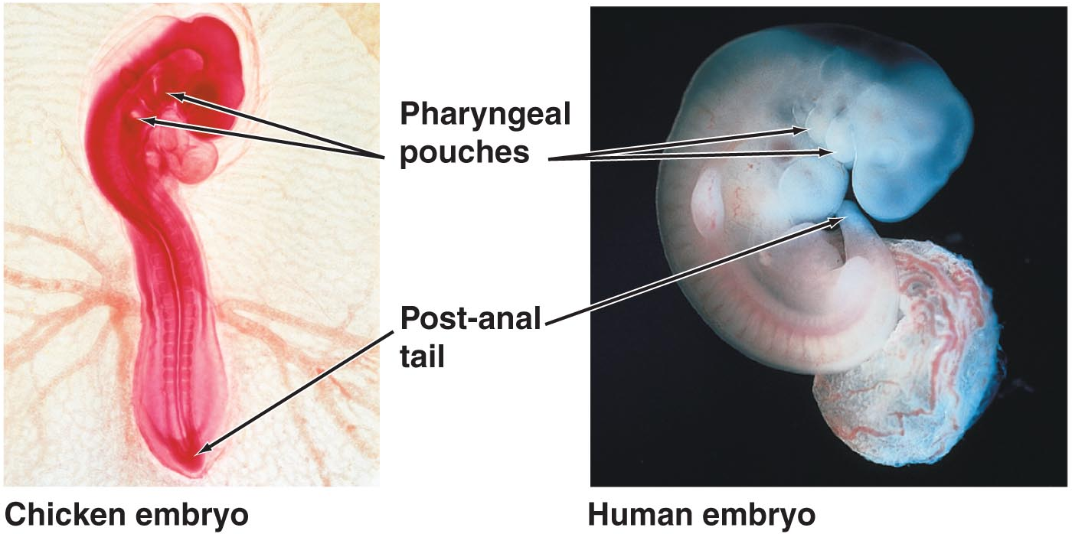
Comparative Embryology (cont’d.)
E.g. pharyngeal gill pouches appear on side of embryo’s throat, which
develop into gill structures in fish
form parts of the ear & throat in humans

Slide 26
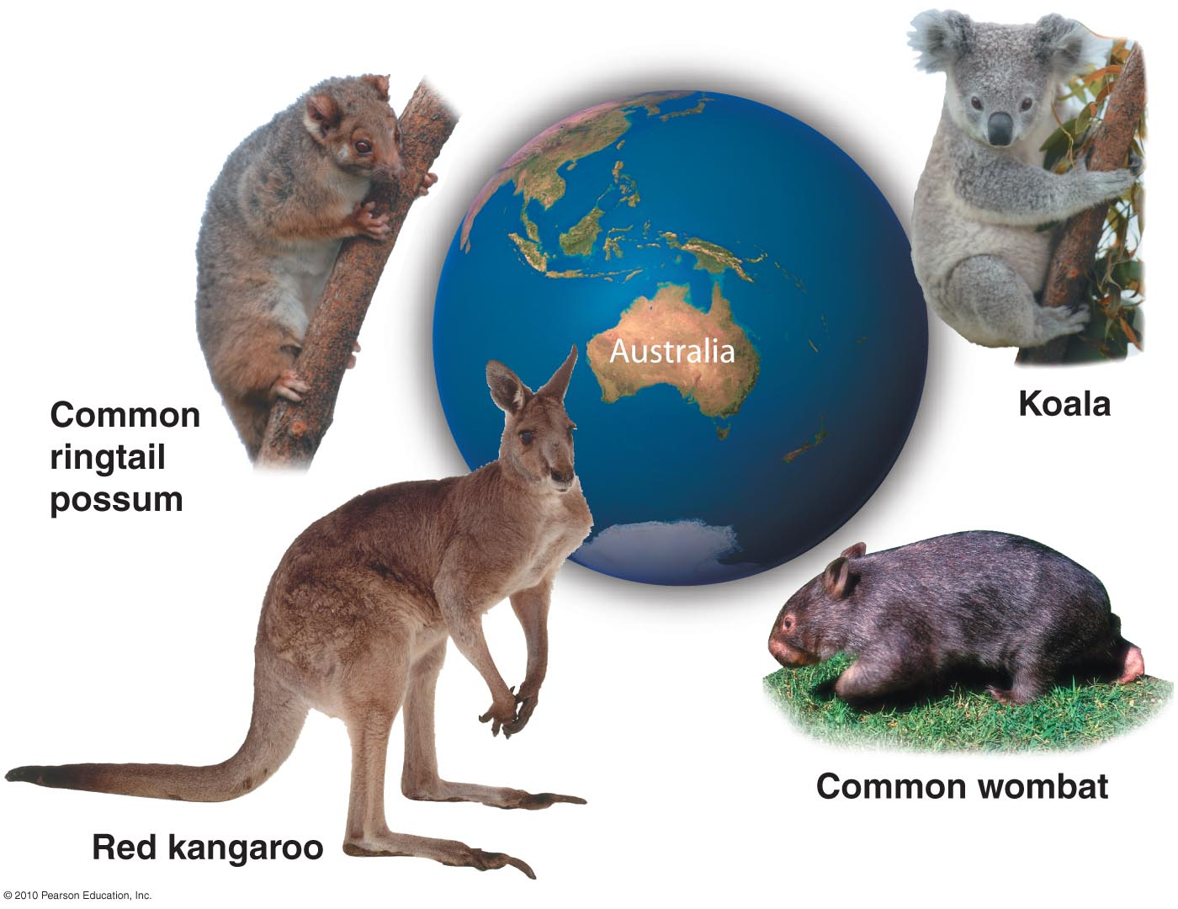
Biogeography
Study of the geographic distribution of species that first suggested to Darwin that today’s organisms evolved from ancestral forms
Many biogeographic examples would be difficult to understand, except from an evolutionary perspective
E.g. marsupial mammals in Australia

Slide 27
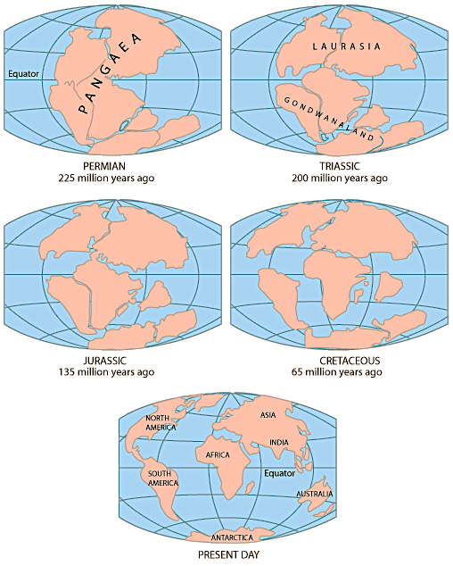
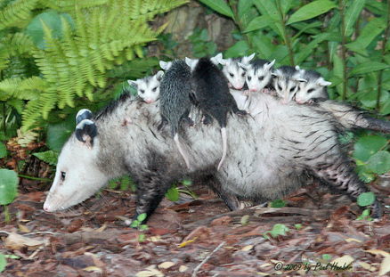
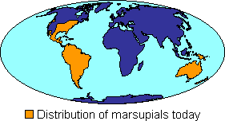
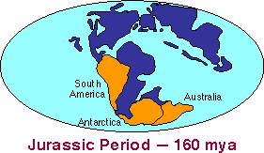
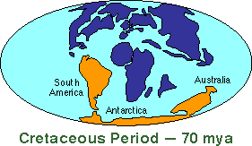
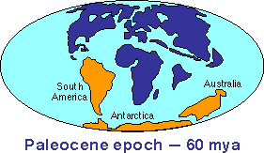
E.g. Marsupial Evolution
Marsupials occur in greatest diversity in Australia (& New Zealand) but also found in Americas
Fossil marsupials found in Antarctic, South America, & Australia
Gondwana split apart 160 to 90 mya → Australia + Antarctica → Australia
Marsupials diversify in “isolation” on this island continent
Notes:
http://evolution.berkeley.edu/evosite/lines/IIIBgeography.shtml

Slide 28
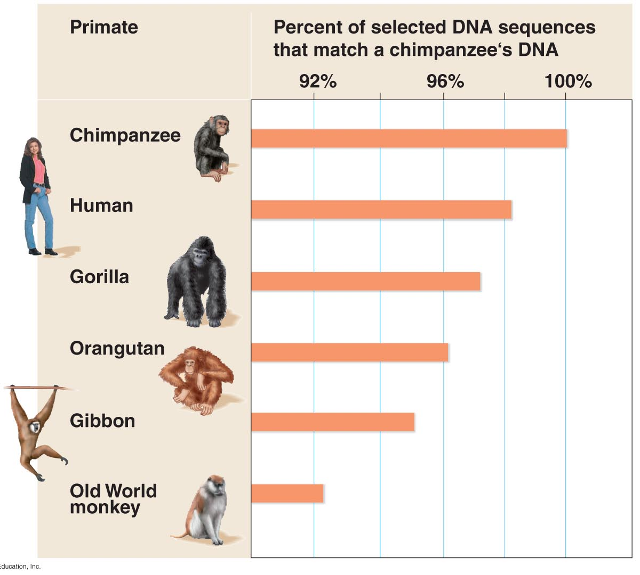
Molecular Genetics
Evolutionary relationships among species can be determined by comparing gene sequences
The DNA code itself is a homology that links all life to a common ancestor
Gene & protein comparisons among diverse species → genetic relatedness & understanding of evolutionary divergence
E.g. homologous genes have DNA sequences that match closely and are thus inherited by a relatively recent common ancestor

Slide 29
ACTIVITY
MUSEUM WALK
Visit the various displays – there are four stations.
Answer the guiding questions as you visit each station.
20 min.

Slide 30
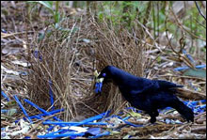
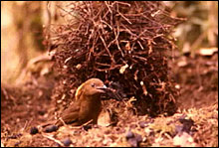
AVIAN ARCHITECTS
Male bowerbirds court potential mates by building elaborate “bowers” that serve as a stage for performing an elaborate courtship ritual.
The bower building mating ritual behavior is
homologous
analogous
Satin Bowerbird
MacGregor’s Bowerbird

Slide 31
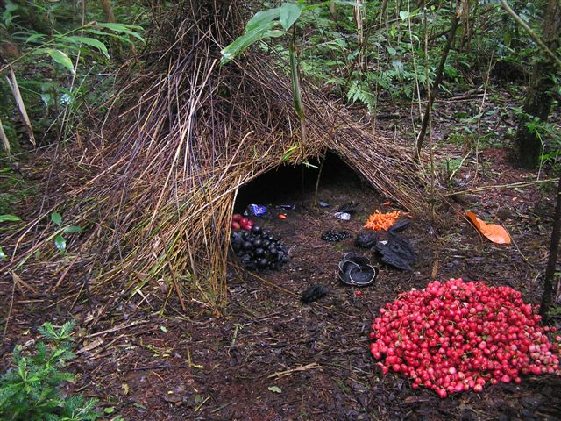
Each species of bowerbird builds slightly different bowers and puts on different courtship performances. However, all bowerbird species inherited this behavior from a common ancestor who also used this type of mating ritual. Thus, this behavior pattern is a homology and supports the close evolutionary relationship among bowerbird species.
http://www.youtube.com/watch?v=E1zmfTr2d4c&list=PL7E135D5698D08CF6&feature=player_detailpage

Slide 32
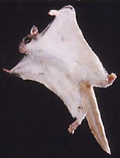
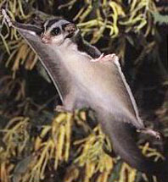
Flying Squirrels vs. sugar gliders
Flying squirrels and sugar gliders are strikingly similar: big eyes, white belly, cute & cuddly, have a thin piece of skin stretched between their arms and legs allowing them to “glide” down from high places.
Their gliding “wings” are _______ structures.
homologous
analogous
Flying squirrel
Sugar glider

Slide 33
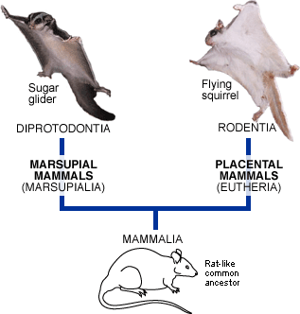
Squirrels vs. sugar gliders
Although they are both mammals, they are distantly related.
Flying squirrels are placental mammals.
Sugar gliders are marsupial mammals.
Gliding wings are analogous structures, independently evolved due to similar lifestyles – their common ancestor did not have gliding wings.

Slide 34
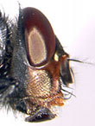
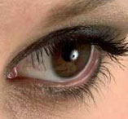
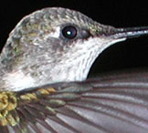
GENES THAT NEVER GO Out OF StyLE
The Pax-6 gene controls the development of eyes (and other sensory organs) in nearly all animals. Human Pax-6 can be inserted into a fly genome and still trigger the development of a fly eye.
Pax-6 is an example of a(n)
homology
analogy

Slide 35
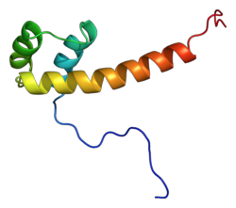
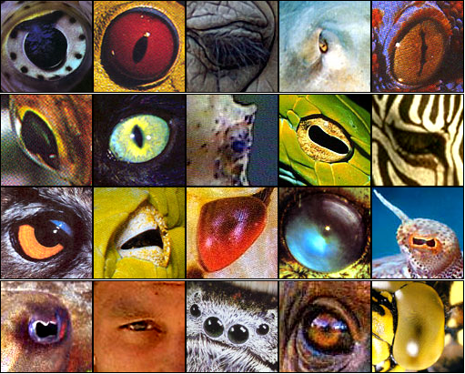
Pax-6 is an ancient gene that was present in the common ancestor of most animals on Earth today and was inherited by descendants as distantly related as flies, humans, and hummingbirds. Pax-6 is an excellent example of a homology.

Slide 36
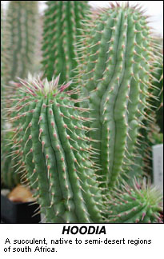
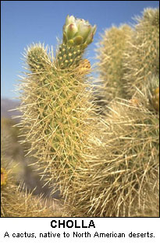
Desert-dwellers
These desert plants have thick, waxy stems that store water and nutrients, and spines that provide shade and prevent herbivory.
Their similarities are
homologies
analogies

Slide 37
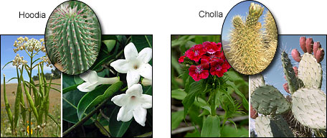
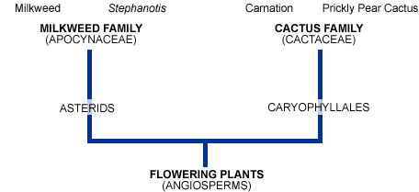
Their similar traits are analogies – independently evolved after their point of common ancestry, i.e., not inherited from a common ancestor.

Slide 38
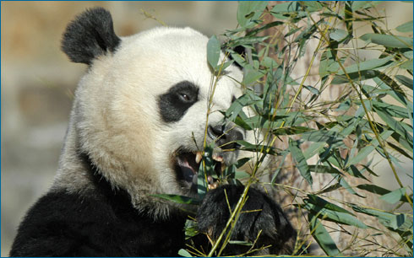
ALL THUMBS
The Giant Panda has a thumb on its hands that it uses to hold onto bamboo while it’s eating.
The panda’s thumb is ________ to your own thumb.
homologous
analogous

Slide 39
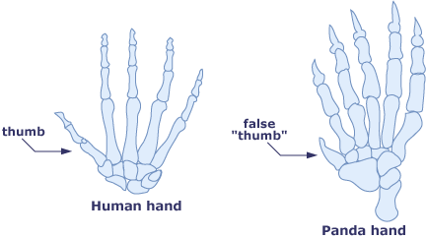
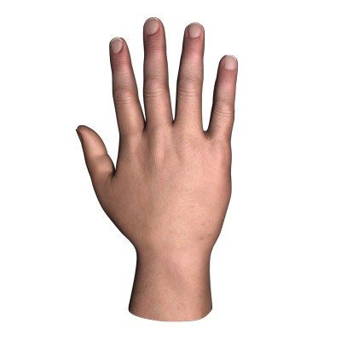
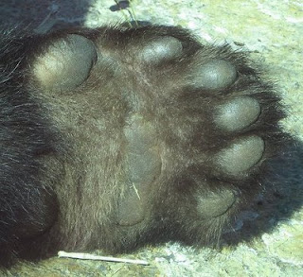
The panda thumb is actually a sixth “finger” that develops from a wrist bone. Thus, the human thumb and panda thumb are analogous structures.

Slide 40
However, the panda thumb is homologous to a human wrist bone, and the human thumb is homologous to the first finger in pandas.

