Slide 1
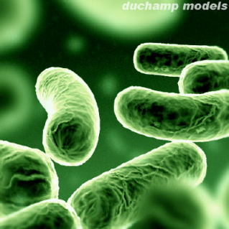
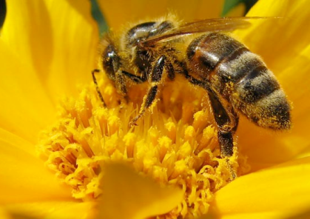
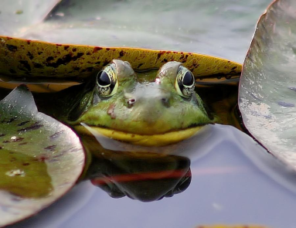
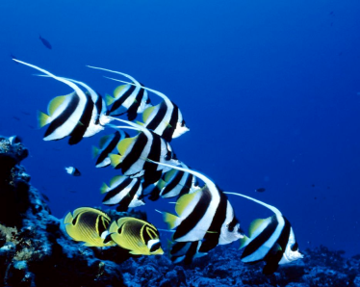
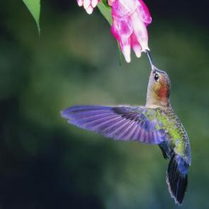
1.2 Mechanisms of evolution – I
IMSS BIOLOGY ~ SUMMER 2012

Slide 2
LEARNING TARGETS
To understand what constitutes a population and that populations are the smallest units of evolution.
To understand the significance of gene (allele) pools, and genetic variation which is fundamental to the process of evolution.
To understand the mechanisms of evolution, including genetic drift and gene flow.

Slide 3
Modern Synthesis: Darwinism Meets Genetics
The fusion of molecular genetics with evolutionary biology
Misconception: Individuals evolve.
Key element: Populations are the units of evolution
A population is
a group of individuals of the same species, living in the same place at the same time
the smallest biological unit that can evolve
individuals do not have diversity from which to select
changes in an individual over time, e.g. muscle size due to increased work outs, are NOT passed on to offspring (this is Lamarckian evolution!)

Slide 4
Modern Synthesis: Darwinism Meets Genetics
The fusion of molecular genetics with evolutionary biology
Misconception: Individuals evolve.
Key element: Populations are the units of evolution
A population is
a group of individuals of the same species, living in the same place at the same time
the smallest biological unit that can evolve
individuals do not have diversity from which to select
changes in an individual over time, e.g. muscle size due to increased work outs, are NOT passed on to offspring (this is Lamarckian evolution!)

Slide 5
Evolution is defined as descent with modification from a common ancestor. What exactly has evolution modified over time?
(A) Physiological mechanisms
(B) Anatomical features
(C) Individual organism’s genome
(D) Number of genes passed onto offspring
(E) Gene frequency within a population
0
1 | 2 | 3 | 4 | 5 | 6 | 7 | 8 | 9 | 10 | 11 | 12 | 13 | 14 | 15 | 16 | 17 | 18 | 19 | 20
21 | 22 | 23 | 24 | 25 | 26 | 27 | 28 | 29 | 30

Slide 6
There is variation within a population
The gene pool is the total collection of alleles in a population at any one time
Microevolution occurs when the relative frequency of alleles changes over a number of generations
For many genes, there are 2 or more alleles in gene pool
Can you imagine a scenario in which an environmental “pressure” could change allele frequencies in a population?
There is variation amongst individuals in a given population, but
not all variation in a population is heritable
only the genetic component of variation is relevant to evolution

Slide 7
The Source of genetic variation
We will be discussing this again later, but ultimately genetic variation comes from
Mutations
Genetic recombination (as due to sexual reproduction)
Gene flow
Misconception: natural selection is a source of genetic variation in populations.
Natural selection can only act on genetic variation that already exists in a population; it cannot create variation.

Slide 8
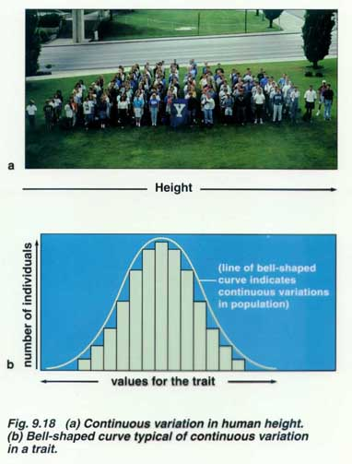
Variable traits in populations
Variable traits in a population may be
Polygenic, resulting from the combined effects of several genes
Tend to produce physical traits (phenotypes) that vary more or less continuously
E.g. height in humans
Determined by a single gene
Tend to produce only a few distinct phenotypes
E.g. ABO blood type in humans

Slide 9
How Does evolution work?
The mechanisms of evolutionary change include
gene flow
genetic drift
natural selection
mutation
Cannot operate without genetic variation

Slide 10
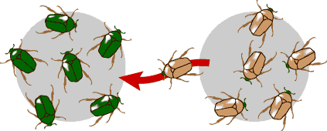
Gene flow
“Migration” of genes from one population to another, i.e., genetic exchange between populations
A population may gain or lose alleles as individuals (or gametes, e.g. pollen) move into (migrate) or out of (emigrate) the population.
Gene flow can be very important source of genetic variation if genes are carried to a population where those genes previously did not exist.
http://evolution.berkeley.edu/evolibrary/

Slide 11
Gene flow tends to _____ genetic differences between populations.
(A) increase
(B) decrease
(C) have no effect on
(D) prevent
0
1 | 2 | 3 | 4 | 5 | 6 | 7 | 8 | 9 | 10 | 11 | 12 | 13 | 14 | 15 | 16 | 17 | 18 | 19 | 20
21 | 22 | 23 | 24 | 25 | 26 | 27 | 28 | 29 | 30

Slide 12
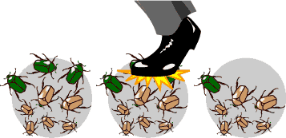
Genetic Drift
Change in gene pool of a population due to chance.
Although genetic drift is an evolutionary mechanism, it doesn’t result in adaptations.
In each generation, some individuals may, purely by chance, leave behind a few more descendants (thus genes) than other individuals.
The genes of the next generation will be the genes of the “lucky” individuals, not necessarily the healthier or “better” individuals.
http://evolution.berkeley.edu/evolibrary/

Slide 13
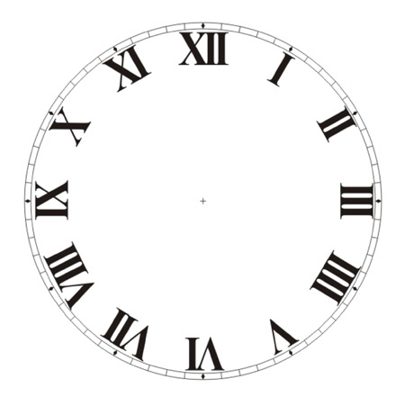
ACTIVITY
THE EFFECTS OF GENETIC DRIFT
Form teams of two.
30 min.

Slide 14
Genetic drift tends to ____ the amount of genetic variation in populations.
(A) increase
(B) reduce
(C) have minimal effect on
(D) prohibit
0
1 | 2 | 3 | 4 | 5 | 6 | 7 | 8 | 9 | 10 | 11 | 12 | 13 | 14 | 15 | 16 | 17 | 18 | 19 | 20
21 | 22 | 23 | 24 | 25 | 26 | 27 | 28 | 29 | 30

Slide 15
GENERATING QUESTIONS
What questions (and answers) did you
come up with?
0
1 | 2 | 3 | 4 | 5 | 6 | 7 | 8 | 9 | 10 | 11 | 12 | 13 | 14 | 15 | 16 | 17 | 18 | 19 | 20
21 | 22 | 23 | 24 | 25 | 26 | 27 | 28 | 29 | 30

Slide 16
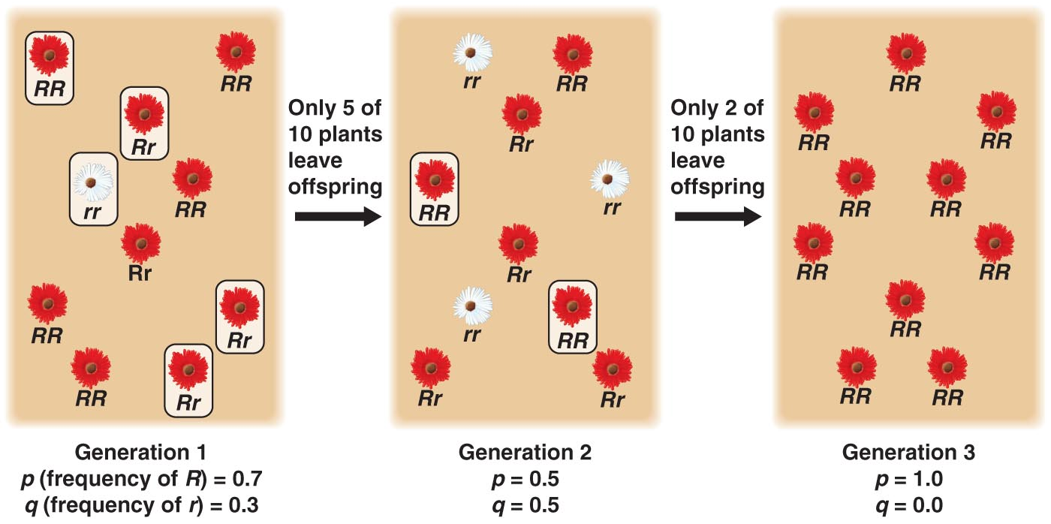
Genetic Drift (cont’d.)
Genetic drift happens to ALL populations, but its effects may be amplified in small populations
Reduction in genetic variation → inability to adapt to new selection pressures, e.g. climate change, shift in available resources, because genetic variation that selection would act on may have drifted out of the population.

Slide 17
How does genetic drift reduce genetic variation in populations?
Consider random draws from a marble bag resulted in the following ratios of brown:green marbles
Draw #5 failed to produce any green marbles, so each draw thereafter will yield 10:0, representing the gene for green coloration drifting out of the population.
Green gene is gone for good, unless a mutation or gene flow reintroduces it.
With ⬇genetic variation, there’s less for natural selection to work with (selection cannot ⬆the frequency of the green gene if it’s gone from the population).
Selection cannot create variation – it can only act on what variation is already in a population.

Slide 18
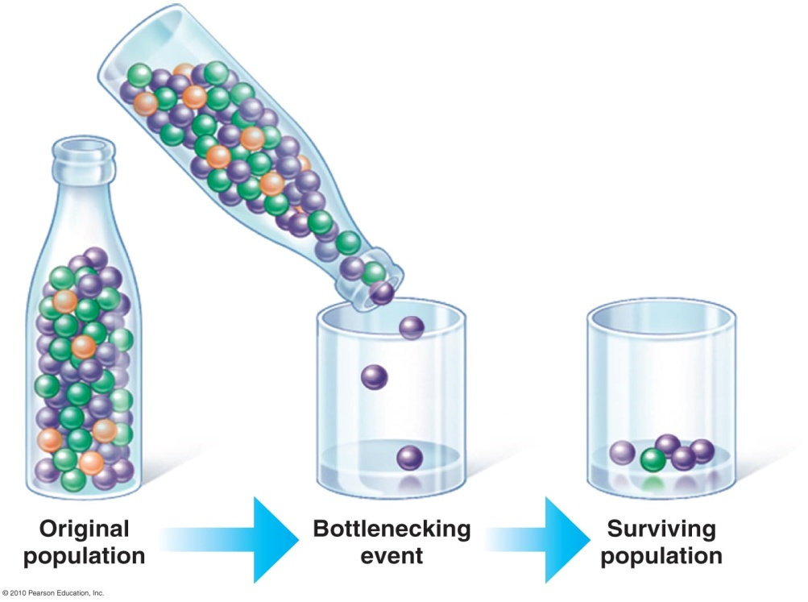
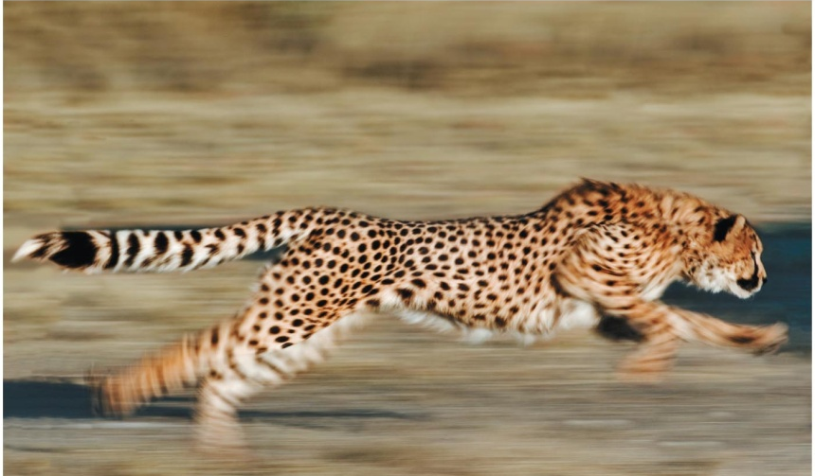
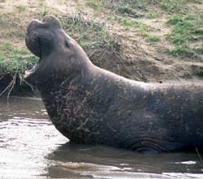
Bottleneck Effect
Is an example of genetic drift
Results from a drastic reduction in population size
Usually reduces genetic variation, because at least some alleles are likely to be lost from gene pool
E.g. cheetahs have experienced at least two genetic bottlenecks in past 10,000 yrs.; genetic variation is very low → ⬆risk of extinction
E.g. Northern elephant seals experienced bottleneck due to overhunting down to 20 individuals in the 1890s. Pop. now > 30,000 but have far less genetic variation than Southern elephant seals that were not so intensely hunted.

Slide 19
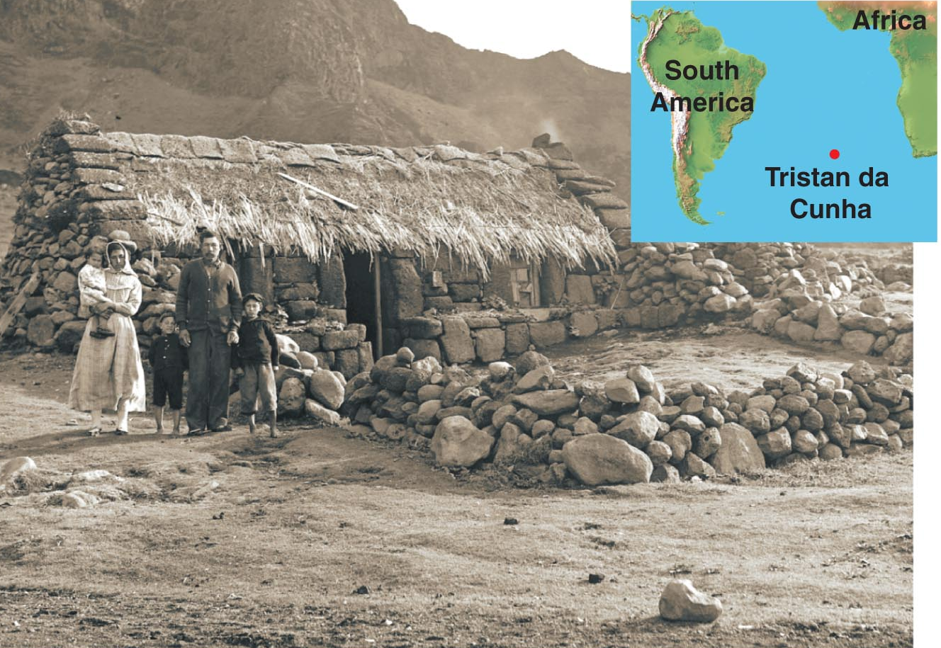
Founder Effect
Occurs when a few individuals from an original population colonize an isolated habitat.
Explains the relative hi frequency of certain inherited disorders among some small human populations
E.g. Tristan da Cunha – the world’s most remote inhabited island; genetic isolation resulted in disproportionately hi incidence of hereditary blindness

