Slide 1
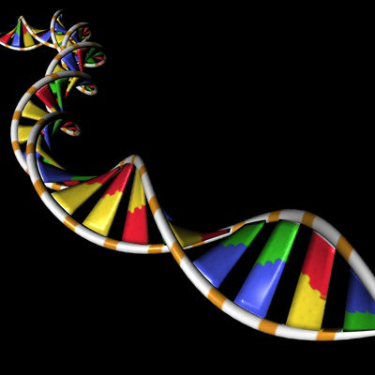
getfreeimage.com
DNA Structure & Function II

Slide 2
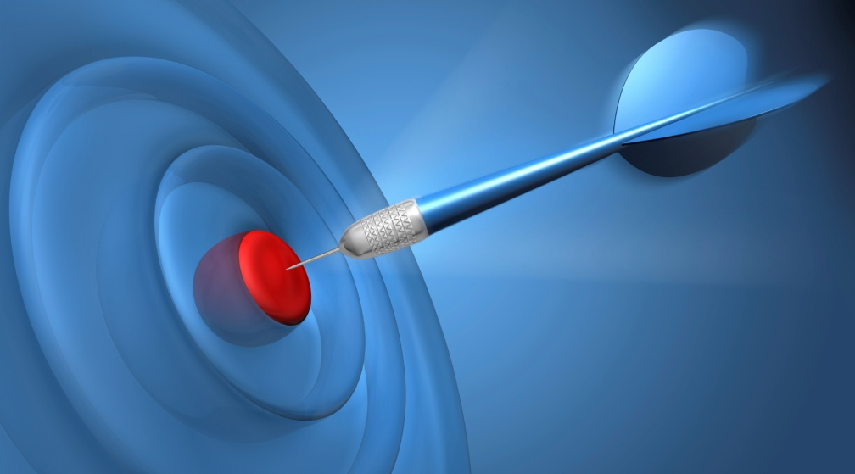
LEARNING TARGETS
To understand how the structure of DNA relates to its function, particularly replication, transcription, and translation (the flow of genetic information in a cell).
To understand the integrated function of organelles in cells, particularly as it relates to protein synthesis.
To understand what determines protein structure and how protein structure determines its functionality.
To be able to distinguish between genotype and phenotype
To understand the importance of mutation as a major source of genetic variation.

Slide 3
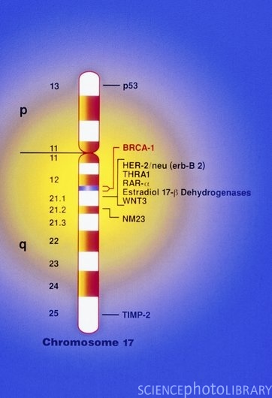
The Gene
Unit of heredity with a specific nucleotide sequence that occupies a specific location on a chromosome
E.g. Map of human chromosome 17 showing a breast cancer gene (BRCA-1)
Humans have two copies of BRCA-1 which normally suppresses breast cancer
If one copy is defective, then no back up if other gene damaged by exposure to environmental carcinogens
Inheriting a defective BRCA-1 gene → ↑ risk of breast cancer

Slide 4
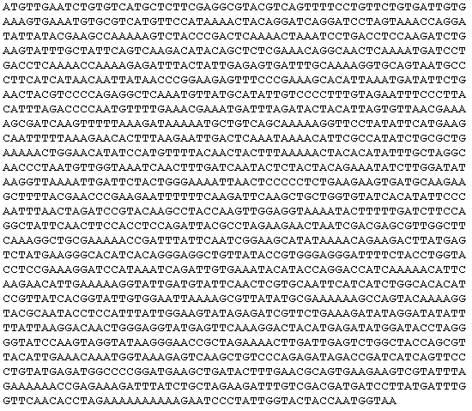
The Language of Nucleic Acids
For DNA, the alphabet is the linear sequence of nucleotide bases
A single DNA molecule may contain 1000s of genes
A typical gene consists of 1000s of nucleotides

Slide 5
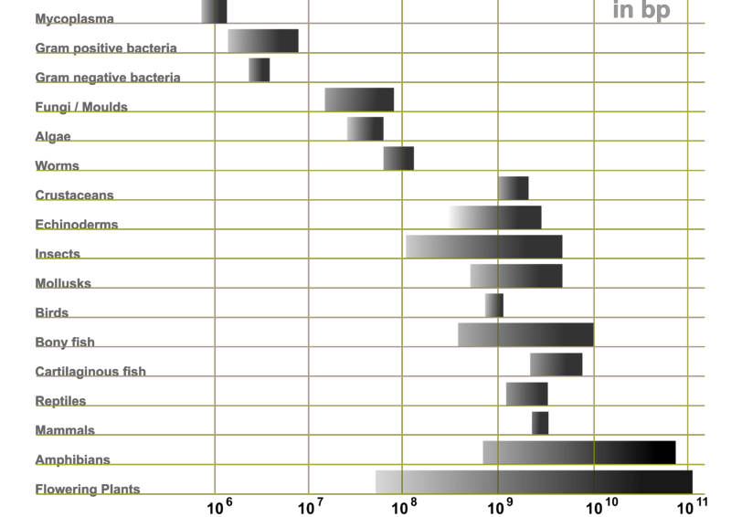
Relative Genome Sizes
http://en.wikipedia.org/wiki/File:Genome_Sizes.png

Slide 6
Phenotype Follows Genotype
Genotype
The genetic makeup of an organism (the sequence of nucleotide bases in DNA)
Phenotype
The physical & physiological traits that arise from the actions of a wide variety of proteins that were “encoded” for by the DNA (genotype)
How does DNA do this?

Slide 7
What do genes produce?
A gene can produce more than one type of protein.
TRUE
FALSE

Slide 8
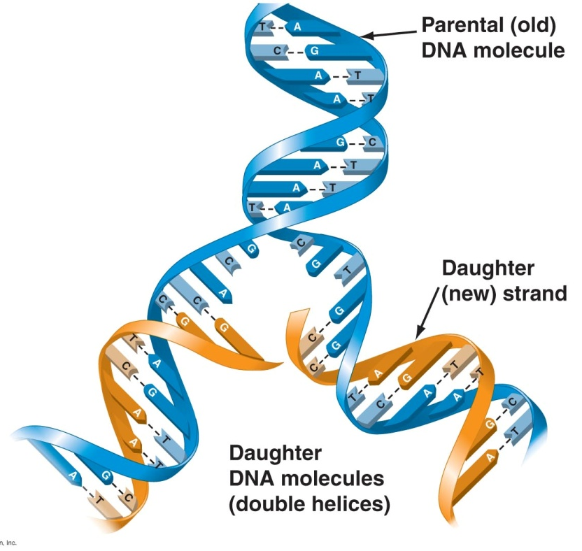
DNA Replication
When a cell reproduces, a complete copy of the DNA must pass from one generation to the next
Watson & Crick’s model for DNA suggested that DNA replicates by a template mechanism
Two strands of “parental” DNA separate
Ea. strand acts as template for assembly of a complementary strand
DNA polymerases key enzymes in
forming covalent bonds between
nucleotides of parental (old) &
daughter (new) strands → 2 new
molecules of DNA
Also involved in repairing
damaged DNA

Slide 9
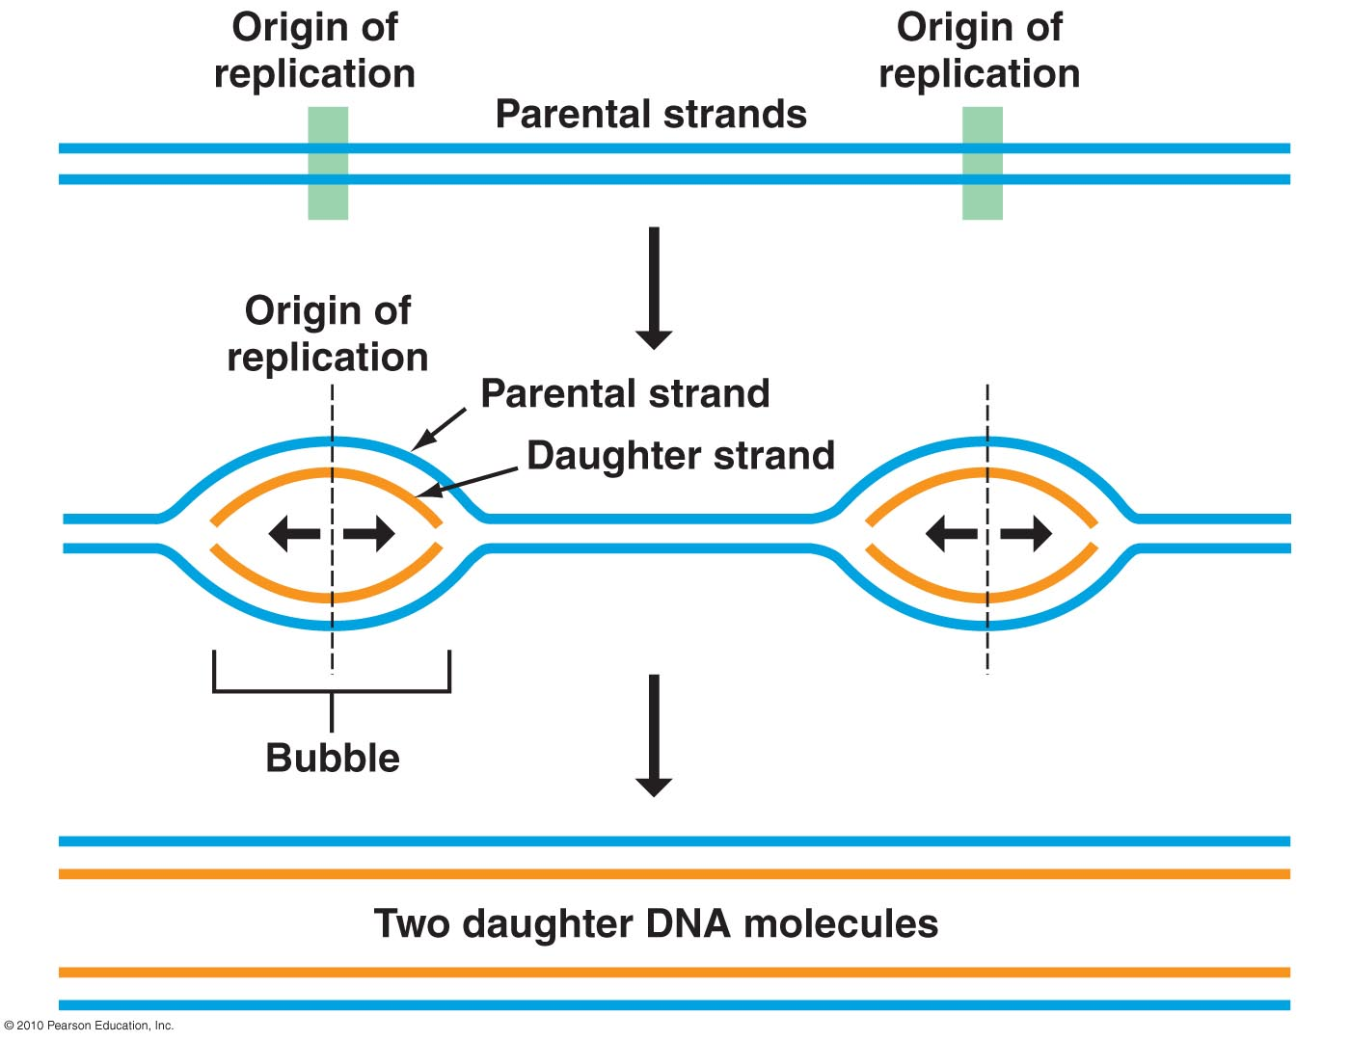
In eukaryotes, DNA replication begins at specific sites on a double helix = origins of replication
From these origins, replication proceeds in both directions → replication “bubbles” – parental strand opens up to allow daughter strands to elongate on both sides of bubble

Slide 10
Importance of DNA Replication
DNA replication ensures
all cells in an organism carry the same genetic information
genetic information can be passed on to offspring

Slide 11
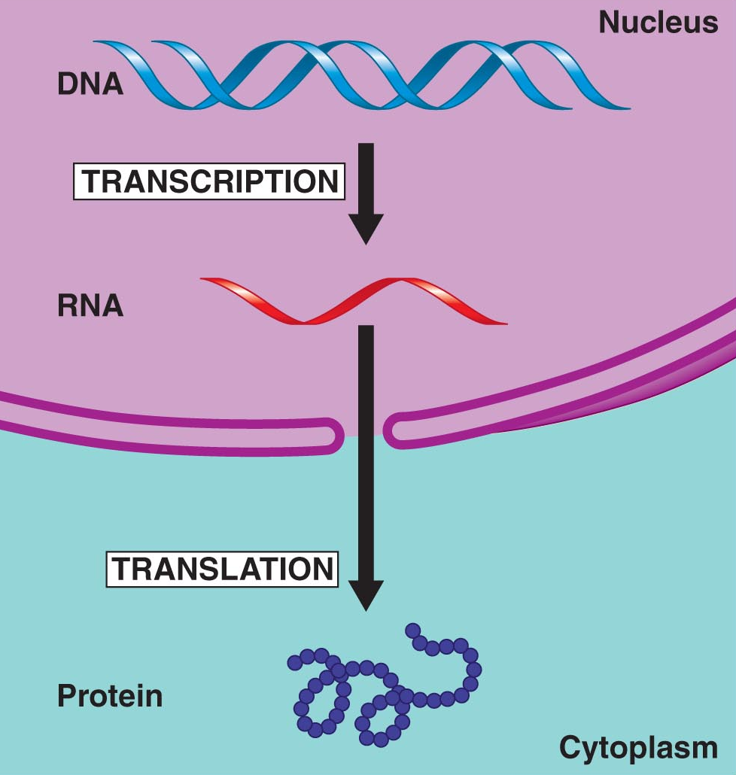
Flow of Genetic Information from DNA → RNA → Protein
This is also known as the “central dogma” of molecular biology (genetics)
Involves processes by which DNA’s directions are carried out

Slide 12
DNA specifies synthesis of proteins in 2 stages:
Transcription
- the transfer of genetic info from DNA → RNA molecule
Translation
- the transfer of info from RNA → protein

Slide 13
Molecular visualization DNA into chromosomes & central dogma
http://www.youtube.com/watch?v=4PKjF7OumYo

Slide 14
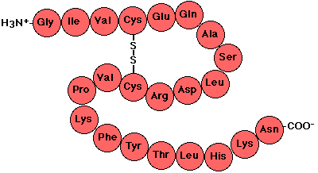
Overview: From Nucleotides to Amino Acids
Nucleotide sequence of DNA is transcribed into RNA, then translated into polypeptides
Proteins consist of two or more polypeptides
Amino acids are the monomers of polypeptides, thus proteins
http://users.rcn.com/jkimball.ma.ultranet/BiologyPages/P/Polypeptides.html

Slide 15
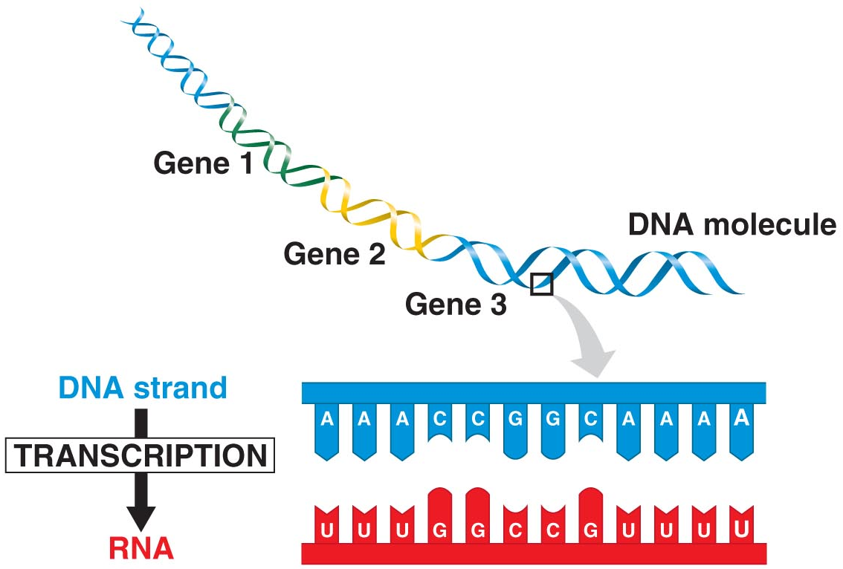
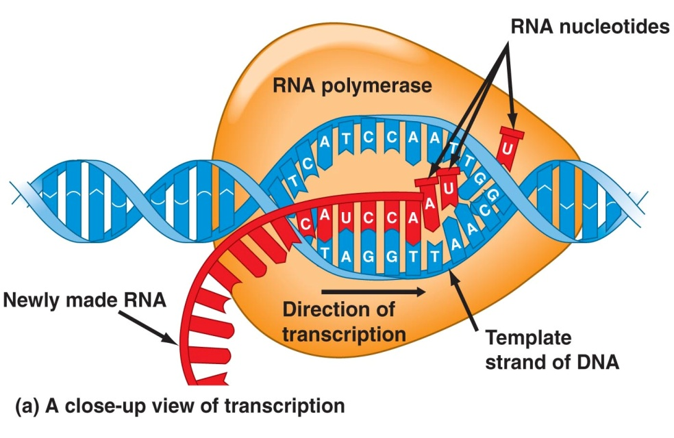
Transcription of DNA
DNA’s nucleotide sequence “rewritten” into RNA nucleotide sequence (remember that both are nucleic acids)
RNA is made from the DNA template, using a process resembling DNA replication except
T’s are substituted by U’s
RNA nucleotides are
linked by RNA polymerase

Slide 16
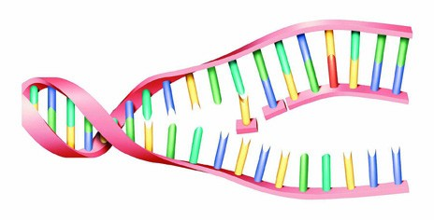
Unpacking Transcription
Three phases
Initiation
RNA elongation
Termination

Slide 17
Initiation of Transcription
“Start transcribing” signal is nucleotide sequence, called a promoter (AUG)
Located at beginning of gene
RNA polymerase attaches to the promoter (via transcription factor)
RNA synthesis begins

Slide 18
RNA Elongation
RNA grows longer
RNA strand peels away from the DNA template

Slide 19
Termination of Transcription
RNA polymerase reaches specific nucleotide sequence, called a terminator
Polymerase detaches from RNA
DNA strands rejoin

Slide 21
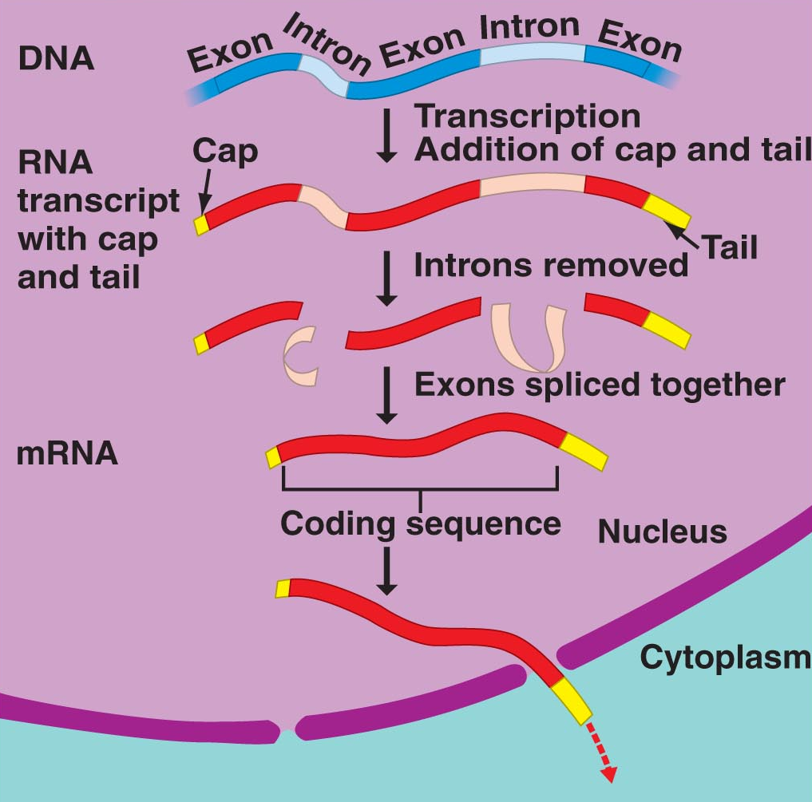
Processing of Eukaryotic RNA
Unlike prokaryotes, eukaryotes process their RNA
Add a cap & tail - xtra nucleotides at ends of RNA transcript for protection (against cellular enzymes) & recognition (by ribosomes later on)
Removing introns – stretches of noncoding nucleotides that interrupt coding stretches = the exons
Splicing exons together to form messenger RNA (mRNA)

Slide 22
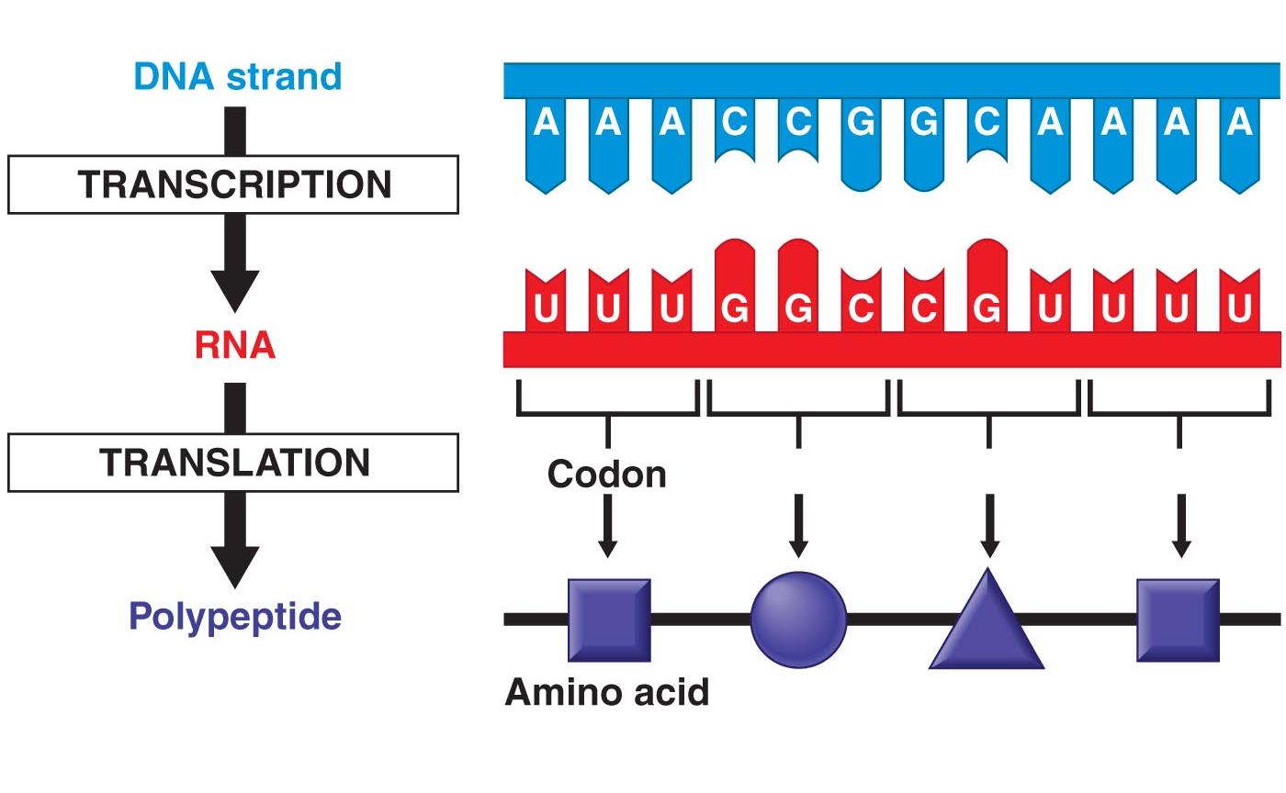
Translation
Conversion from nucleic acid language to protein language
Requires
mRNA
ATP
Enzymes
Ribosomes
Transfer RNA
(tRNA)

Slide 23
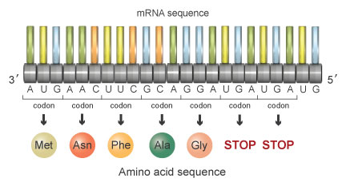
The Genetic Code
Shared by ALL organisms
The set of rules that relates mRNA nucleotide sequence to amino acid sequence
Since there are 4 nucleotides, there are 64 (or 4³) possible nucleotide “triplets” = codons
61 codons code for amino acids, 1 “start” and 3 “stop” codons marking the beginning or end of a polypeptide
http://www.nature.com/scitable

Slide 24
The Genetic Code
Fig. 10.11

Slide 25
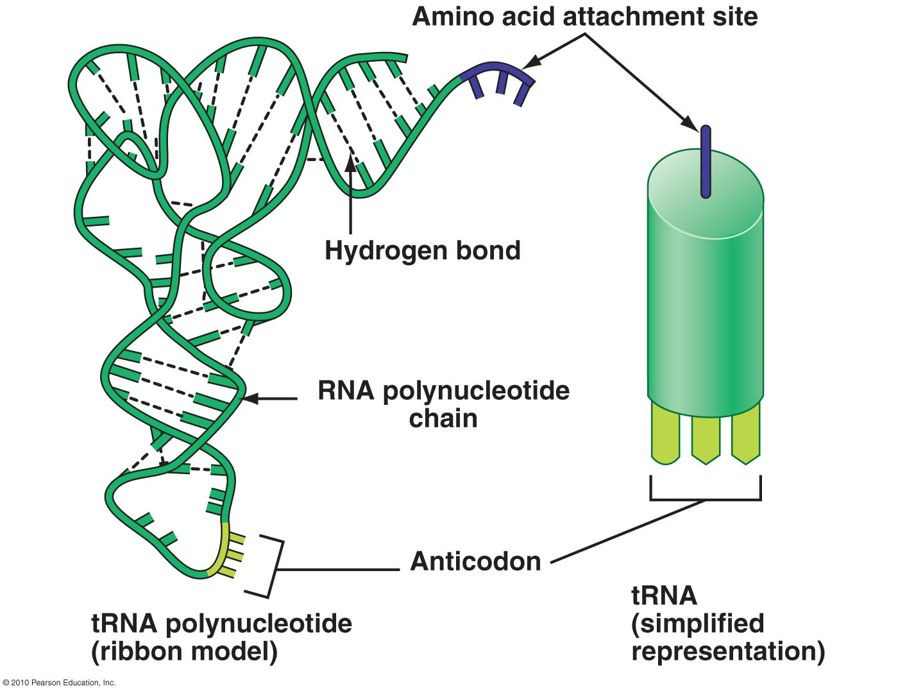
tRNA
Acts as molecular interpreter – decodes mRNA codons into a protein
Each codon (thus amino acid) is recognized by a specific tRNA
Has an anticodon – recognizes & decodes an mRNA codon
Has amino acid attachment site
When tRNA recognizes & binds
to its corresponding codon in
ribosome, tRNA transfers its
amino acid to the end of the
growing amino acid chain

Slide 26
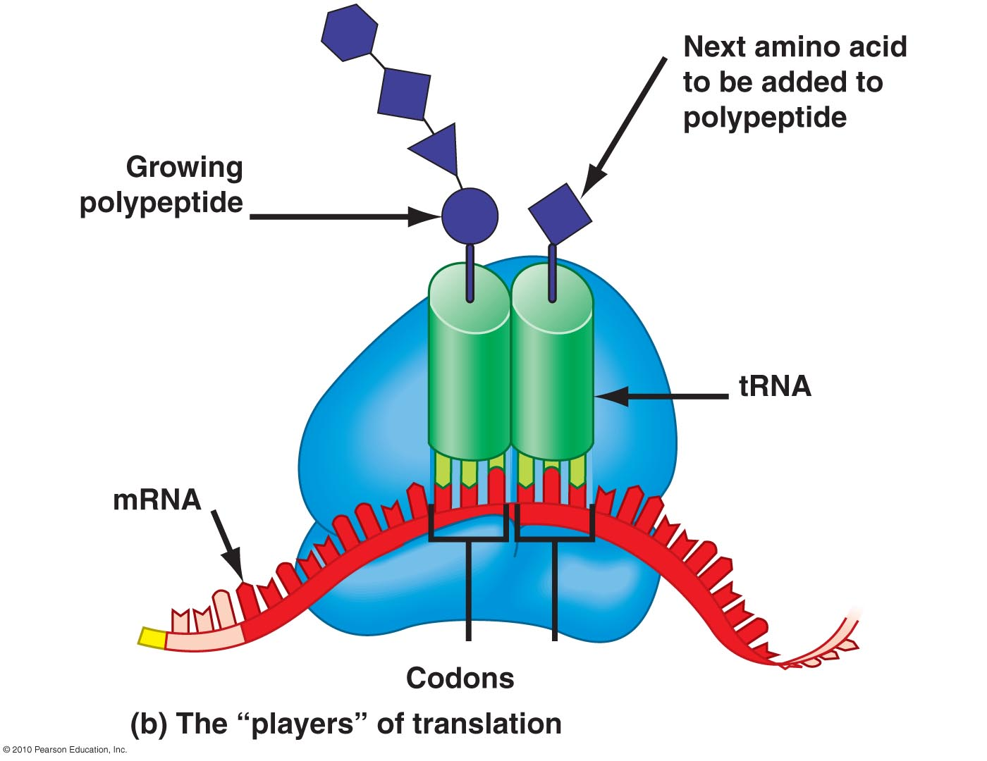
Ribosomes
Organelles that
coordinate functions of mRNA & tRNA during translation
contain ribosomal RNA (rRNA)

Slide 27
Unpacking Translation
Occurs in the ribosome
Like transcription, broken down into 3 phases
Initiation
Elongation
Termination
Short but sweet translation animation
http://www.nature.com/scitable/content/translation-animation-6912064

Slide 28
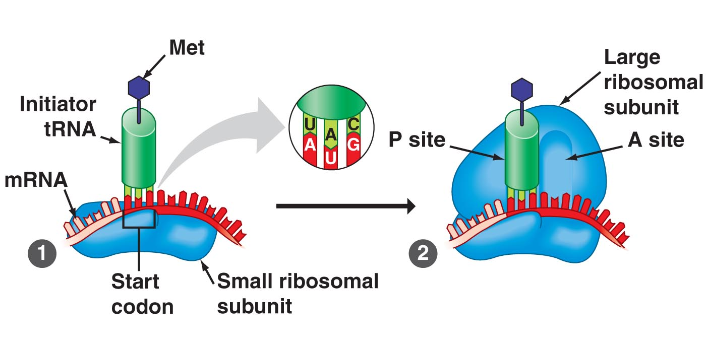
Initiation of Translation
Small ribosomal subunit binds to start of the mRNA sequence
Then, initiator tRNA carrying the amino acid methionine binds to the start codon of mRNA
Start codons in all mRNA molecules are AUG and code for methionine!
Next, large ribosomal subunit binds

Slide 29
Polypeptide Elongation
Large ribosomal unit binds each successive tRNA with its attached amino acid
Ribosome continues to translate each codon
Each corresponding amino acid is added to growing chain and linked via peptide bonds
Elongation continues until all codons are read.

Slide 30
Termination of Translation
Occurs when ribosome reaches stop codon (UAA, UAG, & UGA)
No tRNA molecules can recognize these codons, so ribosome recognizes that translation is complete.
New protein released
Translation complex dismantles
into its subunits

Slide 31
Termination of Translation
sdf
Fig. 10.20

Slide 32
MEDIA
Explains RNAi but in so doing, gives great analogy for central dogma
http://www.teachersdomain.org/asset/lsps07_int_rnaiexplain/
As embedded in a TV report
http://www.youtube.com/watch?v=H5udFjWDM3E

Slide 33
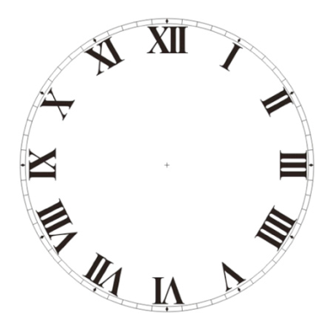
ACTIVITY
Teaching Central Dogma Using Jewelry
30 min.

Slide 34
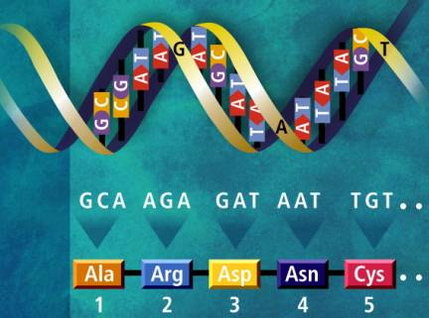
c
Transcription & translation are how genes ontrol
structures
activities of cells
In other words,
FORM & FUNCTION!

Slide 35
Proteins (a review)
Polymers of amino acid monomers
Perform most of the tasks for life

Slide 36
Protein Structure & Function
Primary structure of a protein is due to the unique sequence of amino acids
Secondary structure from folding/
spiraling due to H bonding

Slide 37
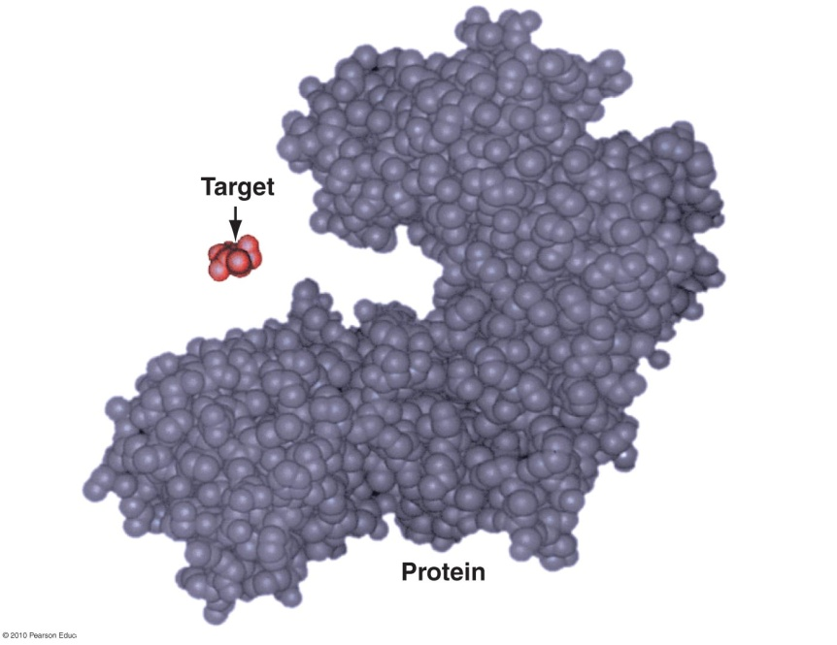
Tertiary structure is a protein’s 3-D shape
Enables protein to carry out its specific function in a cell
Quaternary structure results when proteins have 2 or more polypeptide chains
Specific shape of protein, e.g. enzyme enables it to recognize and bind to another molecule, i.e., target molecule

Slide 38
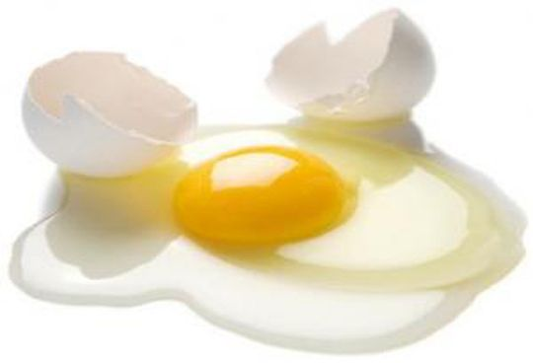
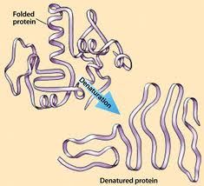
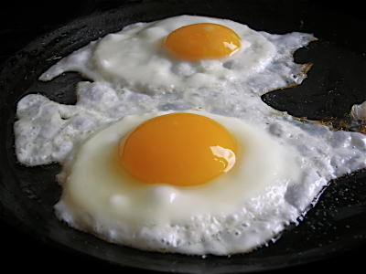
What Determines Protein Shape?
3-D shape of protein sensitive to surrounding environment
pH
Temperature
Unfavorable T & pH changes can denature a protein – unravels & loses its shape, thus function
E.g. egg whites composed primarily of protein, albumin
When cooked, albumin is denatured → turns white, solid, & less soluble

Slide 39
ACTIVITY
Draw an Analogy:
“The cell is like a …”
Use colored pencils to sketch your analogy. Include the following :
Plasma membrane
Nucleus
Ribosomes
Endoplasmic reticulum
Golgi apparatus
Lysosomes
Mitochondria
Cytoskeleton
15 min.

Slide 40
Quick review of cell components
Plasma membrane
Nucleus
Ribosomes
Endoplasmic reticulum
Golgi apparatus
Lysosomes
Mitochondria
Cytoskeleton

Slide 41
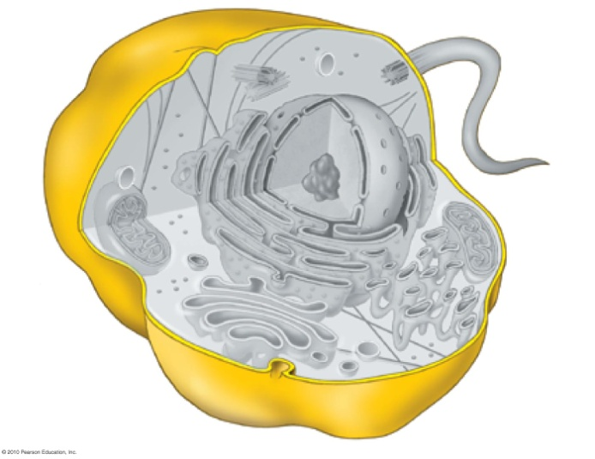
Plasma Membrane (PM)
Separates cell from its outside environment
Misconception: PM function is mainly containment, like a plastic bag
Ultimate traffic controller of substances moving in/out of cell

Slide 42
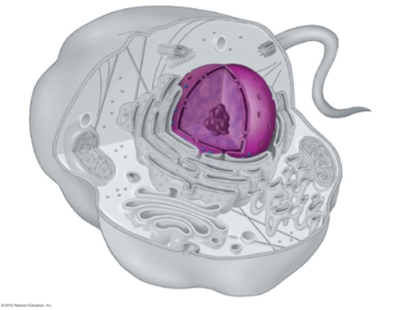
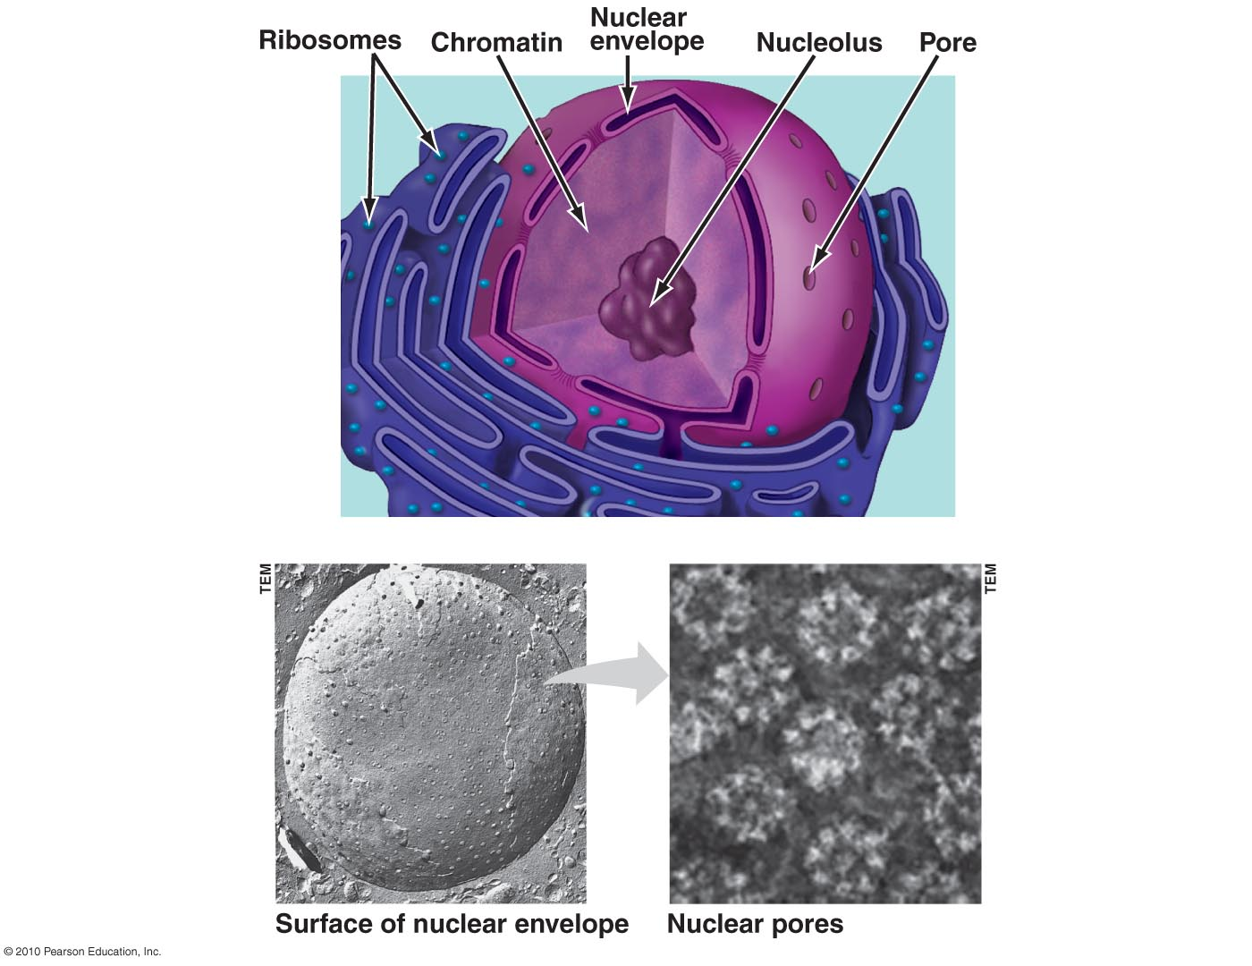
Nucleus
Chief executive of cell
Genes in nucleus store info needed to produce proteins
Surrounded by double membrane = nuclear envelope
Pores in envelope allow materials to move between nucleus & cytoplasm
Nucleus contains nucleolus where ribosomes are made

Slide 43
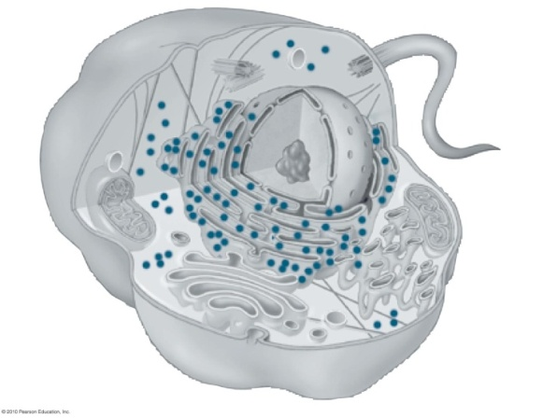
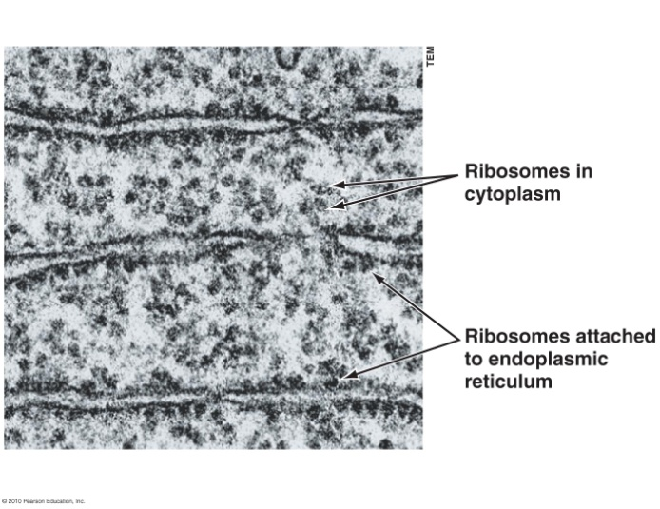
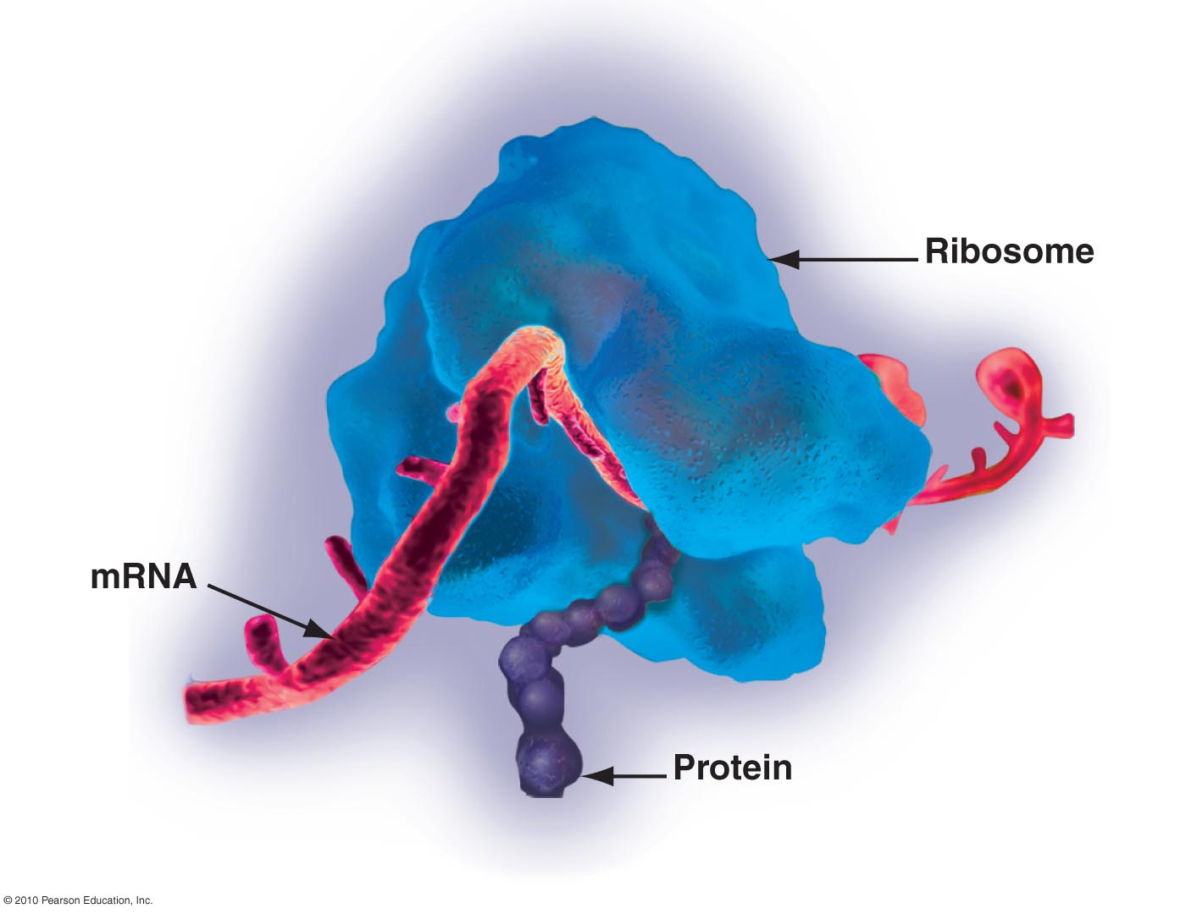
Ribosomes
Together with nucleus are responsible for genetic control of the cell
Ribosomes are responsible for protein synthesis
Suspended in cytoplasm
Attached to endoplasmic reticulum
Ribosome components made in nucleolus, exit nucleus thru nuclear pores, then assembled in cytoplasm
Notes:
We’ll talk more about

Slide 44
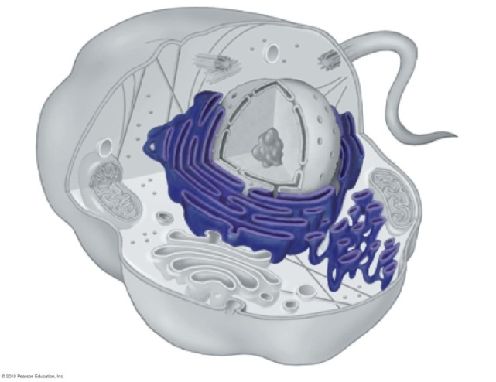
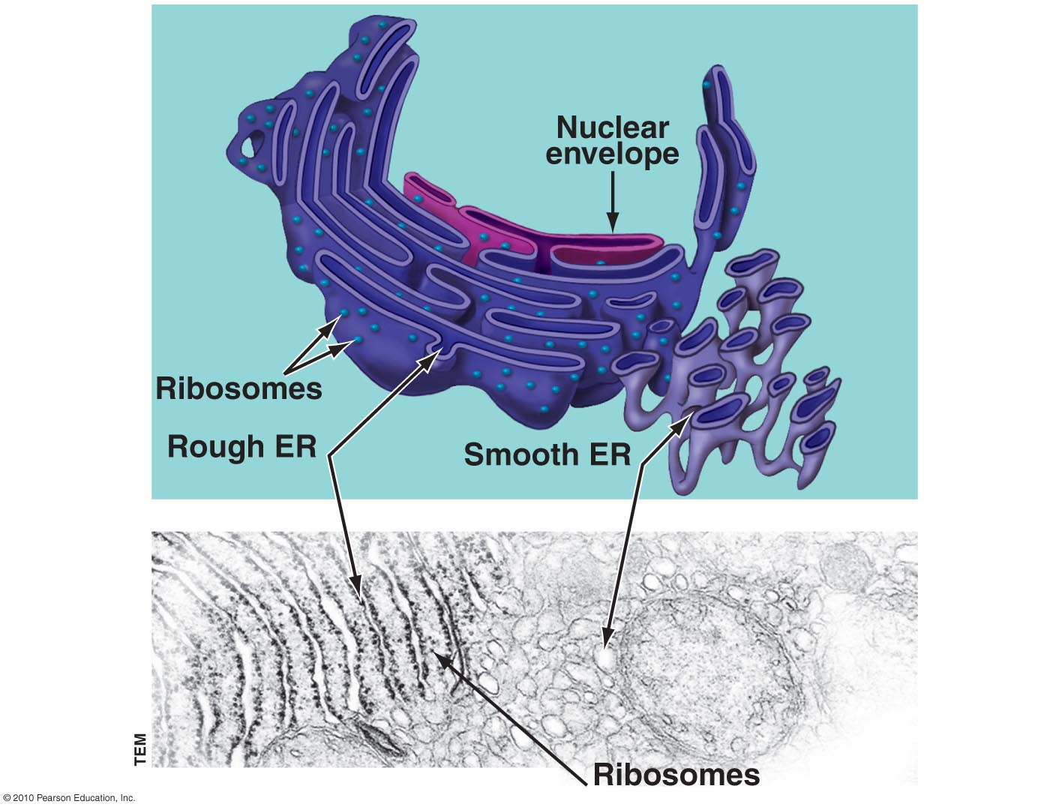
Endoplasmic Reticulum (ER)
Cell’s main manufacturing facility
Endomembrane network of tubes connected to nuclear envelope
Produces variety of molecules
Composed of smooth (no ribosomes) & rough ER (studded with ribosomes)
Rough ER produce proteins destined to become part of the PM or secretory proteins that leave the cell

Slide 45
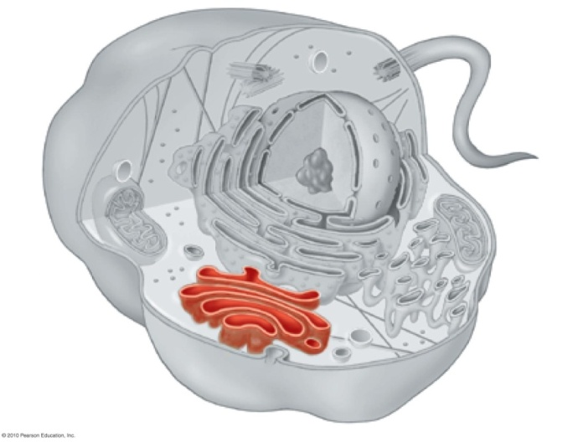
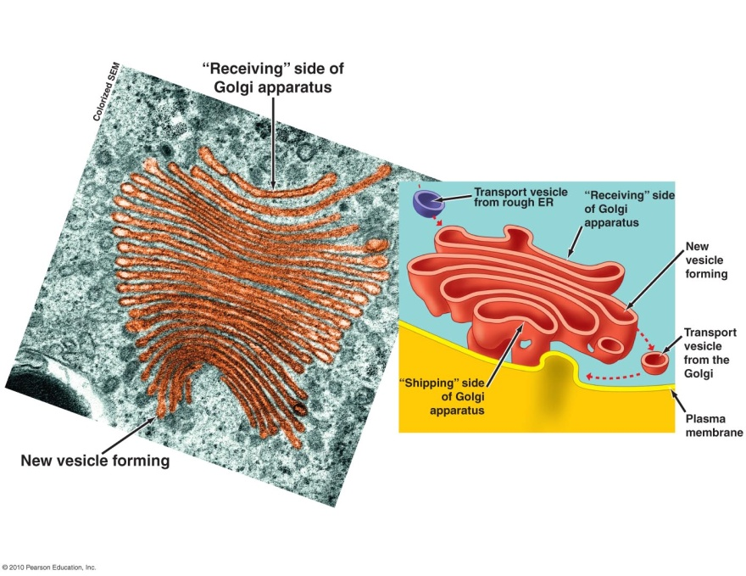
Golgi Apparatus
Works closely with the ER
Like the USPS of the cell
Receives,
modifies,
repackages, &
distributes
chemical products
of the cell

Slide 46
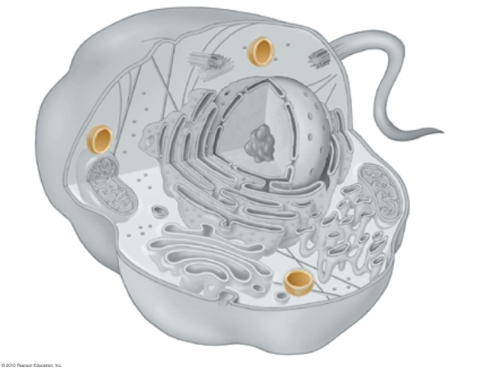
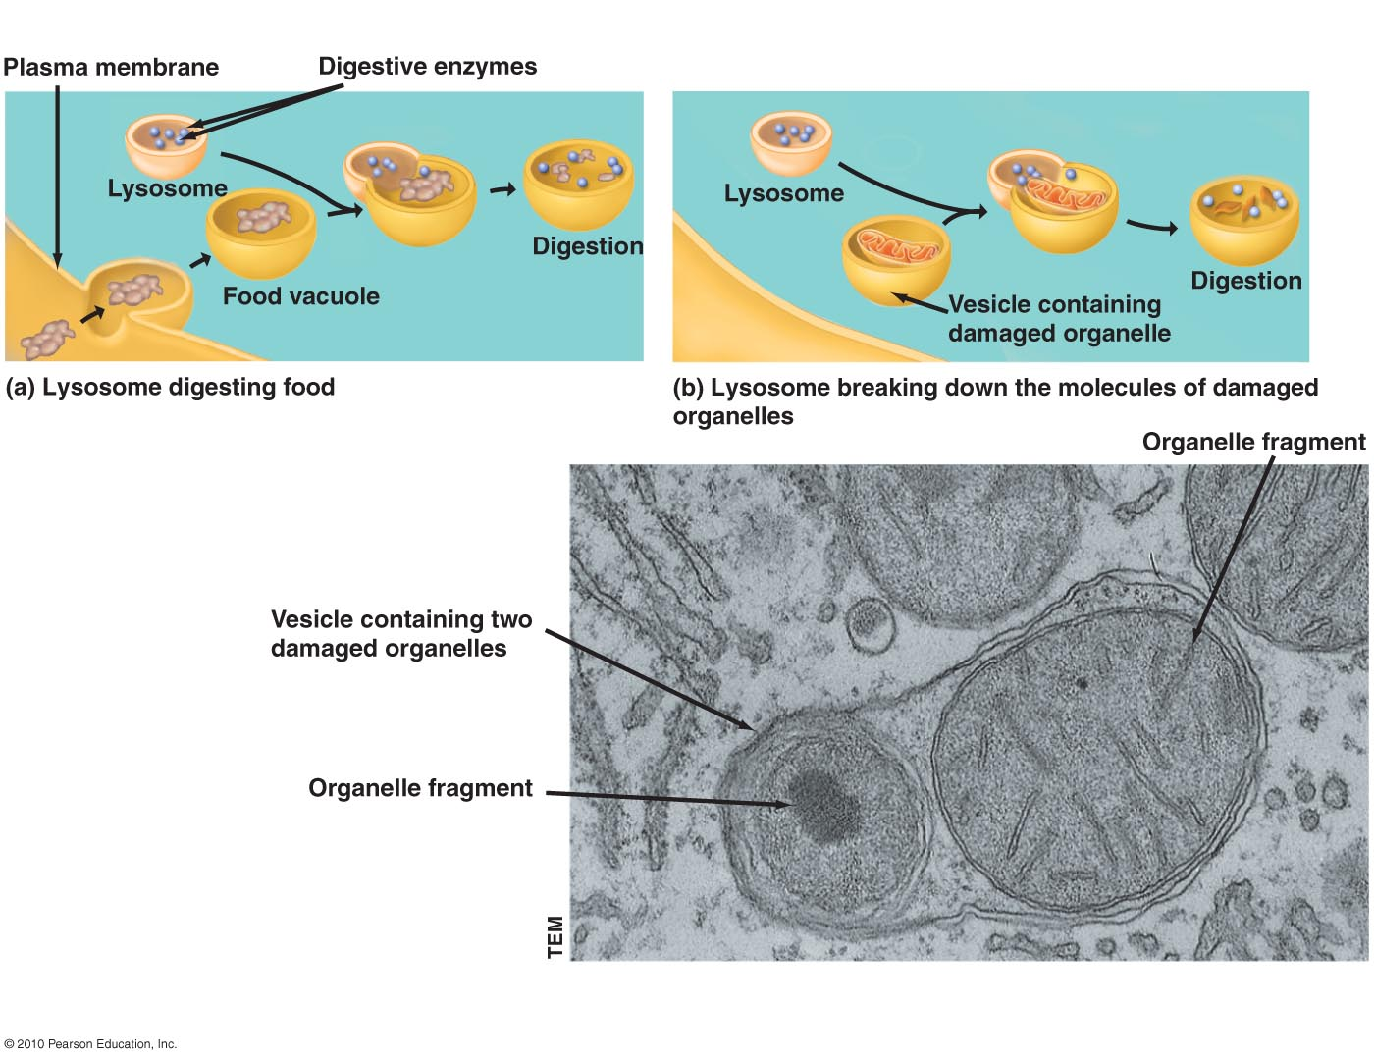
Lysosomes
Sacs of digestive (hydrolytic) enzymes found only in animal cells
Function to
Destroy harmful bacteria
Breakdown damaged organelles
Breakdown food macromolecules
Breakdown broken/incorrect proteins

Slide 47
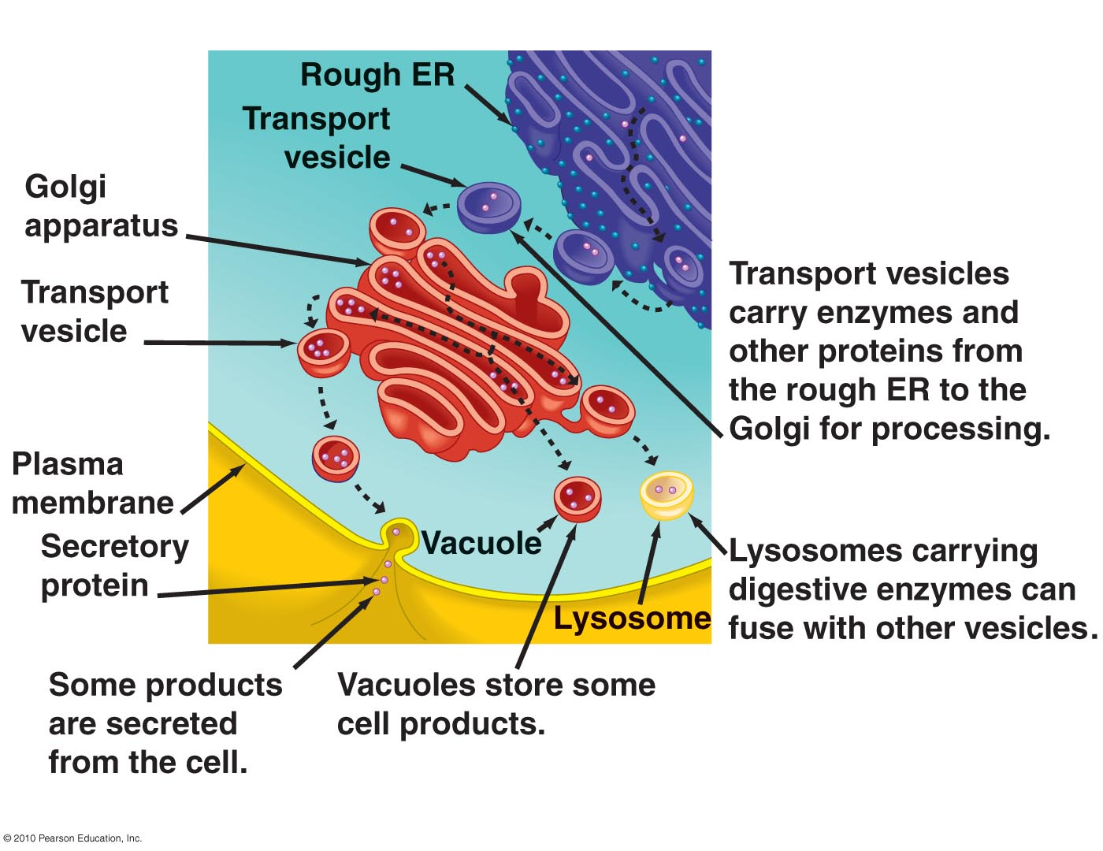
Integrated Function of Organelles
Organelle functions are very diverse but highly interconnected, e.g. consider the pathway of secretory proteins: info & products move from central nucleus → interconnected rough ER → more peripherally located Golgi → out plasma membrane

Slide 48
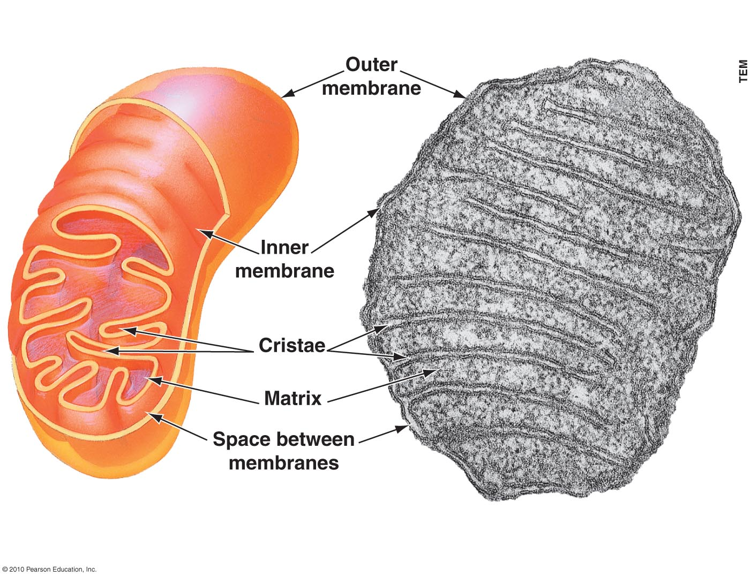
Mitochondria
Sites of cellular respiration – ATP produced from food molecules
Found in almost ALL eukaryotic cells

Slide 49
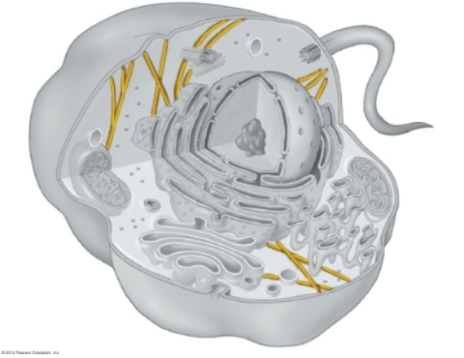
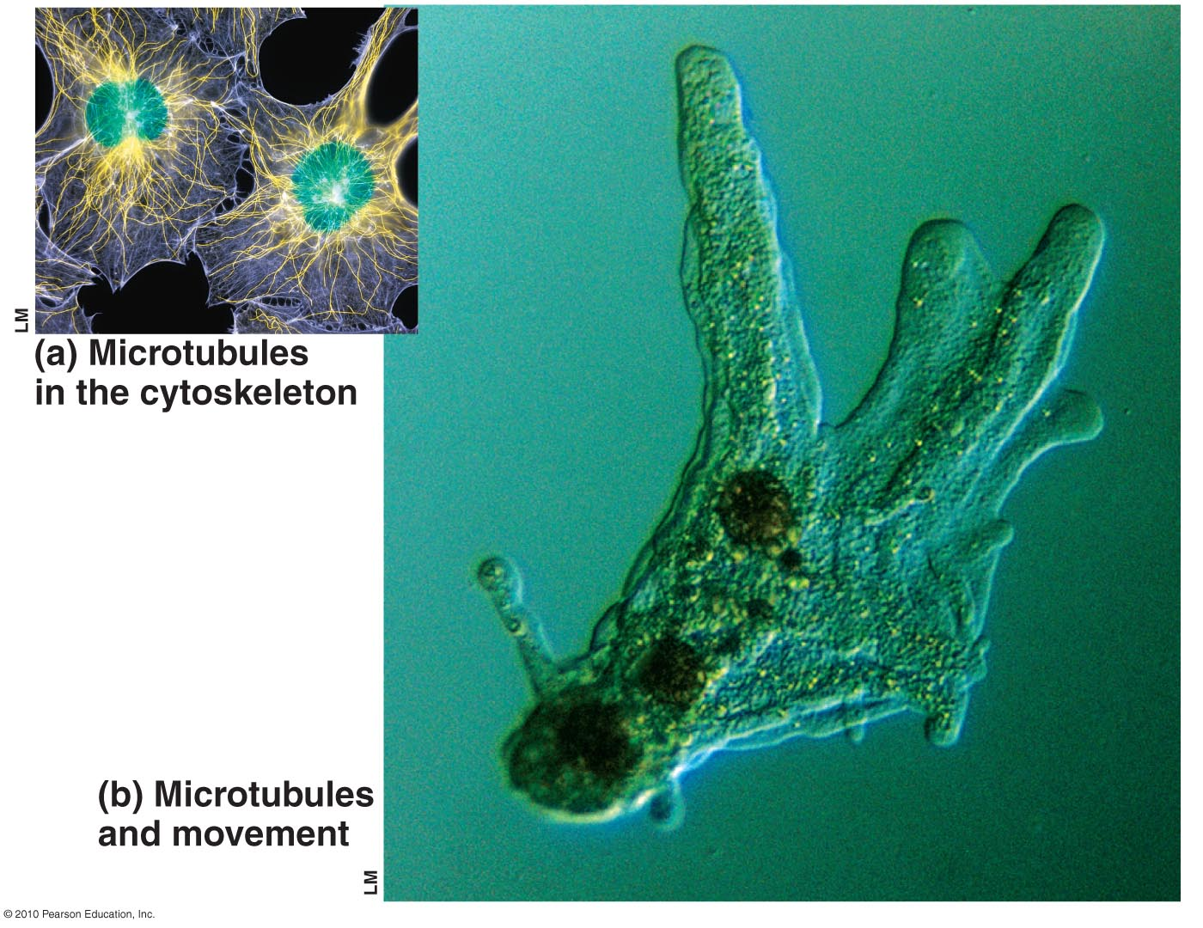
Cytoskeleton
Misconception: Cytoplasm is a watery fluid in which organelles float.
Network of fibers extending throughout cytoplasm
Functions (dynamic):
mechanical support for
cell
cell shape
guides movement of
organelles & chromosomes

Slide 50
ACTIVITY
Getting from DNA to proteins: Using Legos to experience the big picture.
20 min.

Slide 51
Mutation
Any change in the nucleotide sequence of DNA which can change the amino acids in a protein
Mutations can involve
large regions of a chromosome
a single nucleotide pair
Basic types
Base substitution
Nucleotide deletion
Nucleotide insertion

Slide 52
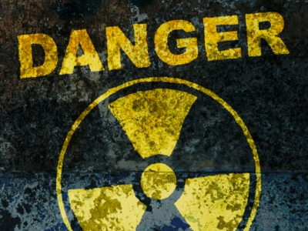
Mutation - overview
Any change in the nucleotide sequence of DNA which can change the amino acids in a protein
Mutations can involve
large regions of a chromosome
a single nucleotide pair
Can occur in the reproductive (germline) cells or in somatic (non-reproductive) cells
Can be caused by external (mutagens) or internal (spontaneous) factors, including
DNA replication errors
transcription errors
code sequence transpositions

Slide 53
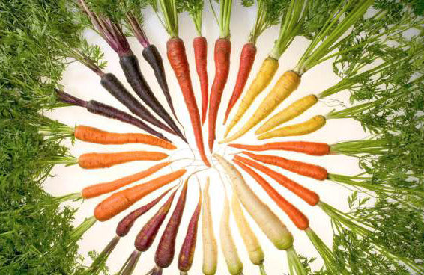
Mutation - source of genetic variation
Types
Mutation in non-coding genomic sequences → no known effect upon organism traits or metabolism
Beneficial mutations → inherited traits of greater fitness or reproductive success
Adverse (including some carcinogenic) mutations → inherited traits of reduced fitness or reproductive success
Non-heritable mitochondrial mutations → different coding instructions for mitochondrial proteins
Lethal or carcinogenic mutations that threaten the life of the organism, but are not heritable
Mutations that diversify the genome and may assist in future generation adaptability
Mutations in carrots have produced overt color distinctions. USDA

Slide 54
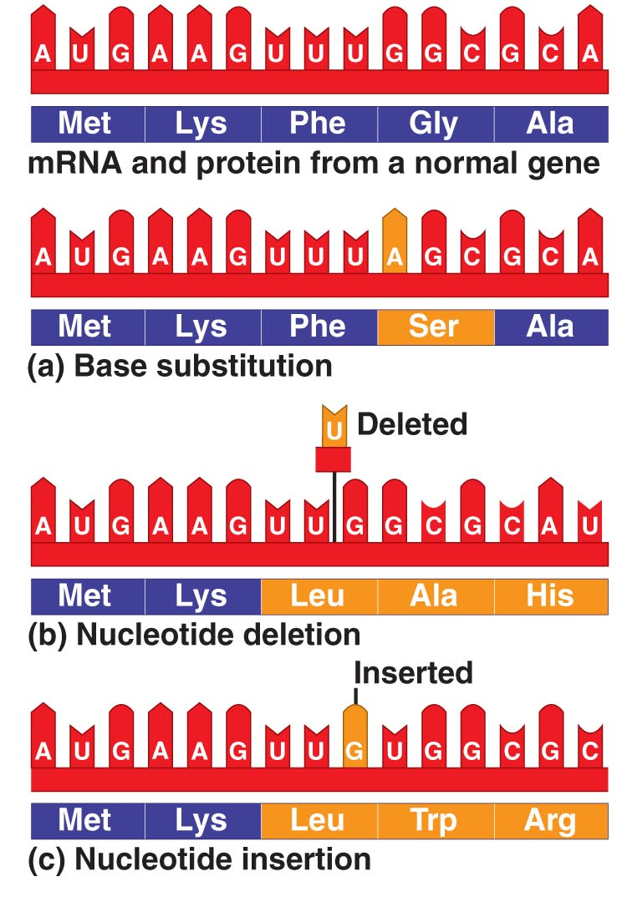
Base substitution – replacement of one base by another
May/not affect protein’s function
Nucleotide deletion – loss of a nucleotide
Nucleotide insertion - addition of a nucleotide
Insertions & deletions change reading frame of code → nonfunctional polypeptide → disastrous effects for organism

Slide 55
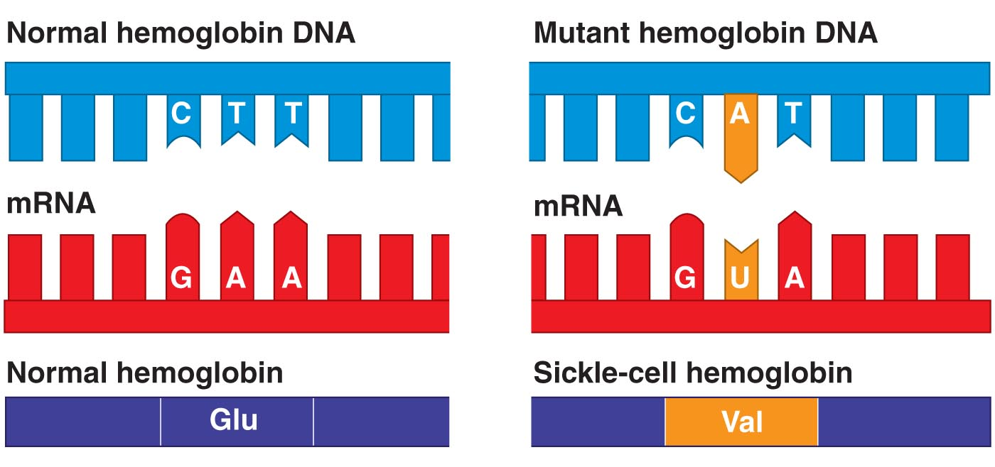
Sickle-cell Anemia
In the gene for hemoglobin (the O₂ carrying molecule in red blood cells), a sickle-cell mutant caused by single nucleotide shift in coding strand of DNA → mRNA codes for Val instead of Glu

Slide 56
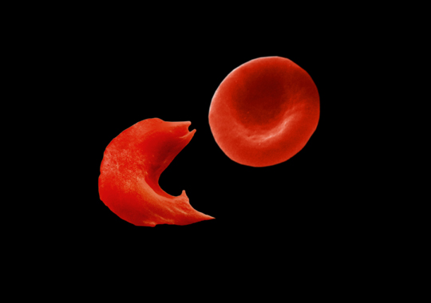
Sickle-shaped deformation of red blood cell on left http://students.cis.uab.edu/slawrenc/SickleCell.html

Slide 57
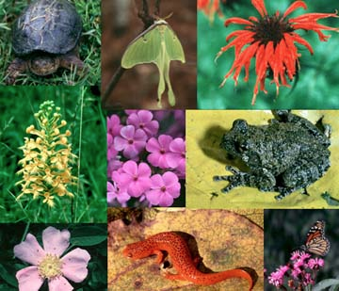
Consequences of Mutation
Source of genetic diversity – can create new alleles!
Can be beneficial, harmful, or neutral
What causes mutations?
Spontaneous errors
Mutagens – physical & chemical agents

Slide 58
ACTIVITY
20 min.
Revisit our mRNA and protein jewelry
Try to model:
Base substitution
Insertion
Deletion
Which type do you think has the greatest impact on the organism?

