Slide 1
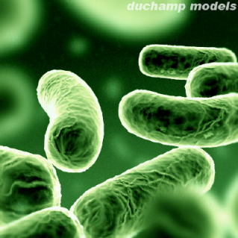
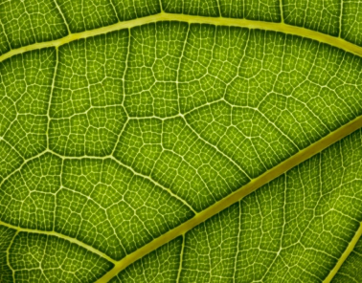
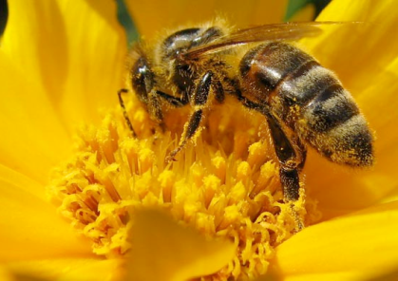
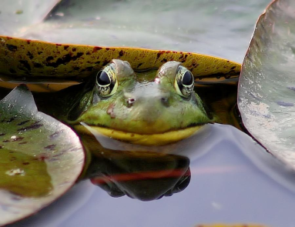
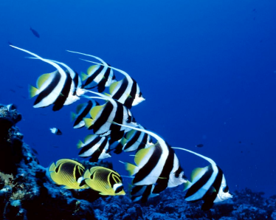
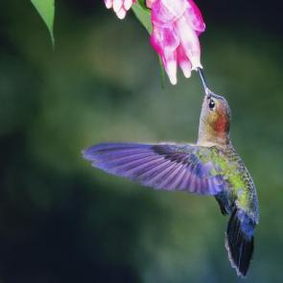
Evolution of metabolism: photosynthesis
IMSS BIOLOGY ~ SUMMER 2012

Slide 2
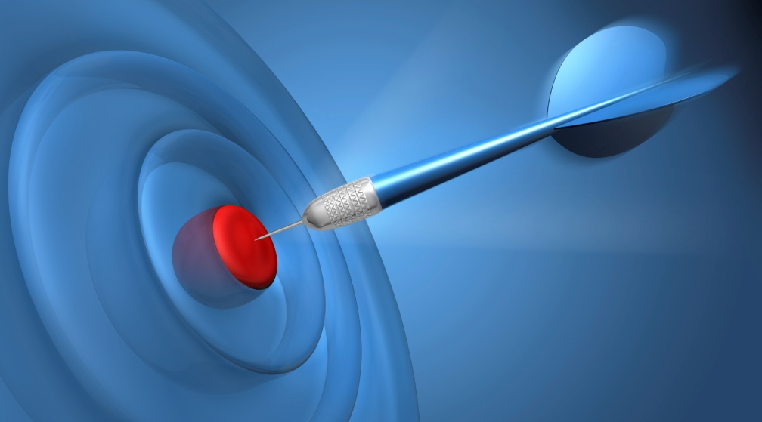
LEARNING TARGETS
To be able to define metabolism.
To understand the evidence for the evolutionary origin of photosynthesis.
To understand the impact of oxygenic photosynthesis on the evolution of life on Earth.
To understand the importance of photosynthesis at the cellular, organismal, and ecological levels.

Slide 3
Defining metabolism
Sum of all chemical reactions occurring in a living organism
Includes
Catabolism – breaking down large molecules into smaller molecules; releases energy (exergonic reactions)
Anabolism – synthesis of large molecules from smaller molecules; requires energy (endergonic reactions)
Photosynthesis and cellular respiration both involve metabolic processes that
Occur on a molecular level inside cells
Produce energy-yielding molecules that sustain life

Slide 4
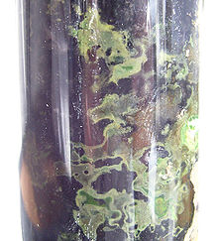
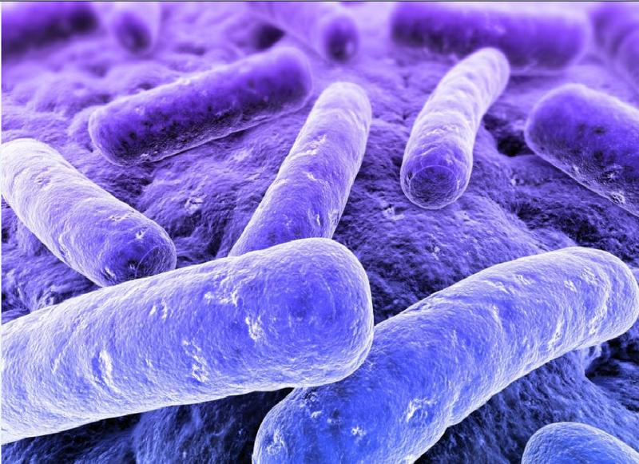
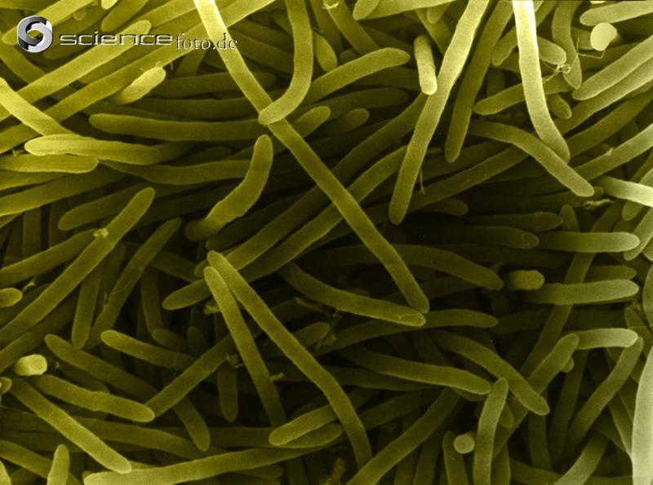
Evolution of photosynthesis
First photosynthetic organisms (prokaryotes) appeared ca. 3.5 bya
Likely used hydrogen sulfide (H₂S) as electron source
Earliest forms of photosynthesis were anoxygenic - light energy captured & converted to ATP without production of O₂, so H₂O not used as electron donor
Extant examples: green sulfur bacteria, purple bacteria, heliobacteria

Slide 5
Evolutionary transition to oxygenic photosynthesis
Single most important point in evolution of life on Earth: evolution of oxygenic photosynthesis - ability of photosynthetic organisms to use water as electron donor, thereby producing O₂ as waste product.
O₂ production and its subsequent accumulation in atmosphere forever changed life on Earth!
Several lines of geochemical evidence suggest free O₂ began to accumulate in atmosphere by 2.4 bya
Cyanobacteria first evolved ability to use H₂O as electron source for oxygenic photosynthesis
H₂O molecule split to make reducing agents for fixing CO₂

Slide 6
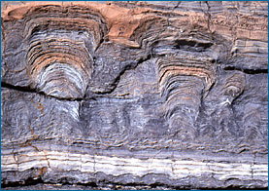
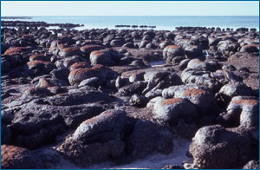
Fossil evidence - stromatolites
Microbial mats of primarily cyanobacteria and mud that build up into a layered rock structure
Stromatolites still produced today and are very similar to ancient stromatolites which provide evidence of earliest life on Earth (some dated back to 3.5 bya) = microfossils
Cross section of 1.8 billion year old fossil stromatolites at Great Slave Lake, Canada (left); modern stromatolites in Shark Bay, Australia
Notes:
Evolution.berkeley.edu

Slide 7
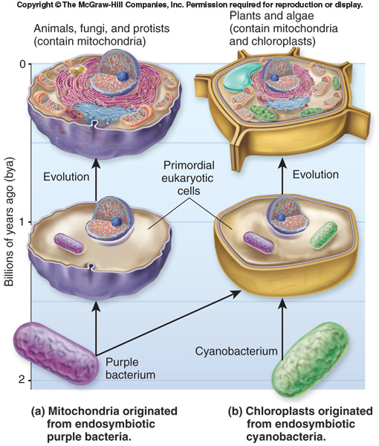
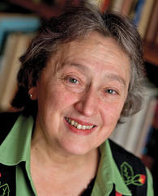
Theory of endosymbiosis
First proposed by Lynn Margulis in 1960s
Much evidence to support eukaryotic photosynthesis originated via endosymbiosis of cyanobacteria-like organisms which ultimately became chloroplasts.
1938 - 2011

Slide 8
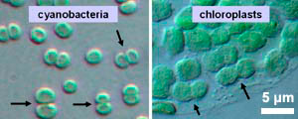
Supporting evidence for endosymbiosis
Chloroplasts have own genome (cpDNA) and are self-replicating (divide independently of cell they live in)
Much reduced from cyanobacteria ancestors: chloroplasts have about 60 – 100 genes; cyanobacteria about 1500 genes
cpDNA, cpRNA, ribosomes, chlorophyll, and mechanisms of protein synthesis all similar to that of cyanobacteria
Chloroplasts have double phospholipid bilayers – support entrance of cyanobacteria into eukaryotic cell via endocytosis
Chloroplasts and cyanobacteria similar in size 1-10 μm

Slide 9
Take two minutes
To reflect on what you’ve learned thus far.

Slide 10
Chloroplasts only found in plants and protists

Slide 11
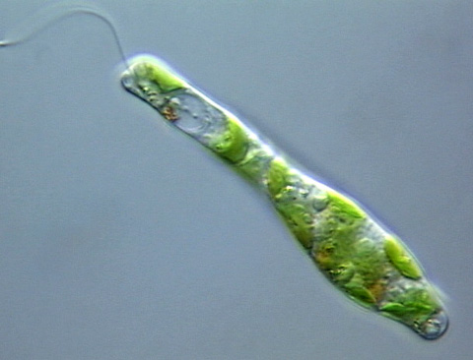
Endosymbiosis & chloroplasts
Chloroplasts of plants and algae arose by primary endosymbiosis.
Chloroplasts of euglenoids arose by secondary endosymbiosis – a chloroplast-containing eukaryotic cell was engulfed by another eukaryotic cell
“Paint the picture” – draw the process of secondary endosymbiosis and what the Euglenoid chloroplast might look like.

Slide 12
Endosymbiosis & chloroplasts
View animation: http://bcs.whfreeman.com/thelifewire/content/chp28/2802s.swf

Slide 13
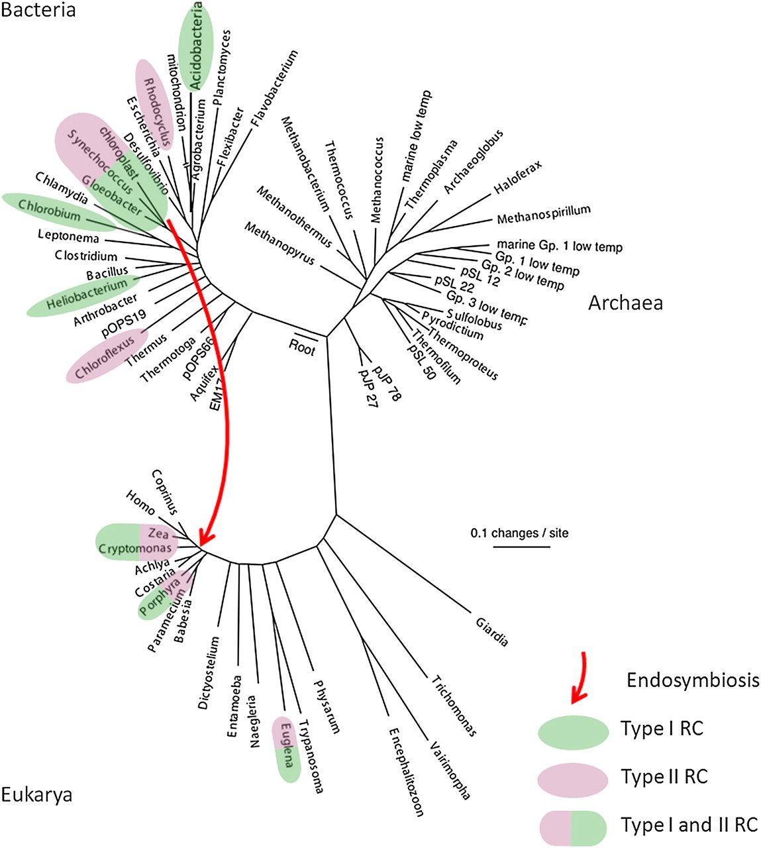
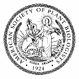
Looking at the tree of life under the photosynthetic lens.
Taxa with photosynthetic representatives highlighted in color. RC = reaction center. Red arrow indicates endosymbiotic event that formed eukaryotic chloroplasts.
Blankenship R E Plant Physiol. 2010;154:434-438
©2010 by American Society of Plant Biologists
Notes:
Small subunit rRNA evolutionary tree of life. Taxa that contain photosynthetic representatives are highlighted in color, with green highlighting indicating a type I RC, while purple highlighting indicates a type II RC. The red arrow indicates the endosymbiotic event that formed eukaryotic chloroplasts. Tree adapted from Pace (1997).

Slide 14
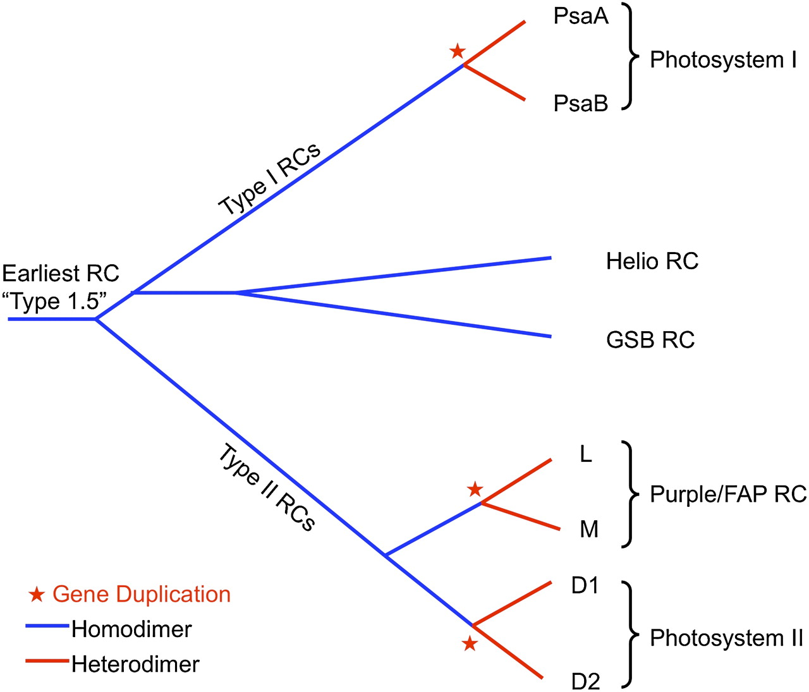
Schematic evolutionary tree showing the development of the different types of reaction center complexes in different types of photosynthetic organisms. Multiple lines of evidence support that all RCs evolved from a common ancestor.
Blankenship R E Plant Physiol. 2010;154:434-438
©2010 by American Society of Plant Biologists
Notes:
Schematic evolutionary tree showing the development of the different types of RC complexes in different types of photosynthetic organisms. This tree is based on structural comparisons of RCs by Sadekar et al. (2006). Blue color coding indicates protein homodimer, while red indicates protein heterodimer complexes. Red stars indicate gene duplication events that led to heterodimeric RCs. Helio, Heliobacteria; GSB, green sulfur bacteria; FAP, filamentous anoxygenic phototroph.

Slide 15
Reaction centers in photosynthetic organisms are examples of
homologies
analogies

Slide 16
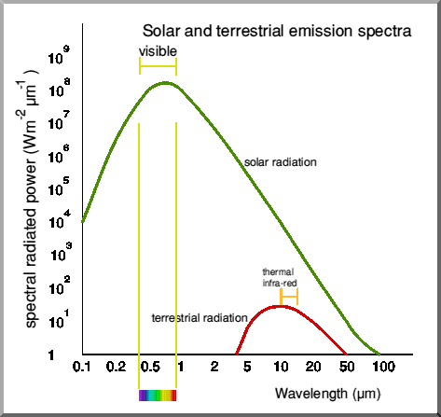
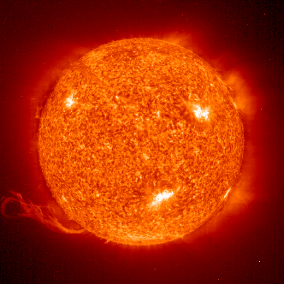
Sunlight
Like all objects, the sun emits electromagnetic nrg (radiation)
What does this graph tell you about the EM output of the sun?
What do chloroplasts have that absorb this EM radiation?

Slide 17
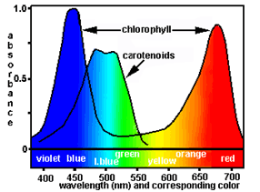
Chloroplast Pigments
Plant pigments selectively absorb in the visible wavelengths of light
Chlorophylls
Carotenoids
What is this graph telling you about the advantages of having both chlorophyll and carotenoid pigments in leaves?

Slide 18
Why do these leaves appear green?

Slide 19
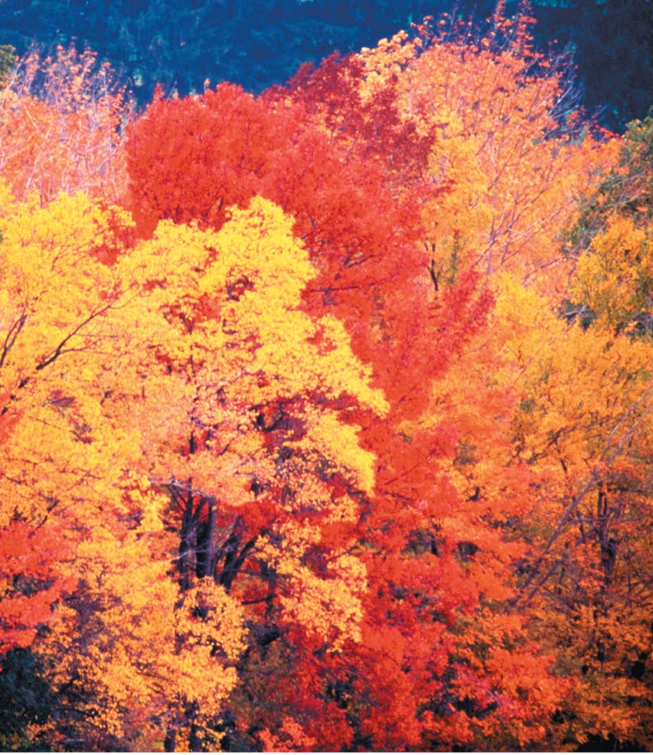
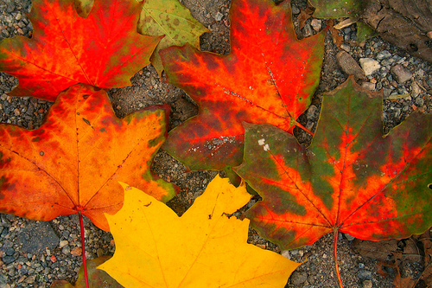
What causes the leaves of deciduous trees to turn color in the autumn?

Slide 20
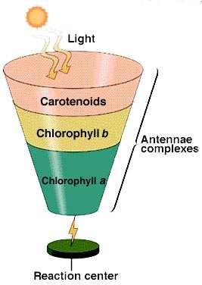
Photosystem acts as light-gathering antenna that focuses light on a reaction center
http://www2.mcdaniel.edu/Biology/botf99/photo/l4ightrx.html

Slide 21
Evidence supports other photosynthesis systems have evolved through convergent evolution (have independently evolved multiple times)
Antenna systems – light-gathering system which functions to collect and transfer excited electrons to RC are structurally varied
Carbon fixation pathways – how inorganic substrates (e.g. H₂O, H₂S, CO₂) are used along with light energy to produce organic carbon compounds (and oxidized donor products)
http://www2.mcdaniel.edu/Biology/botf99/photo/l4ightrx.html

Slide 22
Antenna systems (and modes of carbon fixation) in photosynthetic organisms are examples of
homologies
analogies

Slide 23
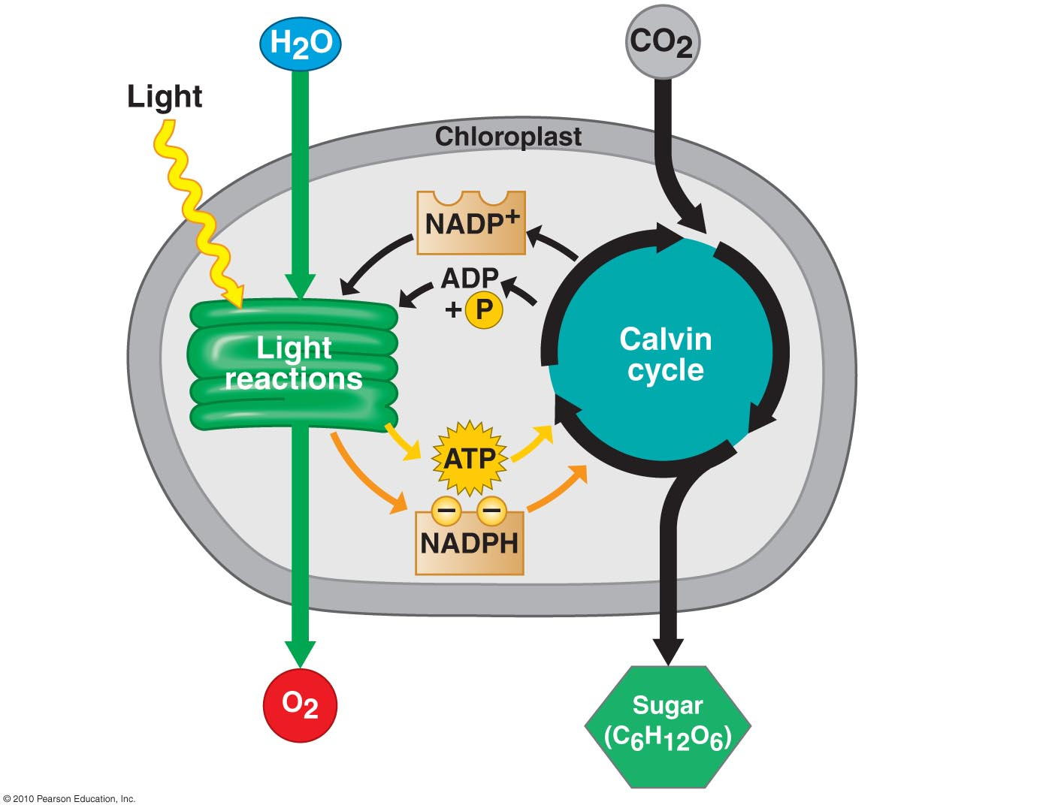
Photosynthesis Road Map
Occurs in 2 stages
Light reactions – convert solar nrg → chemical nrg
Calvin cycle – uses products of the light reactions to make sugar from CO₂

Slide 24
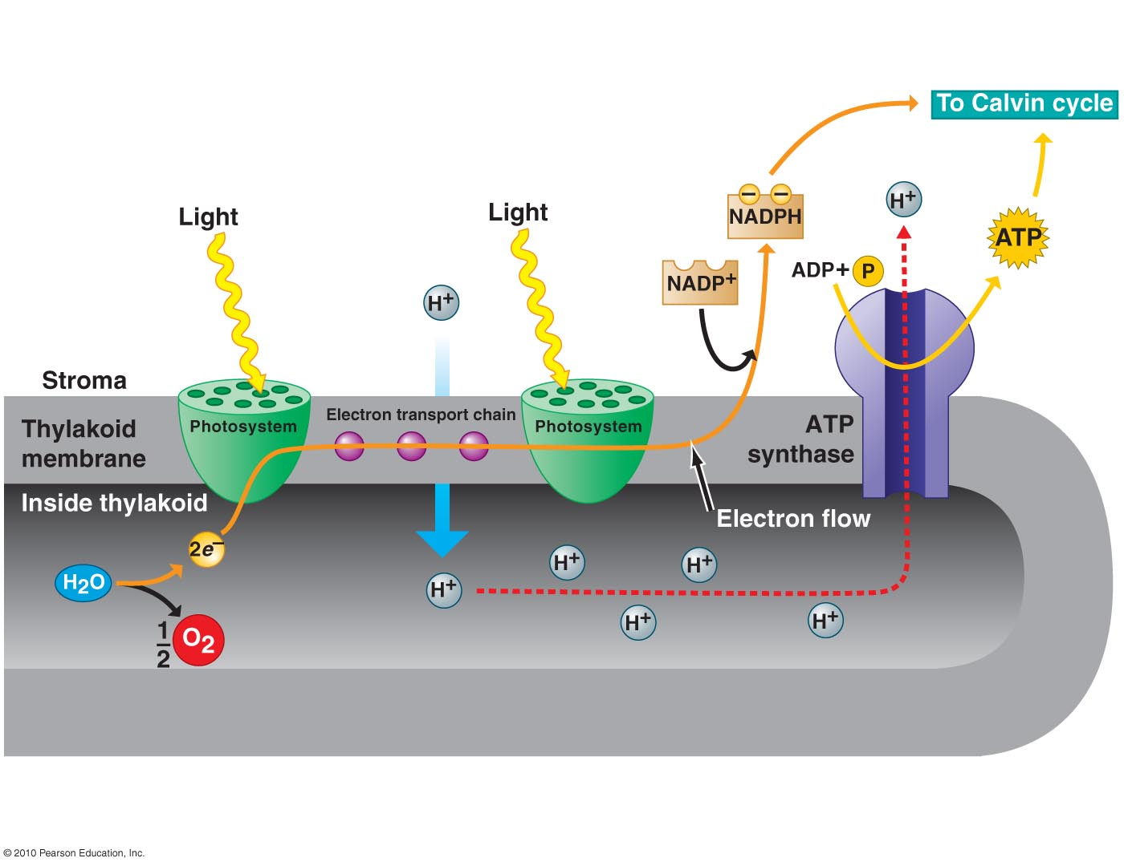
Unpacking light reactions
Two photosystems work together to produce ATP and NADPH needed for light-independent reactions (Calvin cycle)

Slide 25
Photons excite water-splitting photosystem (PS II), then are trapped by an electron acceptor
Light-excited electrons taken from H₂O, so H₂O oxidized into → O and H⁺
Energized electrons from PS II pass down electron transport chain to PS I (NADPH producing photosystem)

Slide 26
Nrg released by this electron “fall” and H⁺ ions used to create proton gradient are used by ATP synthase to generate ATP

Slide 27
NADPH-producing PS (PS I) transfers its light-excited electrons to
NADP⁺, thus
reducing it to
NADPH
NADPH and ATP powers light-independent, CO₂ fixation pathway (Calvin cycle)

Slide 29
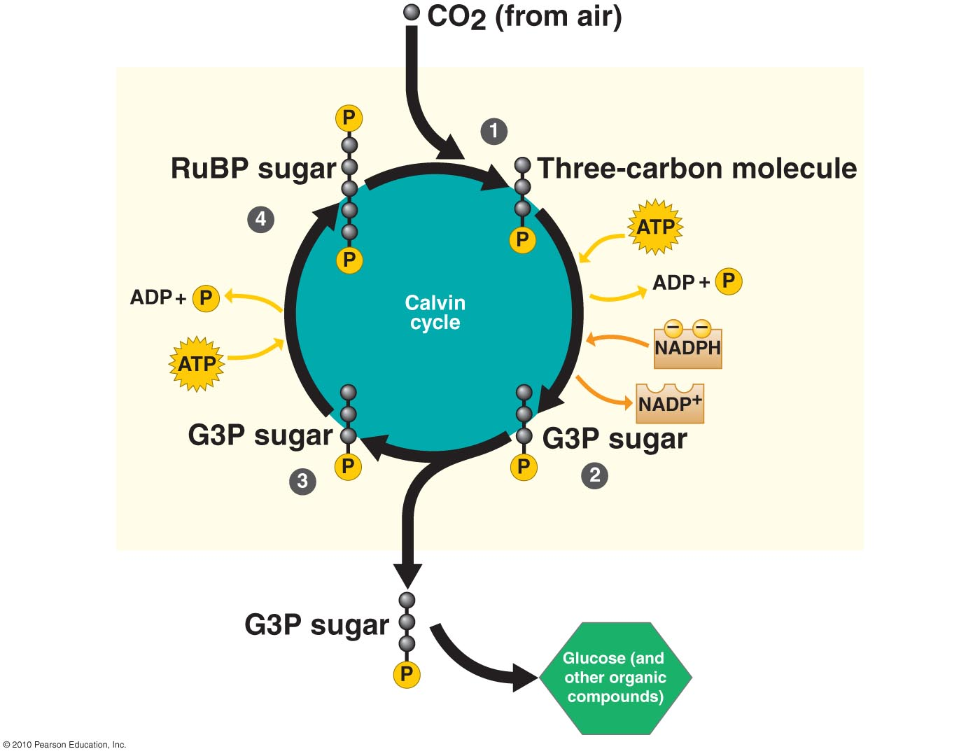
Unpacking the Calvin Cycle
Recall the inputs
CO₂ from atmosphere – the carbon source
ATP – provides nrg to make G3P sugar
NADPH – provider of hi nrg electrons to make G3P sugar
It’s a cycle, so regenerates starting material with each turn

Slide 30
Misconception
Glucose is the direct product of the Calvin cycle
G3P is the direct product. G3P will be made into glucose, sucrose, or carbohydrates for the plant, e.g. starch, cellulose

Slide 31
Photosynthetic Strategies in Plants
Three modes of photosynthesis in plants – these reflect climate adaptations
C₃ plants
C₄ plants
CAM plants

Slide 32
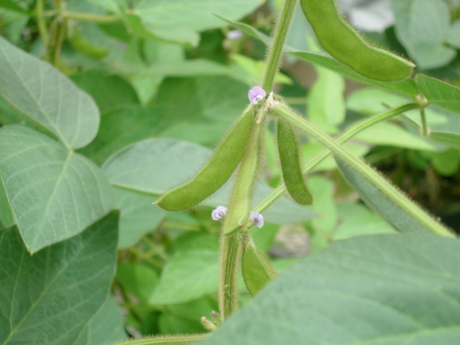
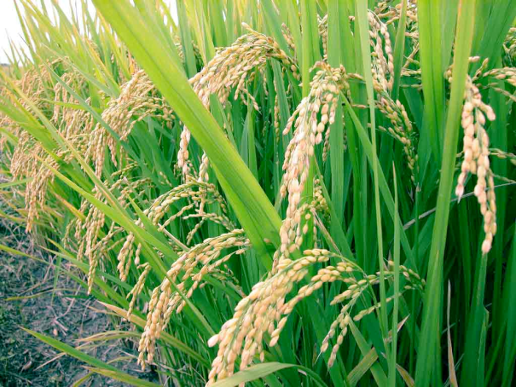
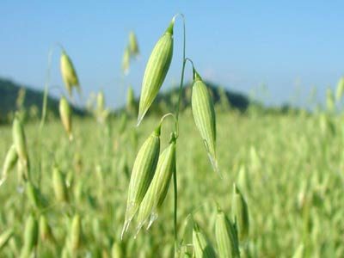
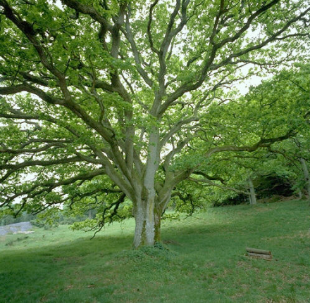
C₃ Plants
Most common (95% if all plant spp)
Use CO₂ directly from air to drive Calvin cycle
First organic compound formed in Calvin cycle is a 3-C molecule
Close stomata in hot, dry conditions with no CO₂ uptake (adaptation to minimize water loss)
E.g. soybean, rice, wheat, oats, most trees

Slide 33
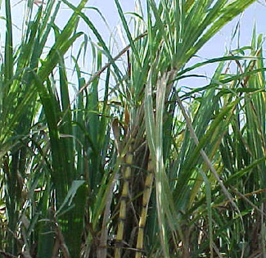
C₄ Plants
Use C from CO₂ to make a 4-C molecule before Calvin cycle
Stomata close when hot, dry, but still capable of making that 4-C molecule which acts as CO₂ shuttle to Calvin cycle
E.g. corn, sorghum,
sugar cane, many weeds

Slide 34
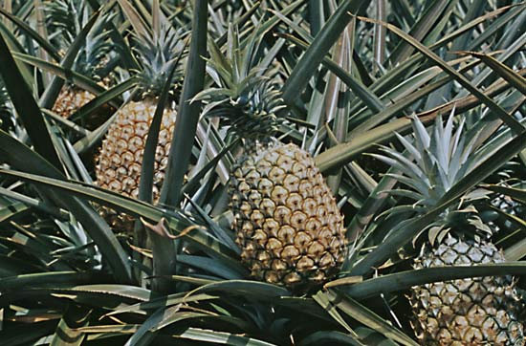
CAM Plants
Adapted to very dry habitats
E.g. succulents, pineapple
Conserve water by opening stomata only at night, so only fix CO₂ at night (when cooler)

Slide 35
Fig. 6.2: Nrg flow & chemical cycling in ecosystems
The products of photosynthesis are reactants for cellular respiration

Slide 36
Plants also respire!
All eukaryotes (including plants) evolved from a common ancestor with mitochondria
Endosymbiotic origin of mitochondria
All eukaryotes have mitochondria (or once did, and later lost them)
Origin of mitochondria and eukaryotic cell plausibly the same event
Land and Martin (2011) ask, “why did only mitochondrion-bearing cells evolve true complexity?”

Slide 37
Resources
Great overviews on key biology concepts http://www.shmoop.com/biology/
Advanced tutorial on photosynthesis http://highered.mcgraw-hill.com/olcweb/cgi/pluginpop.cgi?it=swf::535::535::/sites/dl/free/0072437316/120072/bio13.swf::Photosynthetic%20Electron%20Transport%20and%20ATP%20Synthesis
Early evolution of photosynthesis http://www.plantphysiol.org/content/154/2/434.full

Slide 38
Muddiest point
Take a few moments to jot down what was the most difficult or confusing part of today’s presentation.

Slide 39
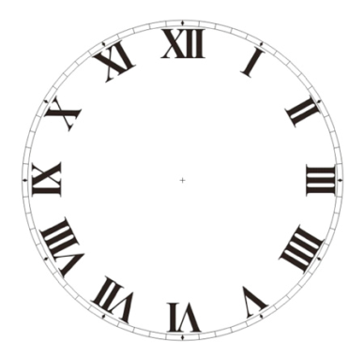
ACTIVITY
Leaf Disk Assay
45 min.

