Slide 1
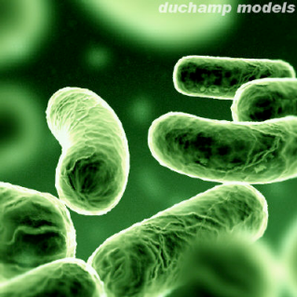
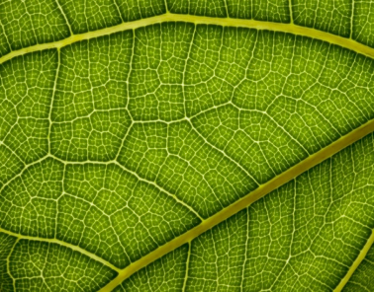
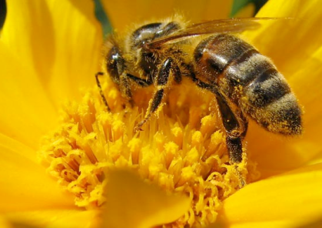
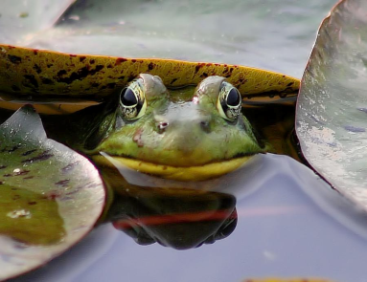
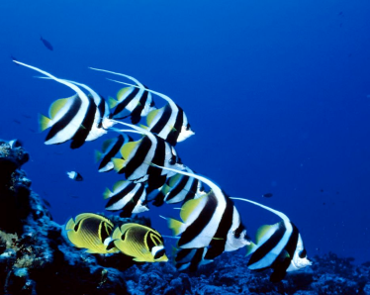
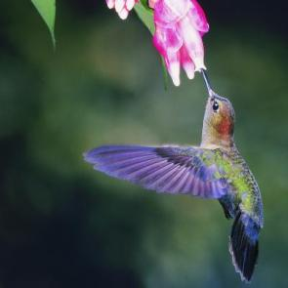




DAY 3: Mechanisms of evolution II, DNA Structure & function
IMSS BIOLOGY ~ SUMMER 2011

Slide 2
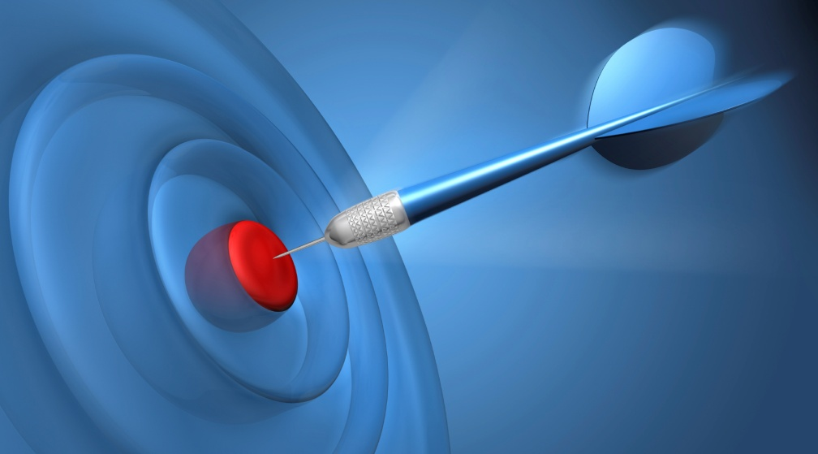
LEARNING TARGETS
To understand the mechanisms of evolution, including
  natural selection
  mutation
To understand how a deleterious allele can be maintained in a population.
To understand how the structure of DNA relates to its function, particularly replication.

Slide 3
Some questions answered?
How large was the founding population of Darwin’s finches? >30 based on Mhc polymorphism

Slide 4
Some questions answered?
How is the timing of genetic bottlenecks determined?

Slide 5
Natural selection
(A) enables organisms to evolve structures that they need.
(B) eliminates non-heritable traits in a species.
(C) works on variation already present in a population.
(D) results in organisms that are perfectly adapted for their environments.
(E) does all of the above.
0
1 | 2 | 3 | 4 | 5 | 6 | 7 | 8 | 9 | 10 | 11 | 12 | 13 | 14 | 15 | 16 | 17 | 18 | 19 | 20
21 | 22 | 23 | 24 | 25 | 26 | 27 | 28 | 29 | 30

Slide 6
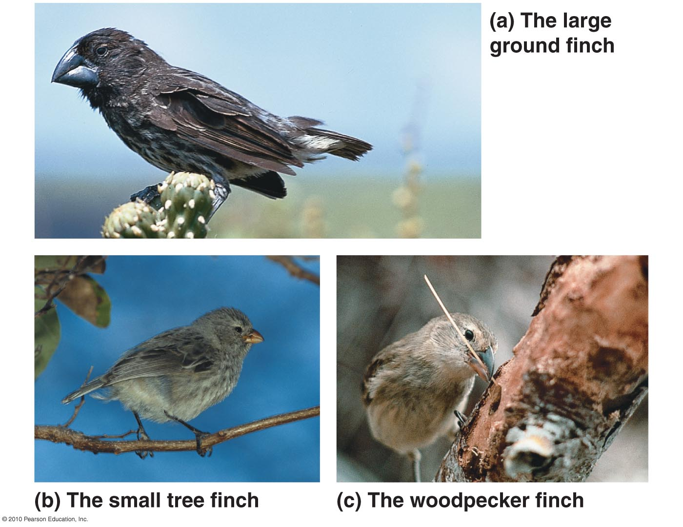
Natural Selection
Darwin noted the close relationship between adaptation to the environment and the origin of new species
Prime e.g. finches on the Galapagos Islands – beak size & shape adapted for certain diets
a. large, seed- cracking bill
b. pincer-like bill
c. probing bill

Slide 7
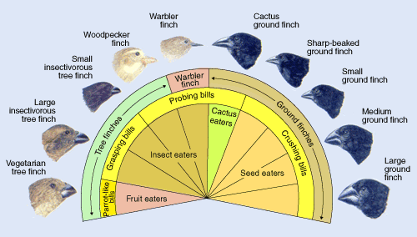
Darwin’s Finches
www.pbs.org
Darwin first described the 14 spp of closely related finches during his voyage on the HMS Beagle (1835). These spp show a remarkable degree of diversity in bill shape & size that are adapted for different food sources in an otherwise scarce environ.
These finches to this day remain the key example of many important evolutionary processes – niche partitioning, morphological adaptation, speciation, & species ecology

Slide 8
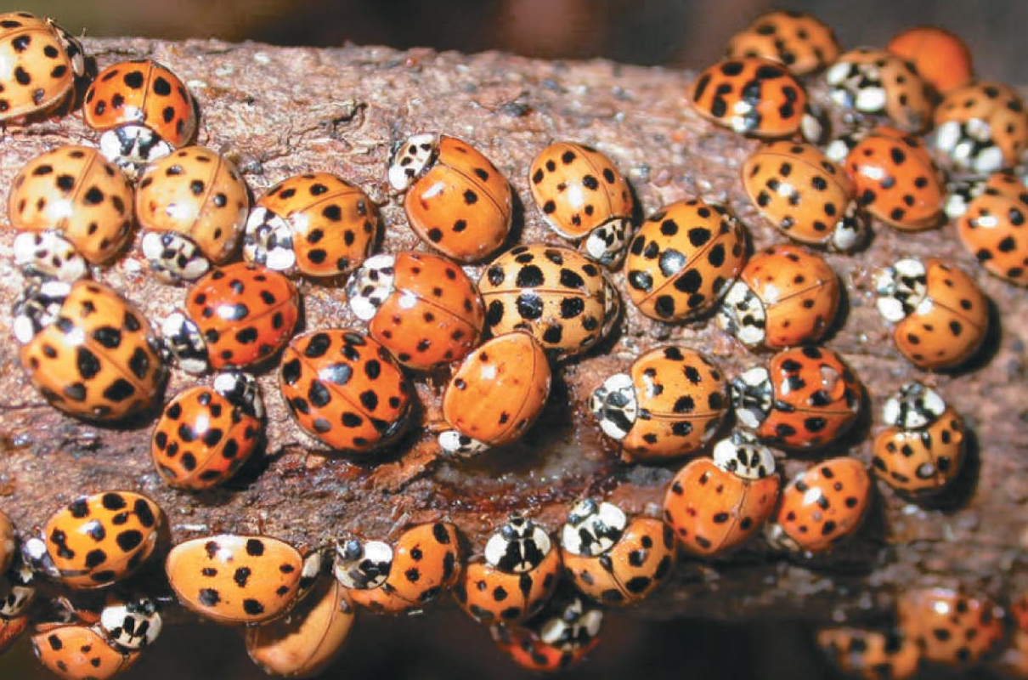
Darwin’s Theory
Darwin based his theory of natural selection on two key observations
Overproduction & competition
  All species have potential to produce more offspring than can be supported in a given environ.
  This overproduction is basis for competition (“struggle for existence”)
Individual variation
  Individuals in a population
  vary in many heritable traits.

Slide 9

Darwin’s Conclusion Defines Natural Selection
Differential survival & reproduction drives the evolution of species
  Those individuals w/ heritable traits best suited to the local environment generally survive to reproduce, thus leave a larger share of surviving, fertile offpsring
  Misconception: The environment does the selecting in natural selection. Species evolve due to “want” or “need.”

Slide 10
Misconceptions Dispelled
Biological diversity exists, and selective pressure from the environment determines who survives to reproduce
Evolution is NOT goal directed and does NOT lead to perfectly adapted organisms
  Evolutionary change is consequence of immediate advantage NOT a distant goal.
  Evolutionary change only reflects improvement in the context of the immediate environment (what is good today may not be so tomorrow)
  Thus, species do not steadily get better, they respond evolutionarily to the environment or go extinct.

Slide 11
The “bad” gene
Why do deleterious alleles remain in some populations? What keeps natural selection from eliminating them?
  Heterozygote advantage
  Mutation
  Gene flow
  Not enough time
  Don’t reduce fitness

Slide 12
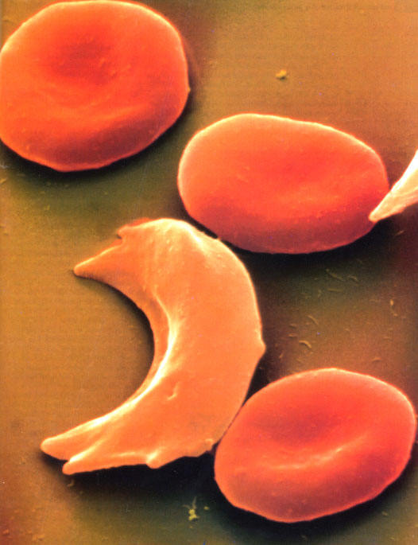
Heterozygous advantage
In some instances, an advantage is conferred when carrying one copy of a deleterious allele, so natural selection will not remove the allele from the population
  E.g. allele that causes sickle cell anemia is deleterious if you carry two copies of it, but carrying one copy confers malaria resistance

Slide 13
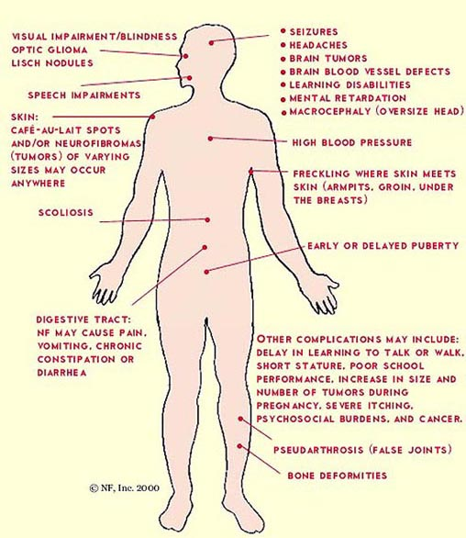
Mutation
Mutation producing deleterious alleles may keep appearing in a population, even if selection weeds it out
  E.g. neurofibromatosis – genetic disorder causing tumors of the nervous system (actually affects all neural crest cells)
    Has hi mutation rate: natural selection cannot completely get rid of the gene, because new mutations arise 1 in 4,000 gametes

Slide 14
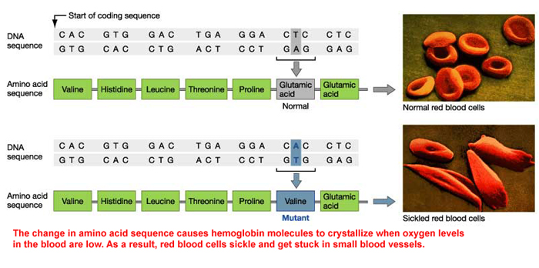
Gene flow
Allele may be common but not deleterious in a nearby habitat, and gene flow from this population is common
  E.g. Sickle cell anemia allele is found in populations throughout the world due to gene flow

Slide 15
Not enough time
Some deleterious alleles observed in populations may be on their way out, but selection has not yet completely removed them
  E.g. allele causing cystic fibrosis occurs in hi frequency in European populations – a possible holdover from time when cholera was rampant in these populations

Slide 16
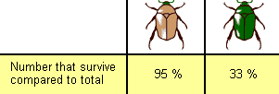
No effect on fitness
Some genetic disorders only exert effects late in life, after reproduction has occurred.
  E.g. allele causing adult-onset Huntington’s disease – a degenerative brain disorder. Symptoms typically develop in mid-40’s.
  Fitness: how good a particular genotype is at leaving offpsring in the next generation relative to other genotypes. Which beetle genotype has the greater fitenss?

Slide 17
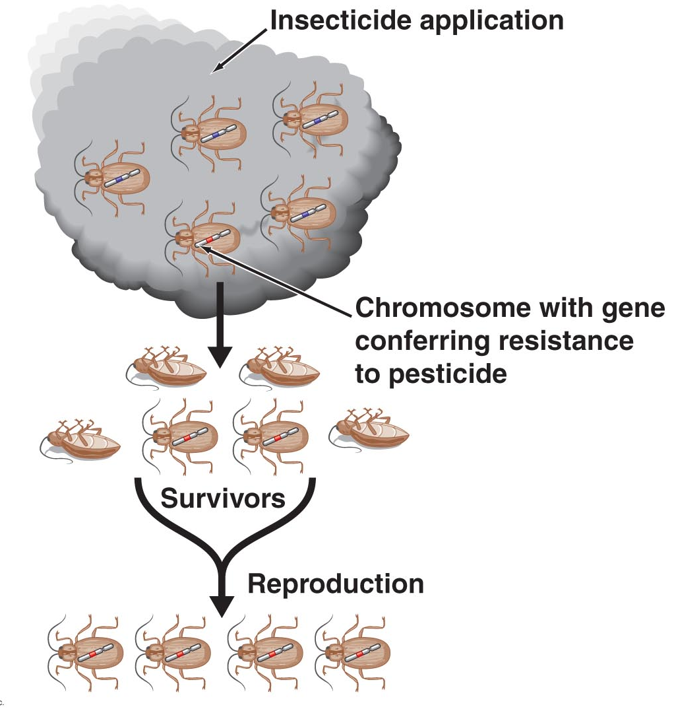
Natural Selection in Action
Examples of natural selection include the evolution of
  Pesticide resistance in insects
  Antibiotic resistance in bacteria
  Drug resistance in strains of HIV

Slide 18
Natural selection is
(A) random
(B) non-random
0
1 | 2 | 3 | 4 | 5 | 6 | 7 | 8 | 9 | 10 | 11 | 12 | 13 | 14 | 15 | 16 | 17 | 18 | 19 | 20
21 | 22 | 23 | 24 | 25 | 26 | 27 | 28 | 29 | 30

Slide 19
No effect on fitness
Some genetic disorders only exert effects late in life, after reproduction has occurred.
  E.g. allele causing adult-onset Huntington’s disease – a degenerative brain disorder. Symptoms typically develop in mid-40’s.
  Fitness: how good a particular genotype is at leaving offpsring in the next generation relative to other genotypes. Which beetle genotype has the greater fitenss?

Slide 20
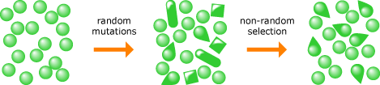
Natural selection is not random
Misconception: natural selection is a random process.
Selection acts on genetic variation in a very non-random way
  Genetic variants that aid survival & reproduction are much more likely to increase in frequency in a population than variants that don’t
A population of organisms undergoes random mutation and non-random selection. The result is non-random evolutionary change.

Slide 21
Which of the following can create new alleles?
(A) Sexual reproduction
(B) Mutation
(C) Natural selection
(D) Sexual recombination
(E) Genetic drift
0
1 | 2 | 3 | 4 | 5 | 6 | 7 | 8 | 9 | 10 | 11 | 12 | 13 | 14 | 15 | 16 | 17 | 18 | 19 | 20
21 | 22 | 23 | 24 | 25 | 26 | 27 | 28 | 29 | 30

Slide 22
Sources of genetic variation
Gene flow: already discussed
Mutation: random changes in DNA that can result in new alleles (more details later)
Sex: can introduce new gene combinations into a population (more details later)

Slide 23
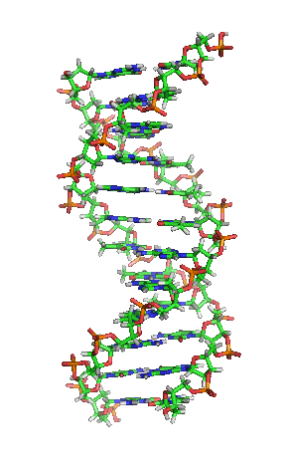
Overview of DNA
Known to be a chemical in cells by the end of 19th C.
Has the capacity to store genetic information
Can be copied and passed from generation to generation
DNA and its close chemical “cousin,” RNA, are nucleic acids
Public domain image, Wikipedia Commons

Slide 24
The article…
Which aspects of DNA’s structure did Watson & Crick elucidate?
What was the profundity of their discovery?
Did you detect any clues/telling statements in the article which reveal the competitive nature of Watson and Crick?
Can you identify one of the most famous scientific understatements of our time?

Slide 25
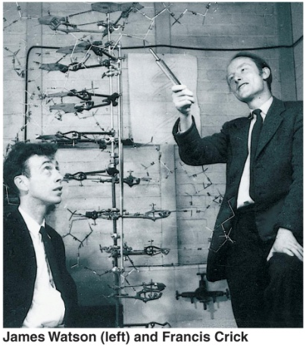
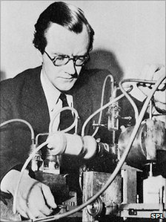
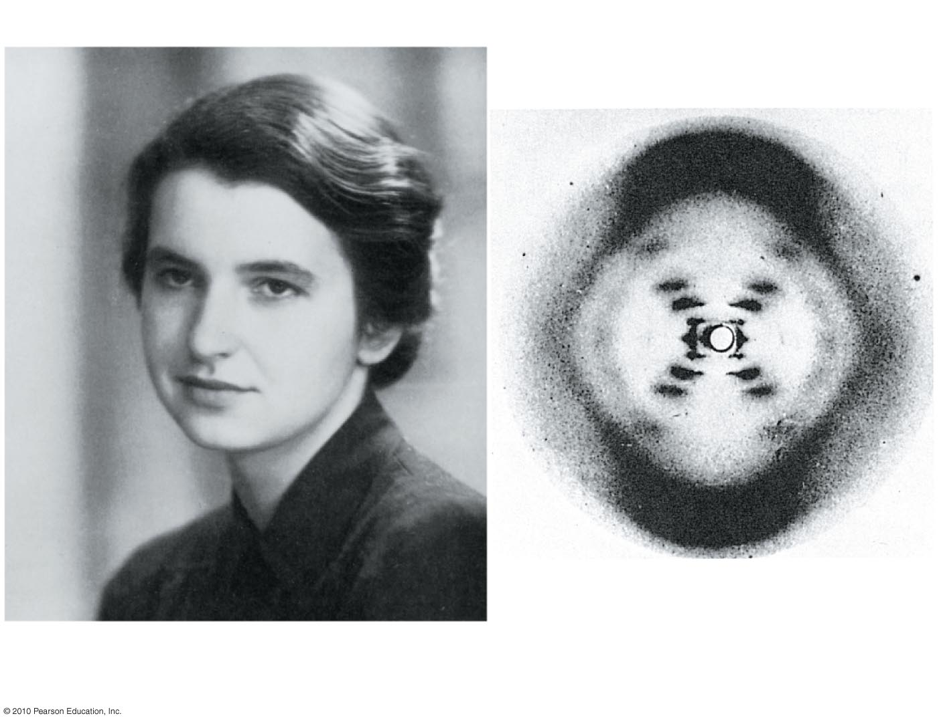
The Double Helix
Glory goes to James Watson & Francis Crick for the discovery of the true structure of DNA
1962, Nobel Prize in Medicine awarded to Watson, Crick, & Maurice Wilkins
  Wilkins proposed use of x-ray crystallography & refined technique
  Rosalind Franklin produced key images (she died in 1958 but would’ve been co-awardee)
Other influential scientific breakthroughs
  Eric Chargaff – equal proportions of A & T and G & C
  Linus Pauling – DNA was helical
  Several other geneticists & chemists – DNA (not protein) in chromosomes, pattern of bonding for DNA

Slide 26
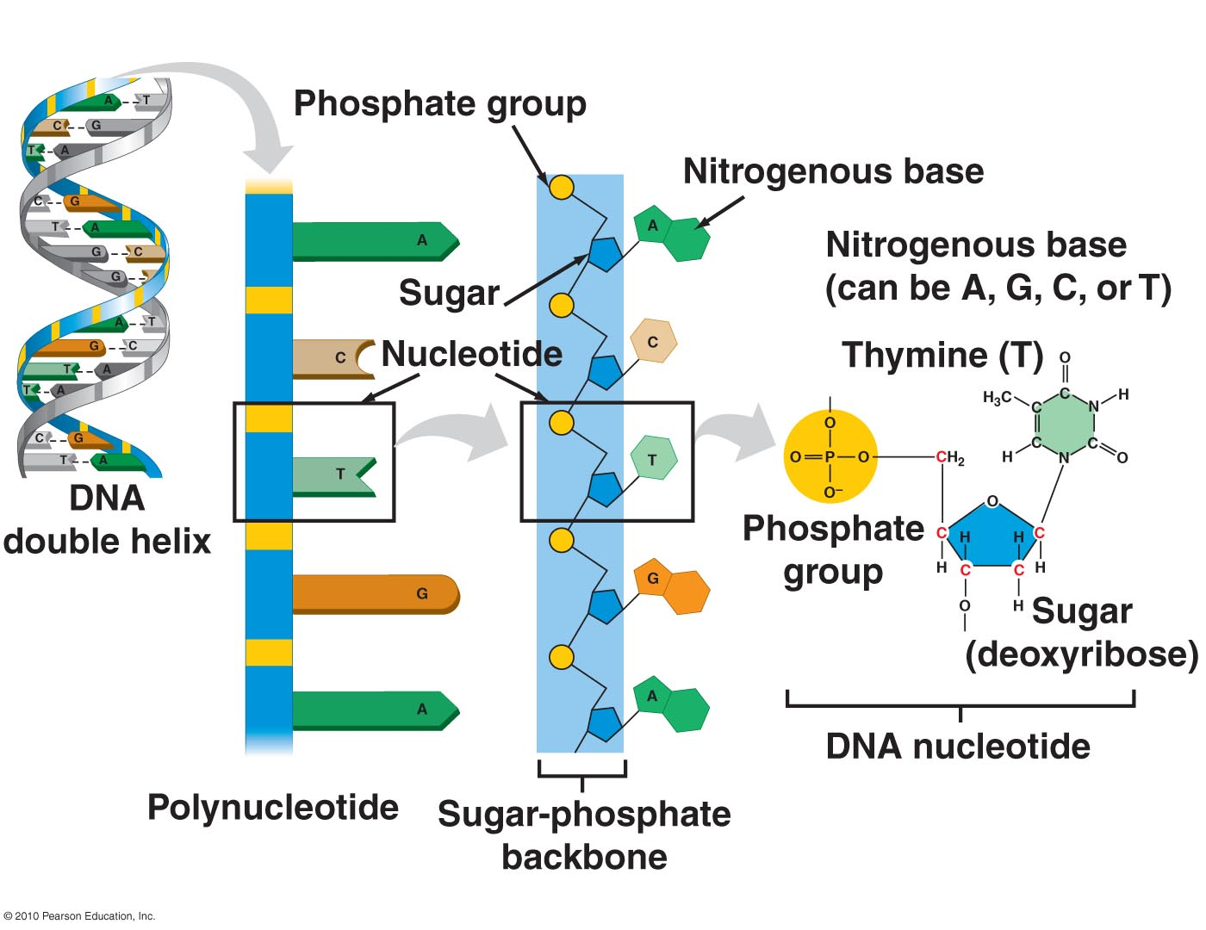
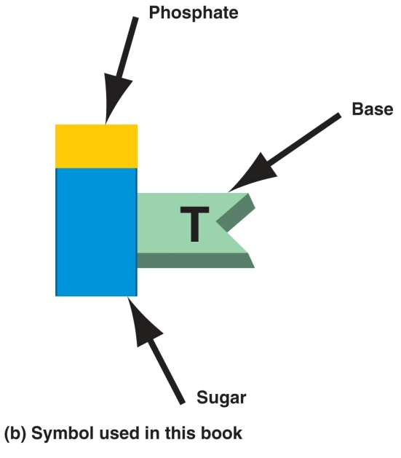
Nucleic Acids
DNA & RNA are nucleic acids
Chemical building blocks (monomers) of nucleic acids are nucleotides, which are joined by covalent bonds between sugar & phosphate groups of adjacent nucleotides → sugar-phosphate backbone

Slide 27
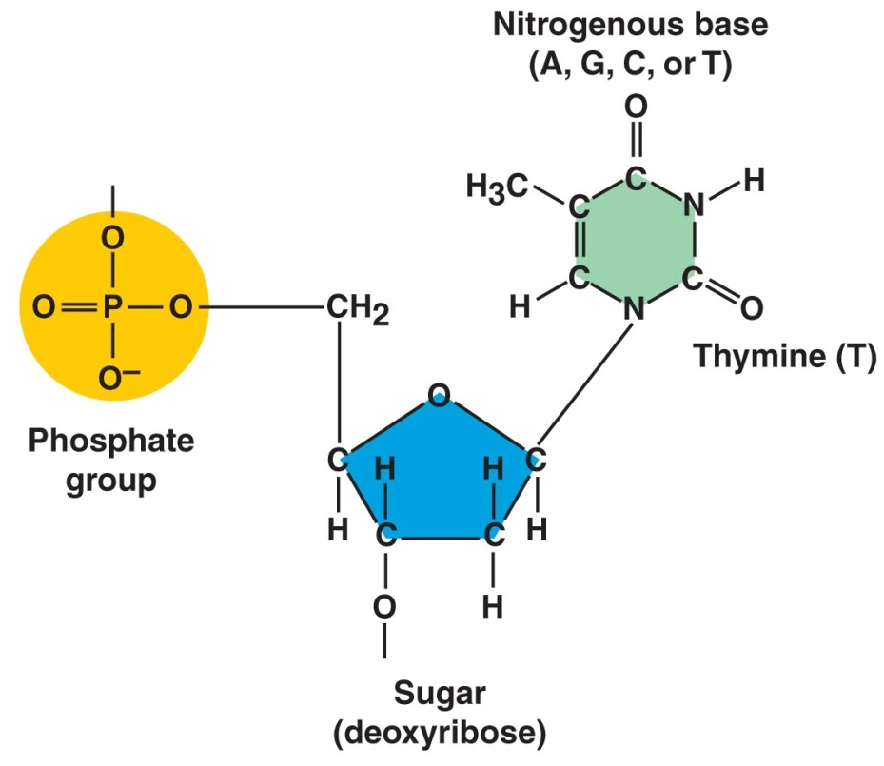
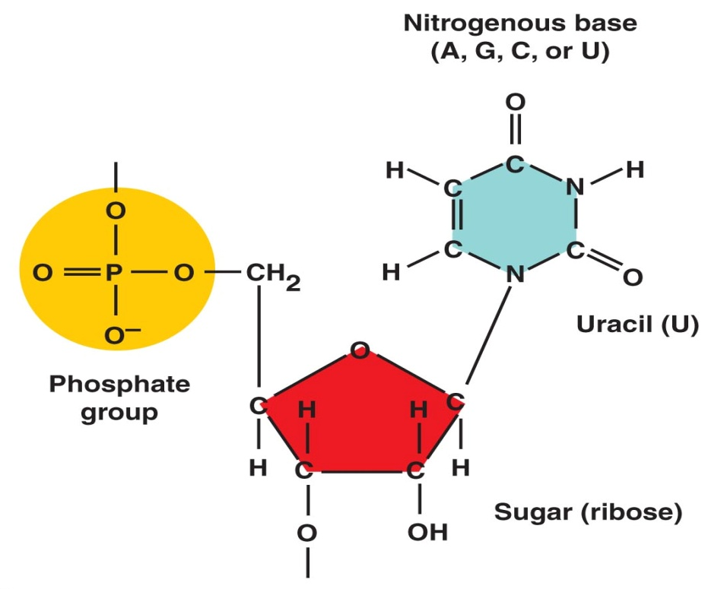
Nucleotides
Consist of 3 parts
  Central 5-C sugar
    Deoxyribose in DNA
    Ribose in RNA
  Phosphate group
    Carries (-) charge, thus makes nucleic acids polar
  Nitrogenous base
    Distinctive feature of each nucleotide
    Made up of 1-2 rings
    Accepts H⁺ in aqueous solution
DNA
Fig. 3.23
Fig. 3.24
Fig. 10.1b, 3.23a
RNA
Fig. 3.26

Slide 28
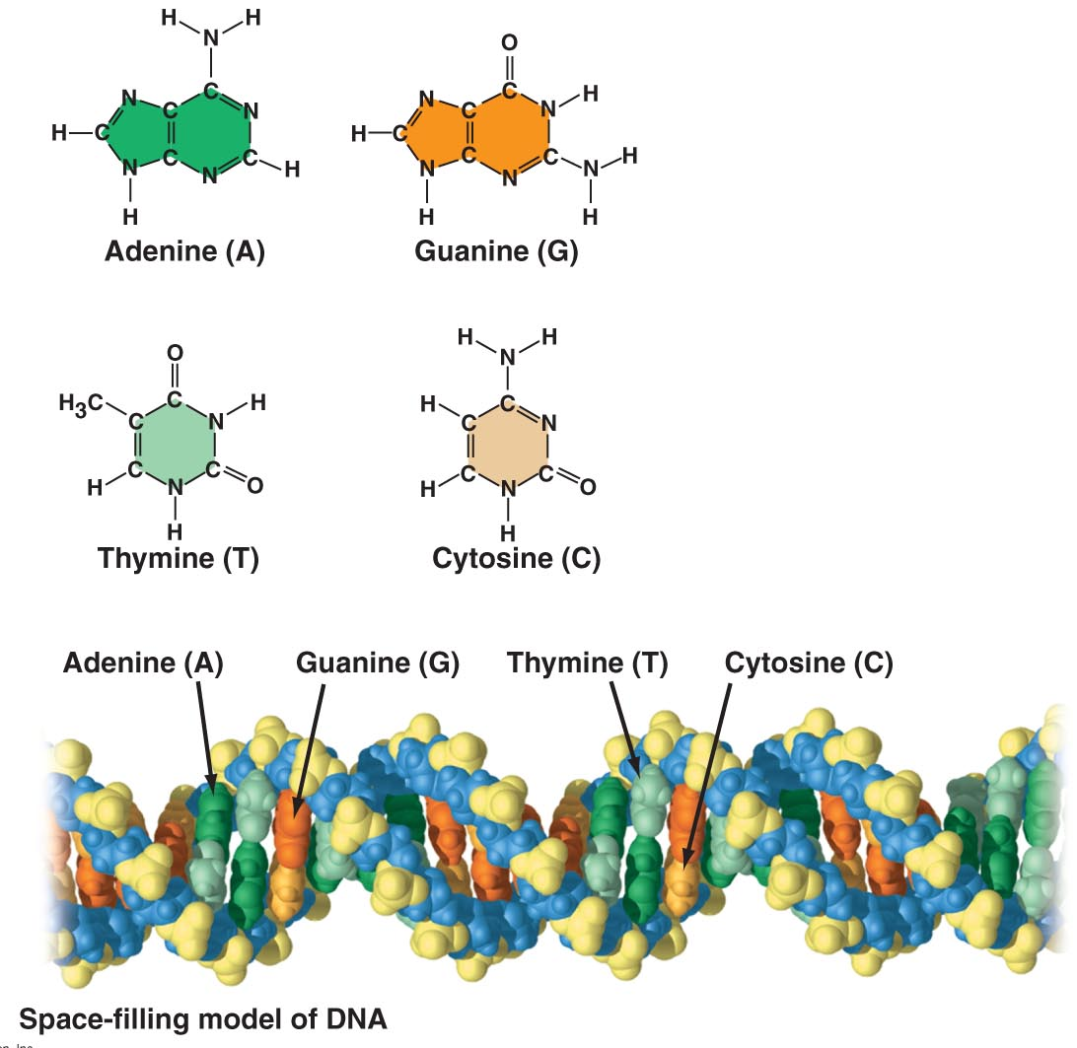

Nitrogenous Bases
Make each nucleotide unique
In DNA, the 4 bases are
  Thymine (T)
  Adenine (A)
  Cytosine (C)
  Guanine (G)
RNA has A, C, G, & uracil (U) in place of T

Slide 29
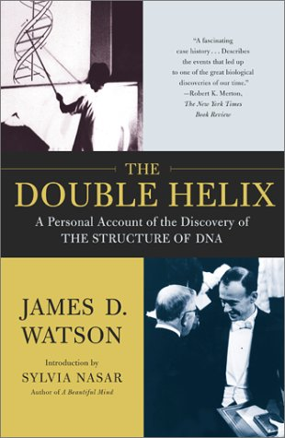
For more information
Interesting article
    http://www.chemheritage.org/discover/chemistry-in-history/themes/biomolecules/dna/watson-crick-wilkins-franklin.aspx
Watson & Crick go down memory lane with a pint each
  http://www.youtube.com/watch?v=OiiFVSvLfGE
TED Talk presentation by James Watson
  http://www.ted.com/speakers/james_watson.html
The Double Helix, Watson’s autobiographical
account of the discovery

Slide 30
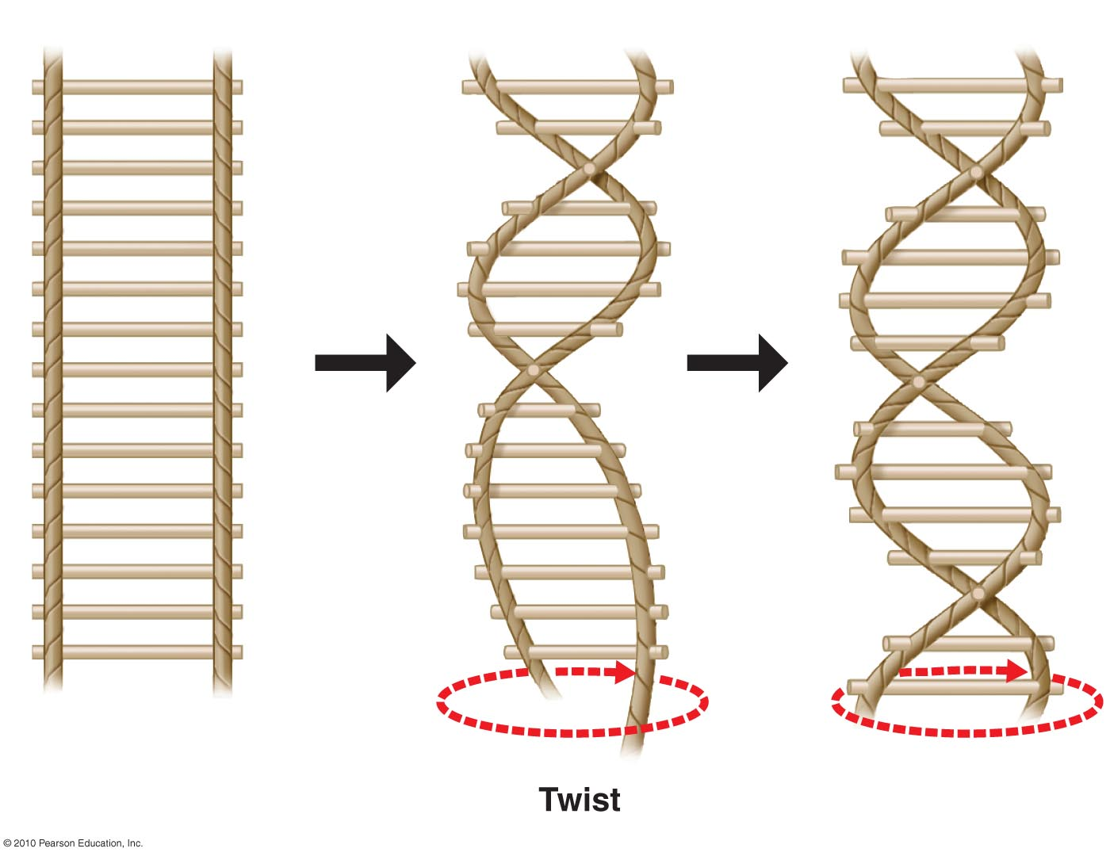
The Discovery
The model of DNA is like a rope ladder twisted into a spiral (helix)
  The ropes at the sides = sugar-phosphate backbones
  Each wooden rung = pair of bases connected by hydrogen bonds

Slide 31
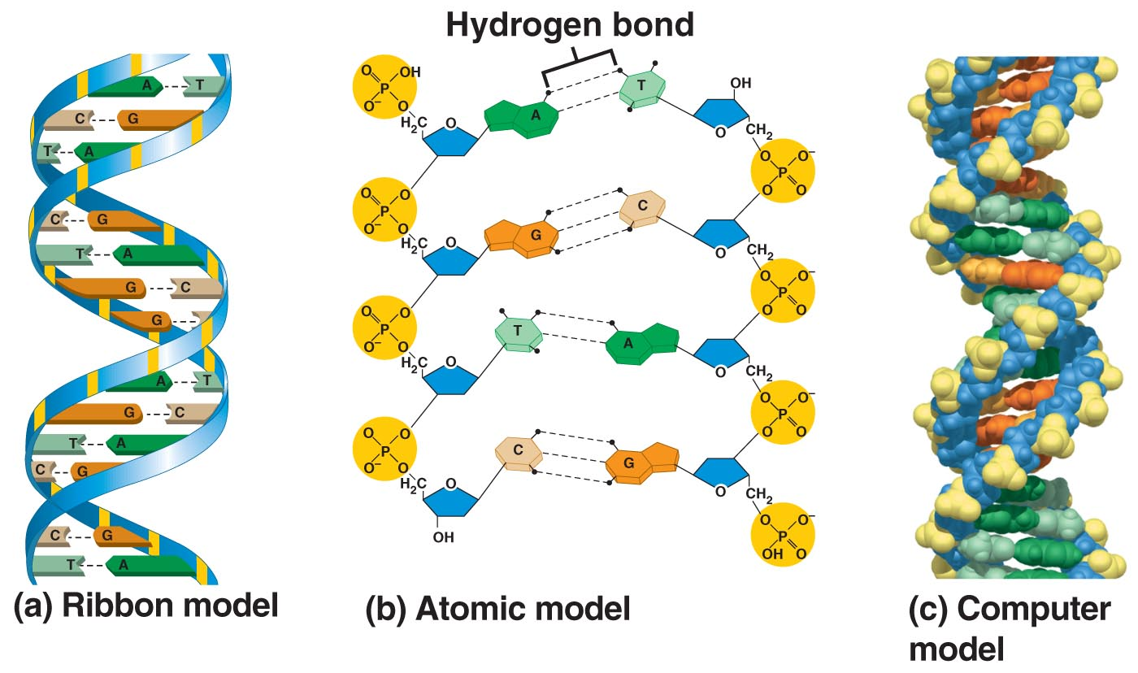
DNA bases pair in complementary way based on H bonding
  adenine (A) pairs w/ thymine (T)
  cytosine (C) pairs w/ guanine (G)
Fig.10.5

Slide 32
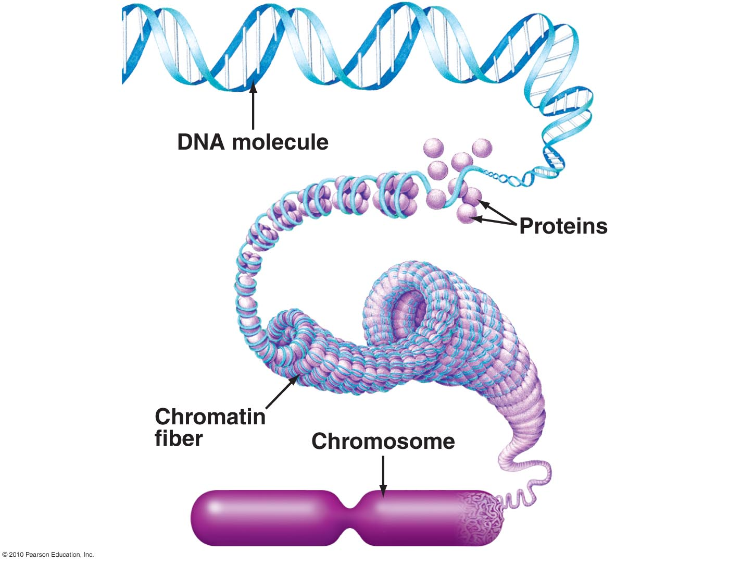
DNA into Chromosomes
How to package 2 m of DNA into a eukaryotic cell?
  DNA compacted by spool-like proteins = histones
    Provide energy to fold DNA
  DNA + histones = chromatin
  Chromatin fiber tightly coiled into
  a chromosome
Fig. 4.8

Slide 33
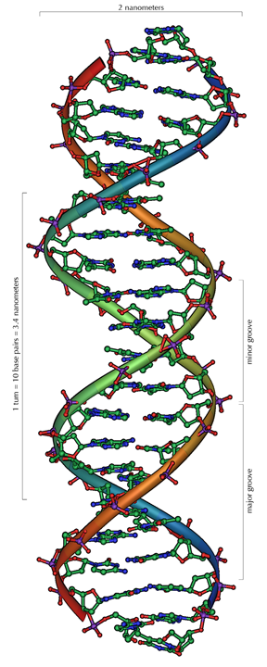
Review: DNA Structure
Video from Essential Cell Biology
http://www.youtube.com/watch?v=ZGHkHMoyC5I&feature=related
Public domain image, Wikipedia Commons

Slide 34
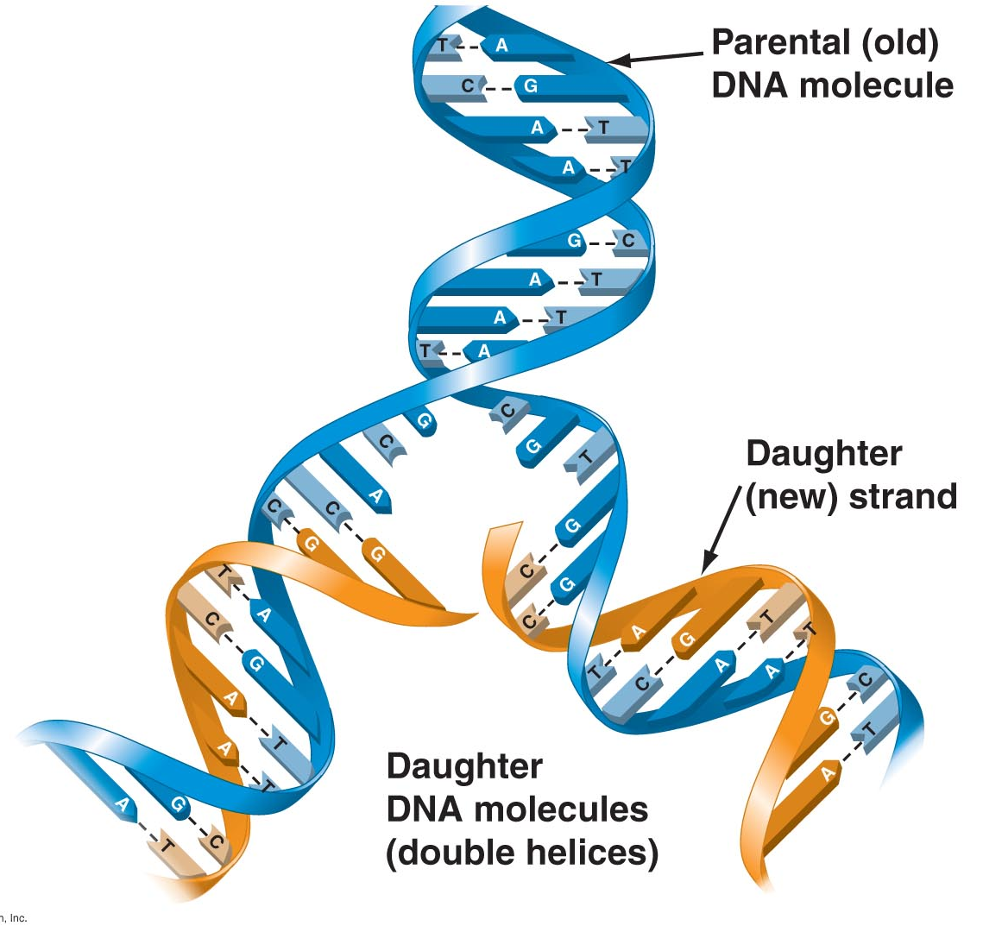
DNA Replication
When a cell reproduces, a complete copy of the DNA must pass from one generation to the next
Watson & Crick’s model for DNA suggested that DNA replicates by a template mechanism
  Two strands of “parental” DNA separate
  Ea. strand acts as template for assembly of a complementary strand
  DNA polymerases key enzymes in
  forming covalent bonds between
  nucleotides of parental (old) &
  daughter (new) strands → 2 new
  molecules of DNA
  Also involved in repairing
  damaged DNA

Slide 35
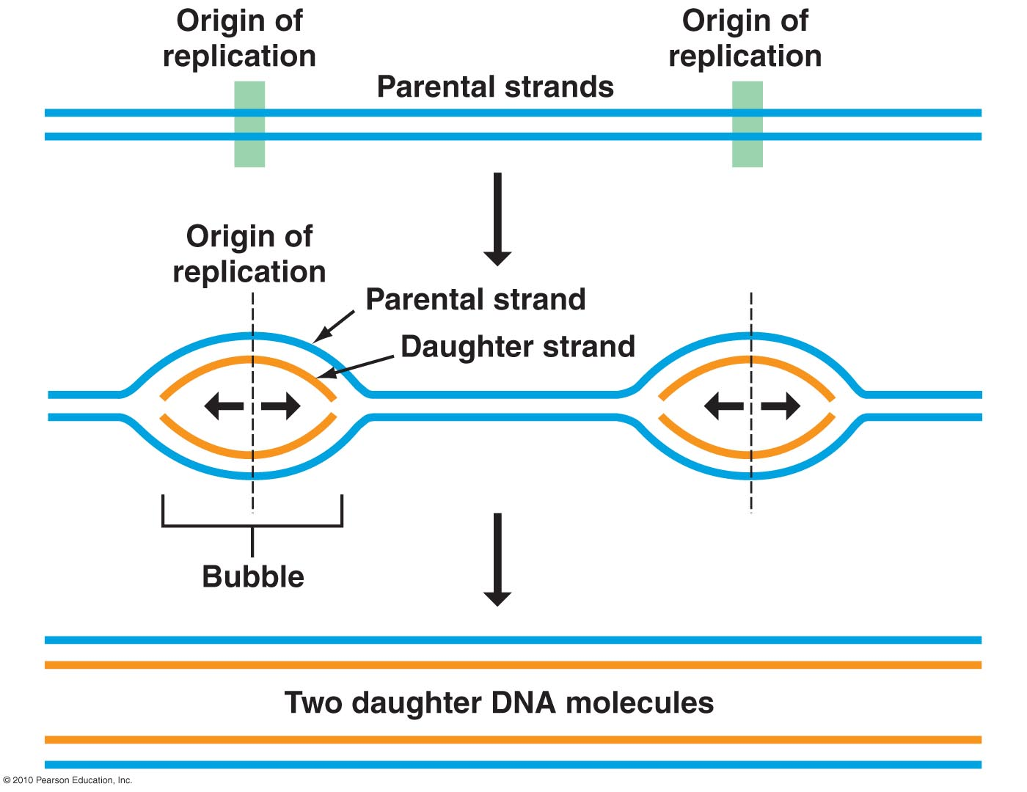
In eukaryotes, DNA replication begins at specific sites on a double helix = origins of replication
From these origins, replication proceeds in both directions → replication “bubbles” – parental strand opens up to allow daughter strands to elongate on both sides of bubble

Slide 36
Recap on Importance of DNA Replication
DNA replication ensures
  all cells in an organism carry the same genetic information
  genetic information can be passed on to offspring

Slide 37
Molecular visualization DNA into chromosomes & central dogma
  http://www.youtube.com/watch?v=4PKjF7OumYo

Slide 38
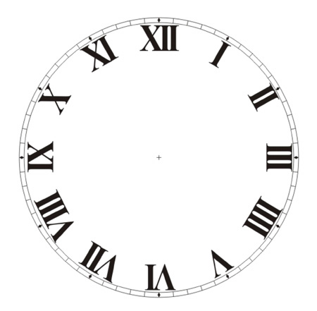
ACTIVITY
Three Ways of DNA
Exploring the structure of DNA via the spectrum of inquiry.
45 min.

