Slide 1
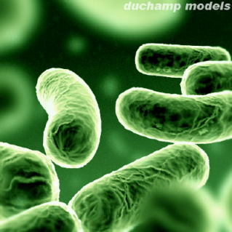
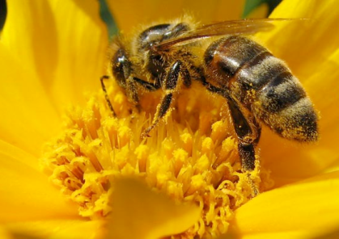
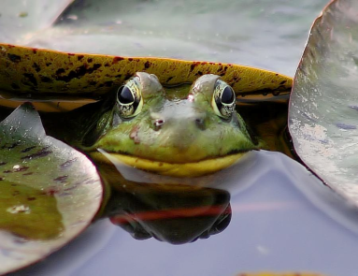
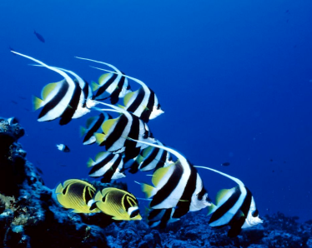
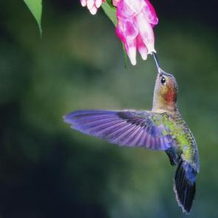
DAY 6: Sources of genetic variation
IMSS BIOLOGY ~ SUMMER 2011

Slide 2
LEARNING TARGETS
To understand sources of genetic variation, in particular
Mutation
Sex (and no sex)
To understand patterns of inheritance, beyond the monohybrid crosses
To understand that genetic variation and patterns of inheritance are keys to understanding the process of evolution.

Slide 3
Mutation - overview
Any change in the nucleotide sequence of DNA which can change the amino acids in a protein
Mutations can involve
large regions of a chromosome
a single nucleotide pair
Can occur in the reproductive (germline) cells or in somatic (non-reproductive) cells
Can be caused by external (mutagens) or internal (spontaneous) factors, including
DNA replication errors
transcription errors
code sequence transpositions

Slide 4
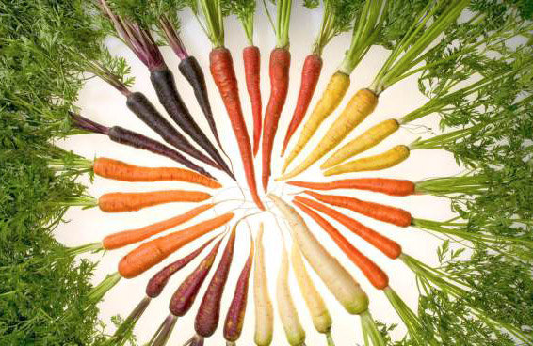
Mutation - source of genetic variation
Types
Mutation in non-coding genomic sequences → no known effect upon organism traits or metabolism
Beneficial mutations → inherited traits of greater fitness or reproductive success
Adverse (including some carcinogenic) mutations → inherited traits of reduced fitness or reproductive success
Non-heritable mitochondrial mutations → different coding instructions for mitochondrial proteins
Lethal or carcinogenic mutations that threaten the life of the organism, but are not heritable
Mutations that diversify the genome and may assist in future generation adaptability
Mutations in carrots have produced overt color distinctions. USDA

Slide 5
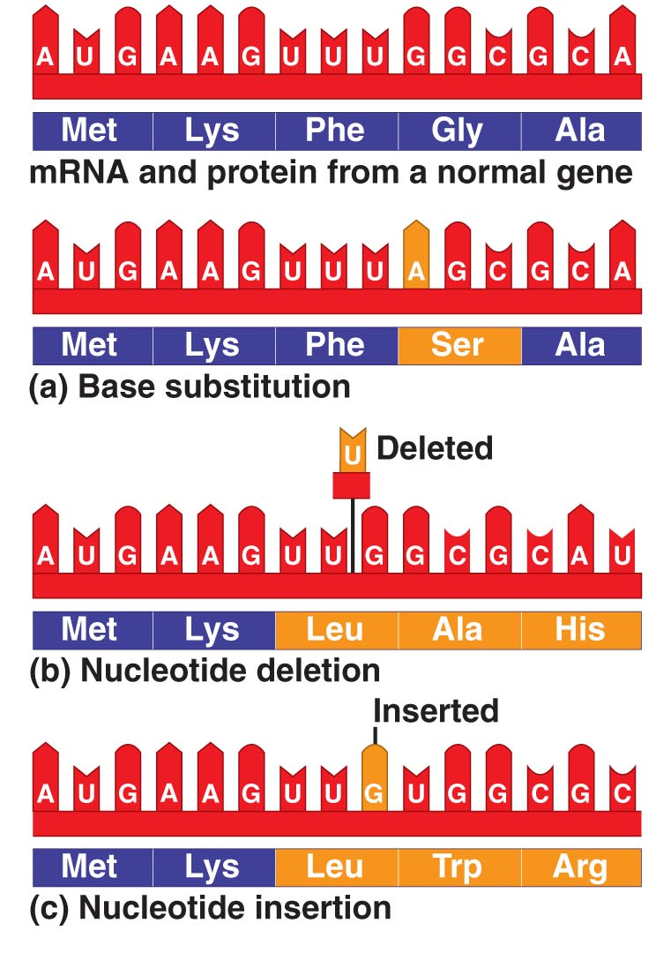
BASIC TYPES
Base substitution – replacement of one base by another
May/not affect protein’s function
Nucleotide deletion – loss of a nucleotide
Nucleotide insertion - addition of a nucleotide
Insertions & deletions change reading frame of code (“frameshift” mutations) → nonfunctional polypeptide → disastrous effects for organism

Slide 6
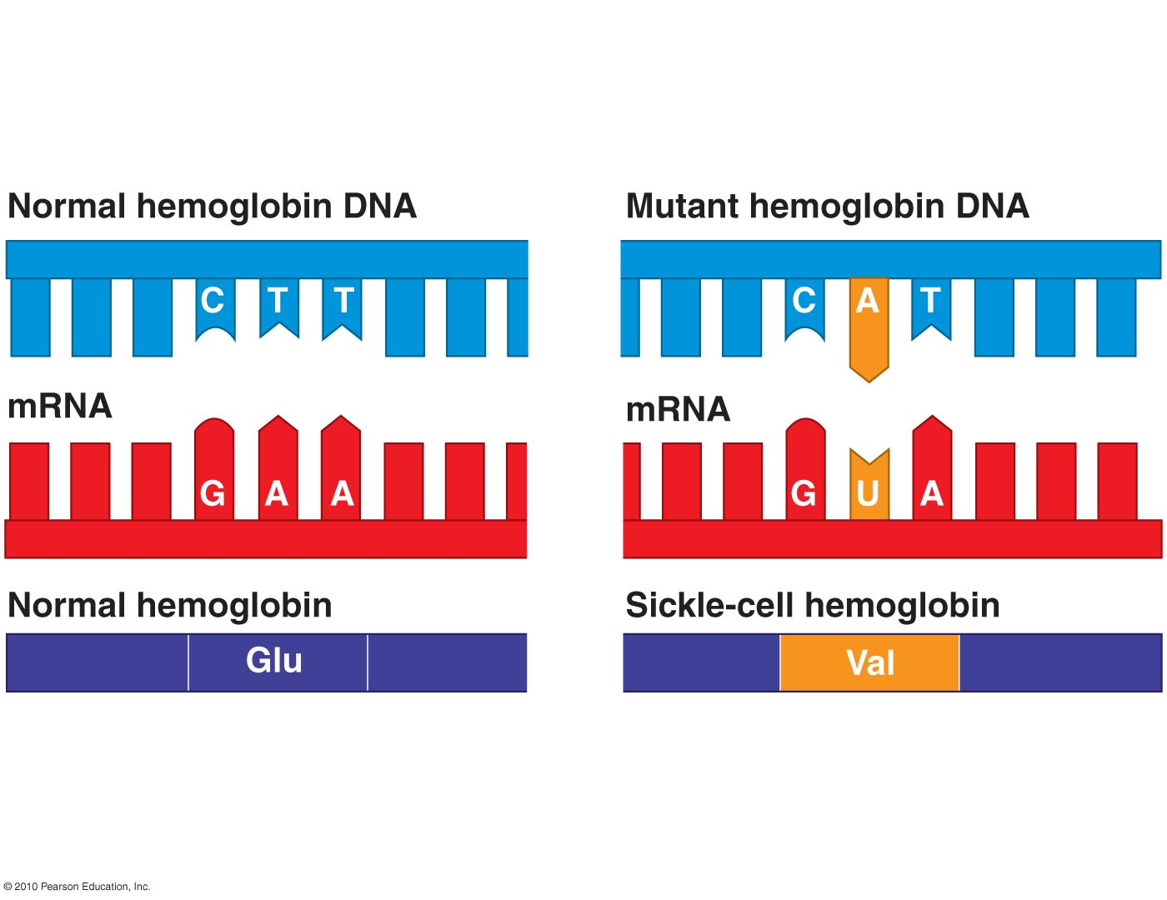
Sickle-cell Anemia
In the gene for hemoglobin (the O₂ carrying molecule in red blood cells), a sickle-cell mutant caused by single nucleotide shift in coding strand of DNA → mRNA codes for Val instead of Glu

Slide 7
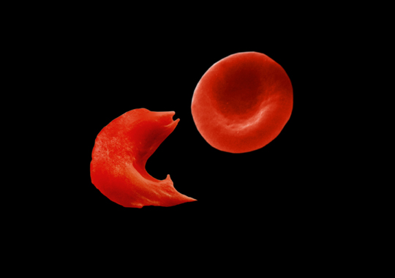
Sickle-shaped deformation of red blood cell on left. http://students.cis.uab.edu/slawrenc/SickleCell.html

Slide 8
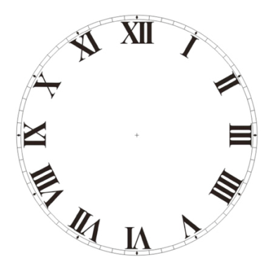
ACTIVITY
Modeling Mutations
15 min.

Slide 9
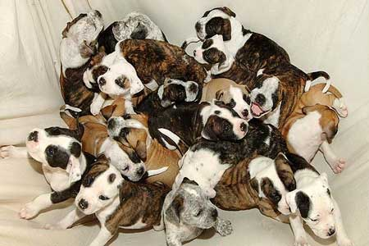
SEX: source of Genetic Variation
Offspring of sexual reproduction are genetically different from their parents and one another
What are the sources of genetic variation?
Chromosome assortment
Random fertilization
Recombination

Slide 10
Independent Assortment of Chromosomes
During metaphase I of meiosis, how each homologous pair of chromosomes align side-by-side is a matter of chance
Every chromosome pair orients independently of the others during meiosis (note: exceptions exist)
We can calculate the total possible chromosome combinations that can appear in the gametes due to independent assortment for any species as 2^{n} (where n = haploid # of chromosomes)
E.g. for a human, n = 23, so 2²³ = 8,388,608 different chromosome combo’s possible in a single gamete!
Let’s consider an example of a species with n = 2 and look at Fig. 8.16…

Slide 11
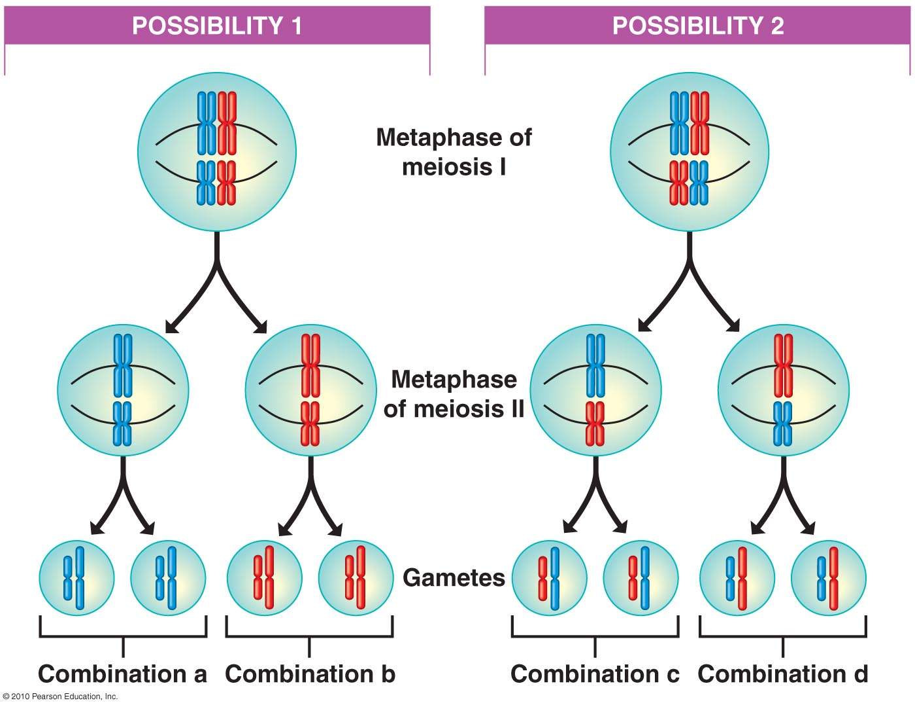

Slide 12
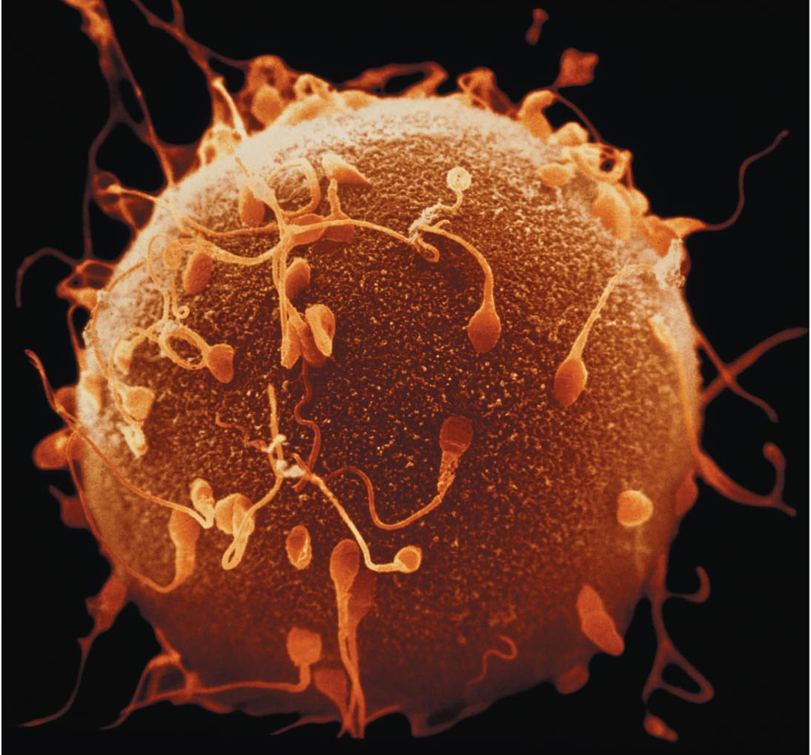
Random Fertilization
E.g. in humans, an egg cell is fertilized randomly by one sperm → genetic variation in the zygote
If ea. gamete represents one of 8,388,608 different chromosome combo’s, then at fertilization, humans would have 8,388,608 x 8,388,608, i.e., > 70 trillion different possible chromosome combo’s!

Slide 13
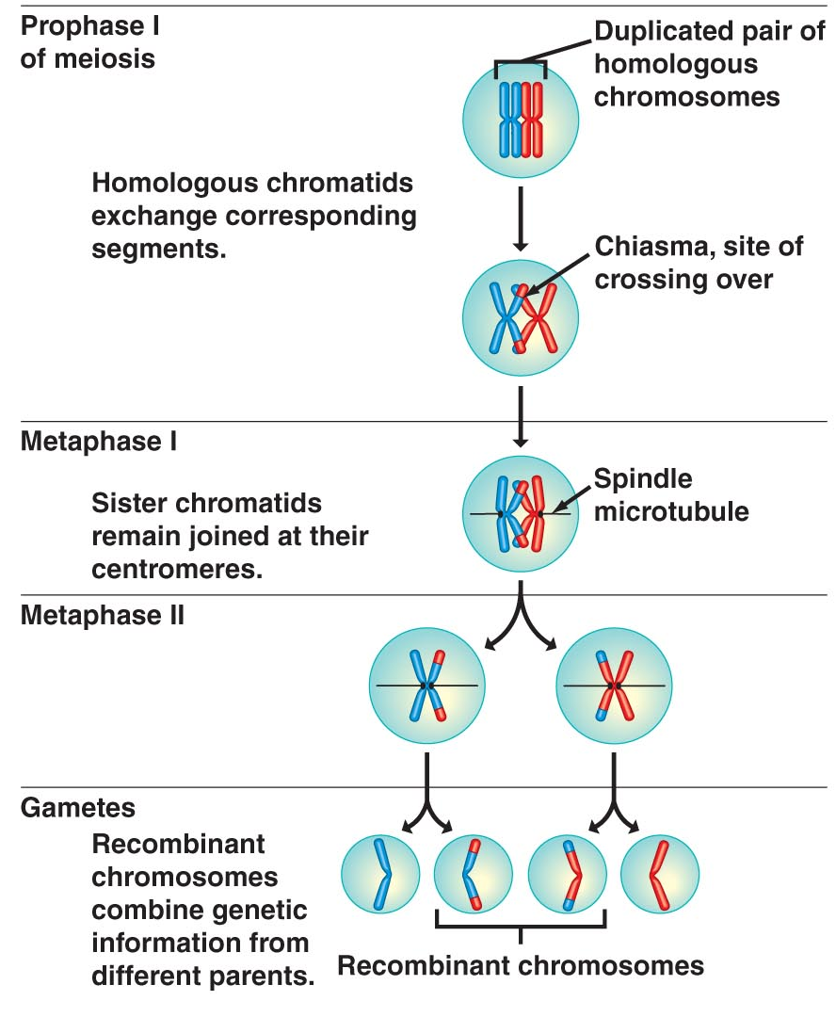
Crossing Over
How genetic recombination occurs
During prophase I, sister chromatids exchange corresponding segments at chiasmata (sites of crossing over)
Result: gene combo’s different from parental chromosomes

Slide 14
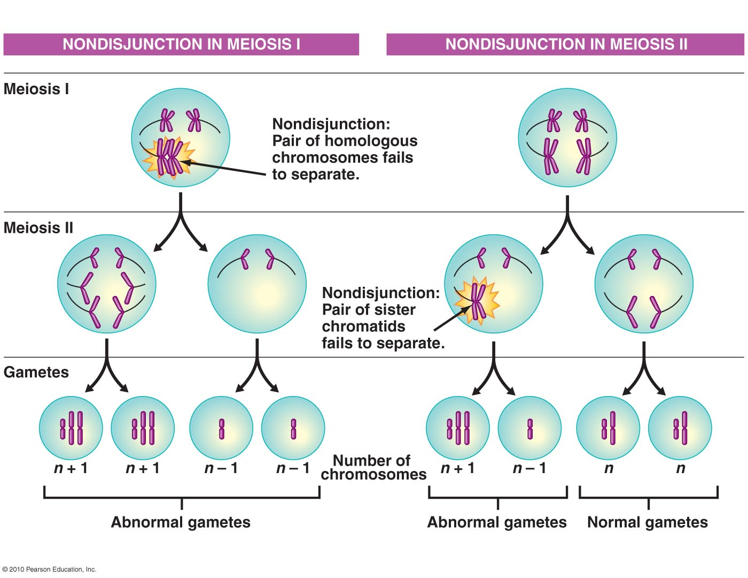
Mistakes in Meiosis
Nondisjunction
Can occur during meiosis I or II
Members of a chromosome pair fail to separate during anaphase → games w/ incorrect chromosome #

Slide 15
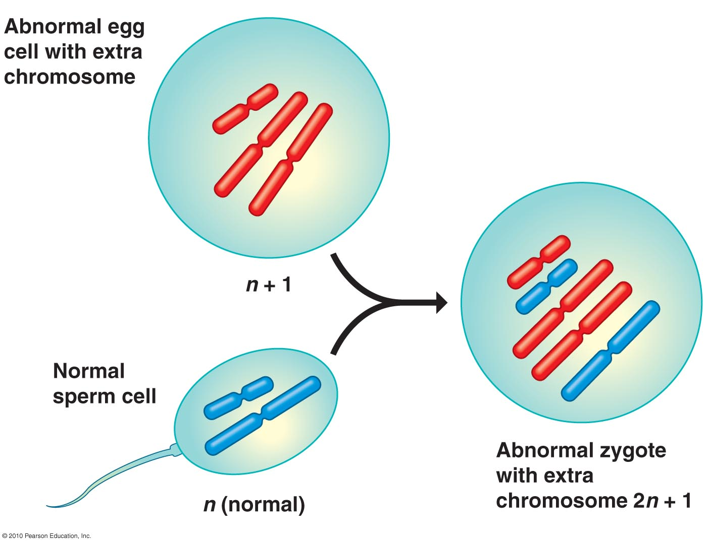
Nondisjunction (cont’d.)
If abnormal gamete joins w/ a normal gamete during fertilization → zygote w/ 2n + 1 chromosomes → abnormal # of genes (if organism survives)

Slide 16
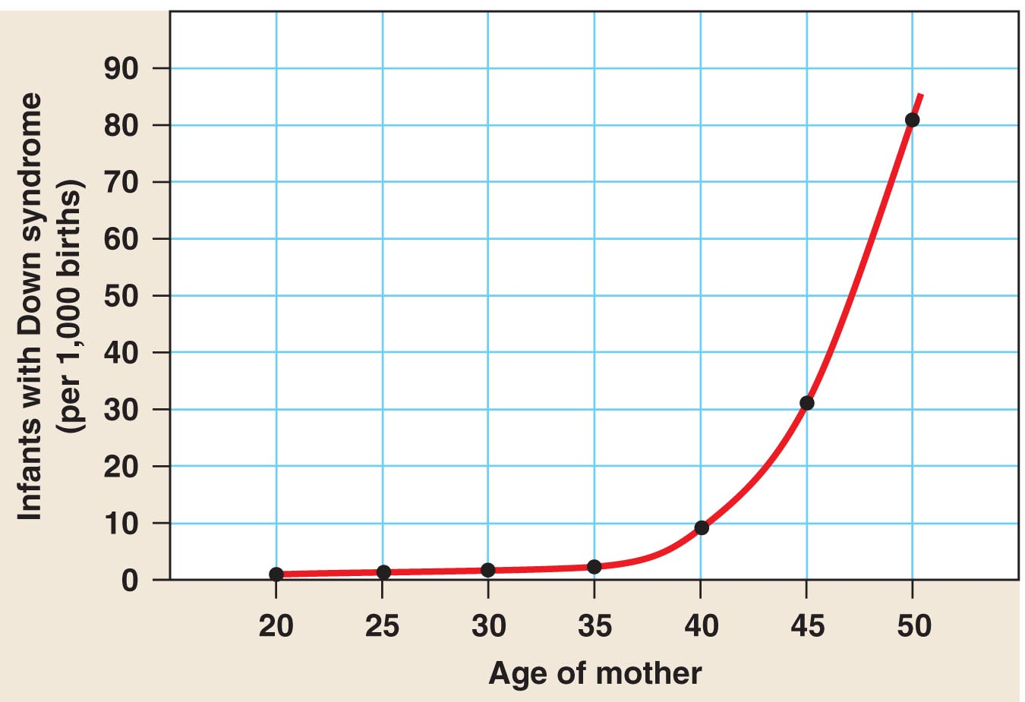
Example of Nondisjunction
Trisomy 21 → Down’s Syndrome
Extra copy of chromosome 21
Occurs in ∼1/700 children
Incidence ↑ w/ age of mother

Slide 17
Asexual Reproduction
Occurs in many taxa
Advantages
Rapid reproduction (rapid ↑ in population size)
No nrg spent in production of eggs, sperm, fertilization
Eliminates need to find a partner
Genetic homogeneity OK in very stable environments
Disadvantages
No genetic variation, potentially disastrous when environmental conditions are changing/unstable…BUT WAIT!!!

Slide 18
No sex?
The measure of the amount of heterozygosity across all genes of a species genome can be used as a general indicator of the amount of genetic variability (thus genetic “health”) of a population.
There is evidence that some asexually reproducing species maintain heterozygosity in some amazing ways!

Slide 19
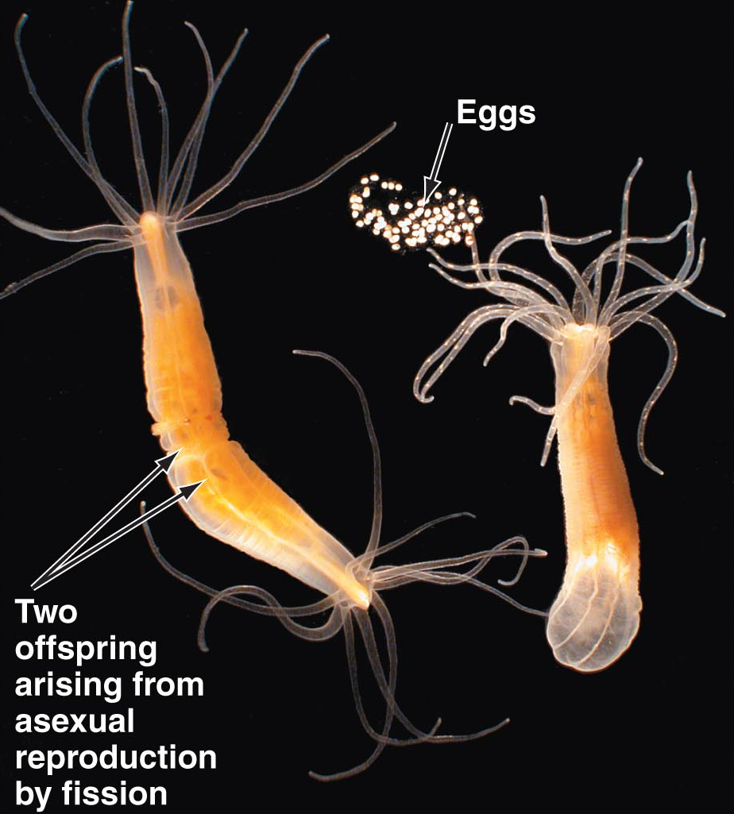
To Have or Have Not?
Some animals are capable of both asexual & sexual reproduction, benefiting from both modes
Asexual mode: ample food supply, favorable environmental conditions
Sexual mode: environmental conditions change, become less favorable/unpredictable
Genetic variation →
↑ capacity for adaptation

Slide 20
parthenogenesis
“parthenos” (virgin) + “genesis” (creation)
Offspring produced asexually (w/out male) from an oocyte
Maintenance of 2N genomic balance via
Fusion of two 1N oocyte polar bodies → 2N zygote
Restricting meiosis to only one division in oocyte → 2N egg
Can be facultative (cyclical) or obligate (strictly asexual, lack males)

Slide 21
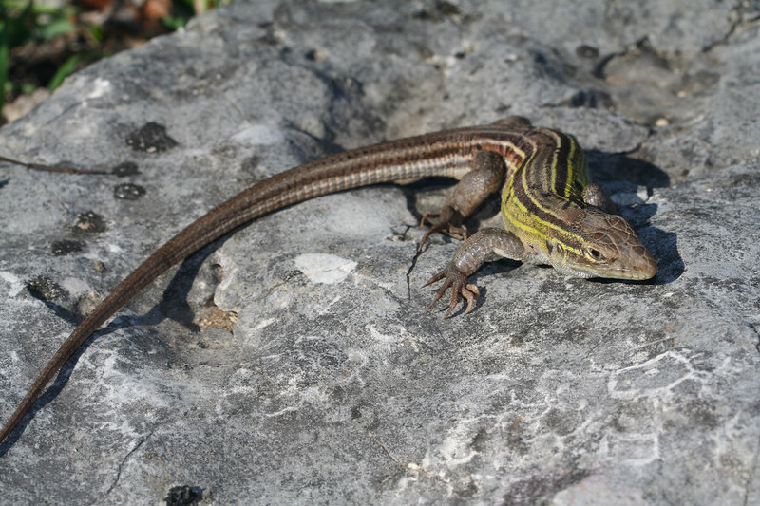
Obligate parthenogen: whiptail lizard
Lutes et al. (2010). Nature 464(7286): 283-286.
No males, maintain stable diploidy & heterozygosity
Mechanisms
Chromosomes originally from hybridization of two sexual spp
Bivalent chromosomes of meiosis form only between sister chromatids from one of the parent species (suppression of homologous chromosome pairing to retain heterozygosity)
Diploidy maintained by DNA endoreplication cycle in oocyte – cells increase DNA content without dividing – enter meiosis w/ 2x amount of DNA
Aspedoscelis

Slide 22
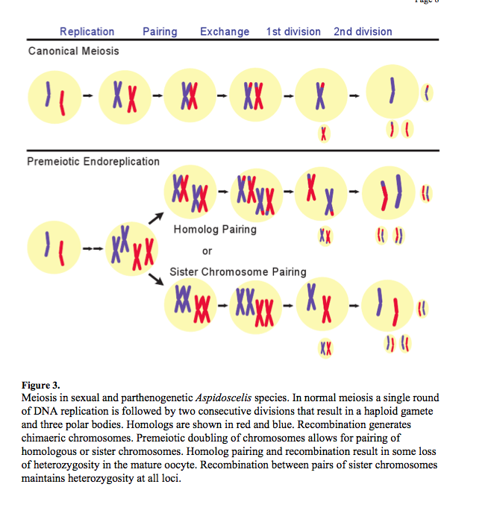
Lutes et al. (2010). Nature 464(7286): 283-286

Slide 23
Beyond Mendel’s Laws
More the norm than the exception
Some examples
Incomplete dominance
Codominance
Pleiotropy
Polygenic inheritance
Sex-linked inheritance

Slide 24
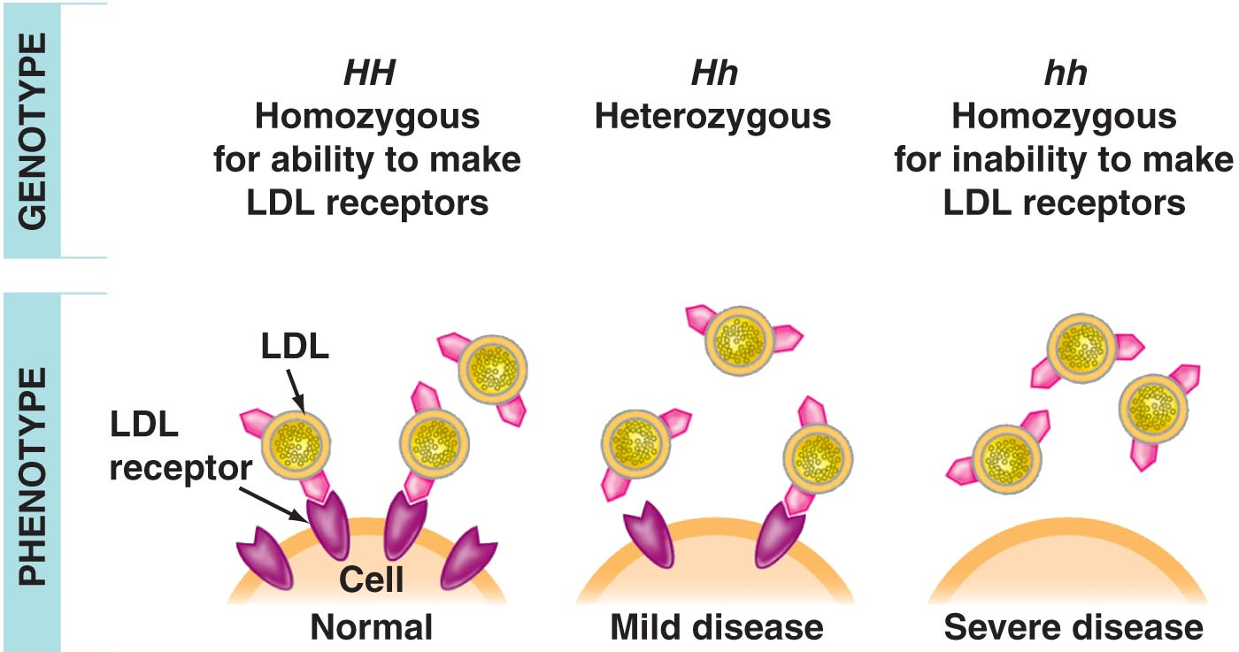
Incomplete Dominance
F₁ hybrids of a homozygous cross (dominant + recessive) have phenotypes in between parents, e.g.
pink color in
snapdragons
Hypercholesterolemia
in humans

Slide 25
Multiple Alleles & Codominance
Many genes exist as multiple alleles in a population (keep in mind that an individual will only carry up to two alleles for a particular gene), e.g. human ABO blood groups (Fig. 9.20)
I^{A} & I^{B} alleles exhibit codominance – both alleles expressed in heterozygotes

Slide 26
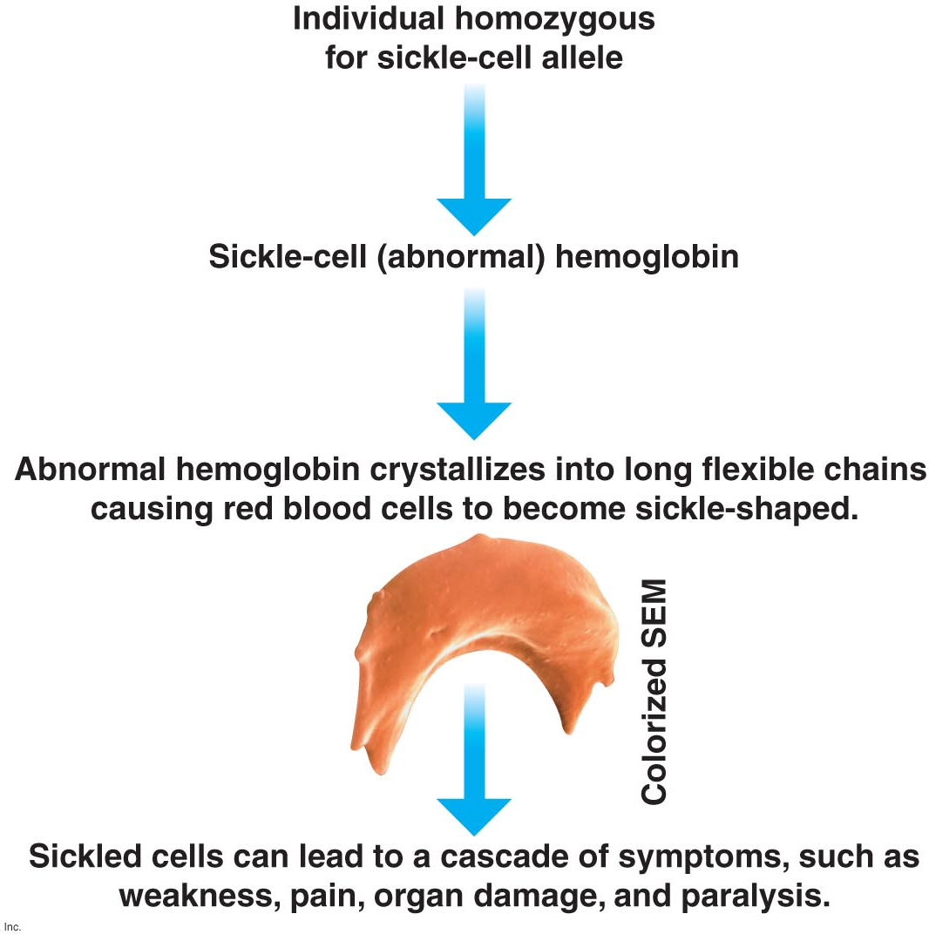
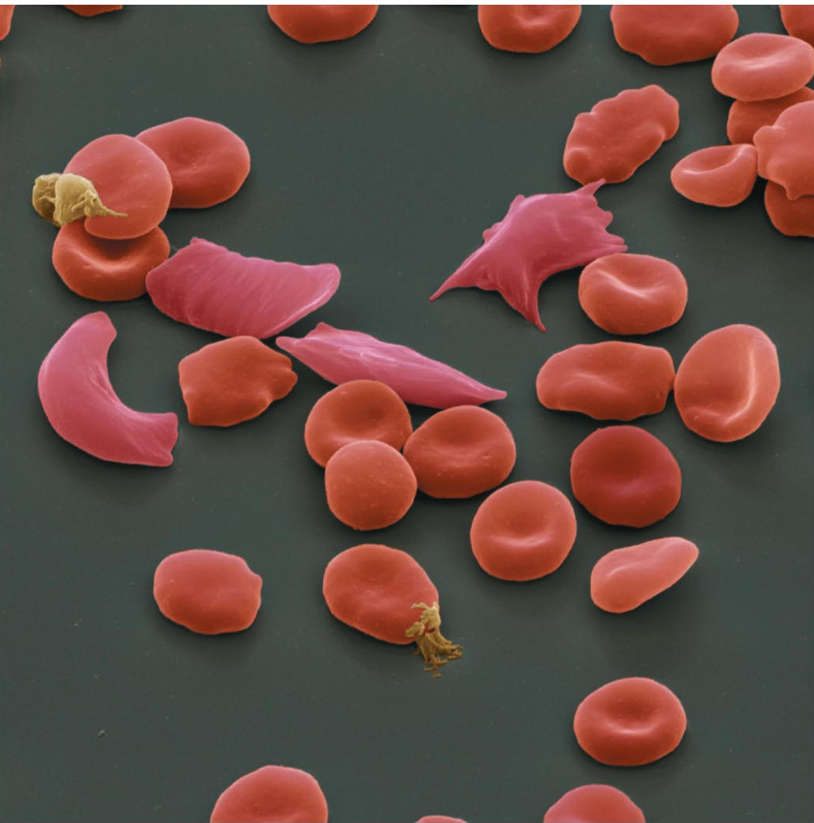
Pleiotropy
Impact of a single gene on more than one trait, e.g. sickle-cell disease
Notes:
Recall that this disease caused by a single nucleotide substitution → change in one aa in Hb protein sequence

Slide 27
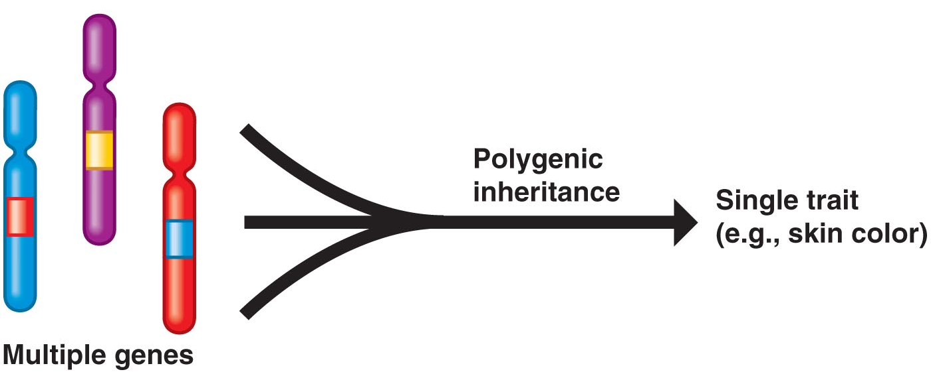
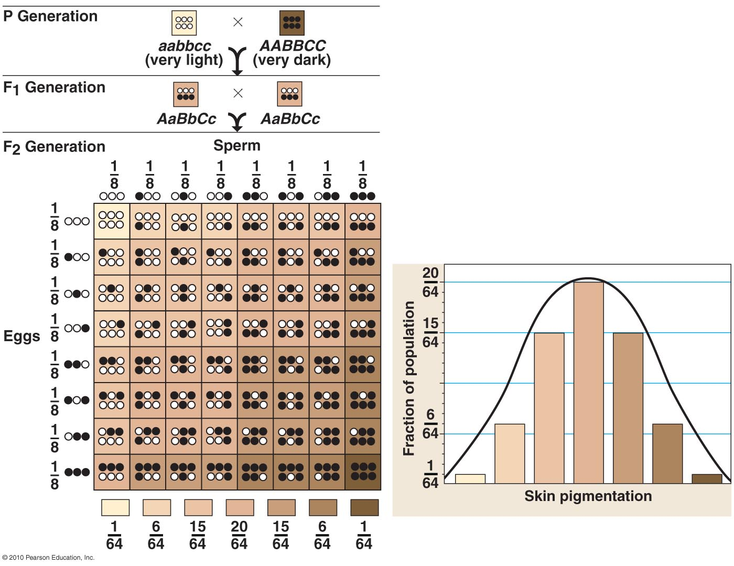
Polygenic Inheritance
Additive effects of two or more genes on a single phenotype, e.g. skin color in humans

Slide 28
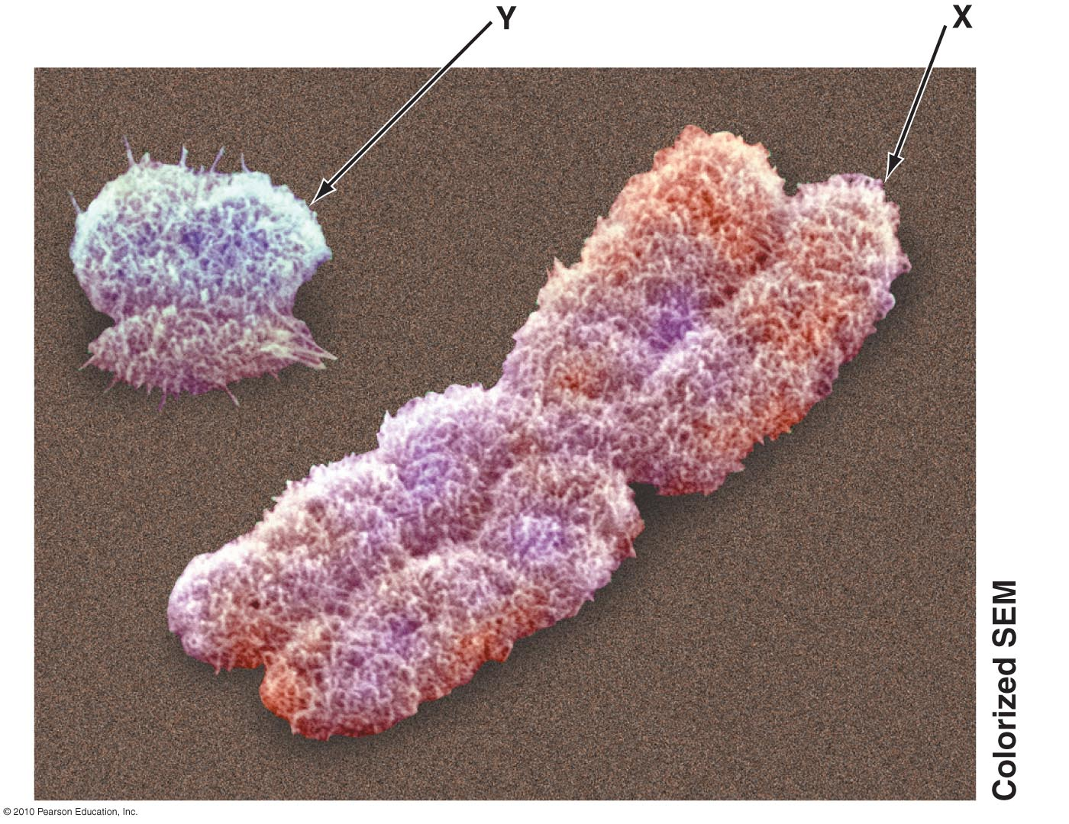
Sex-linked Genes
Sex chromosomes influence inheritance of certain traits
In humans, males are XY & females are XX
Sex-linked gene - any gene located on a sex chromosome
Most are found on X chromosome
Red-green color blindness is common human sex-linked disorder

Slide 29
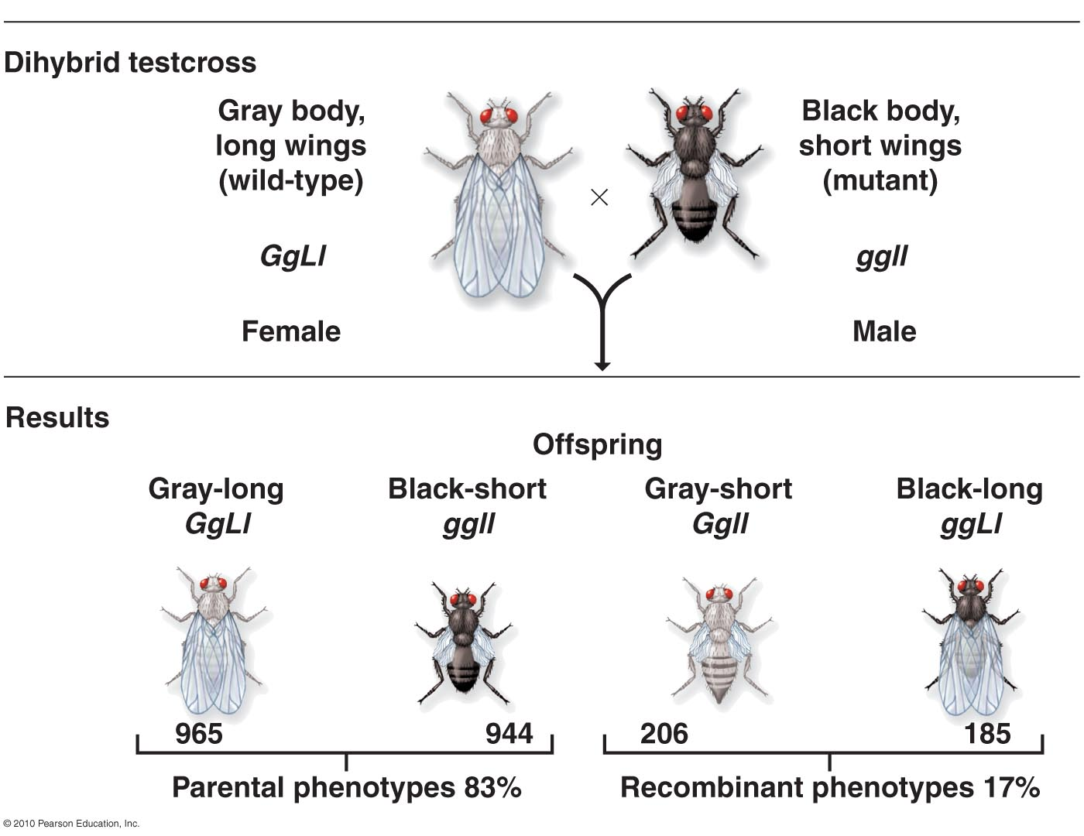
Extension of Mendel’s Work
Linked genes
Located in close proximity on a chromosome
Inherited as a set, thus do not follow Mendel’s law of independent assortment
First discovered by Thomas Morgan in early 1900’s – a dihybrid cross of GgLl x ggll fruit flies yielded unexpected frequencies of phenotypes (genotypes)
Genes for body color & wing shape were linked (i.e., G w/ L & g w/ l) so inherited together
Meiosis → gametes w/ only two genotypes, GL & gl

