Slide 1
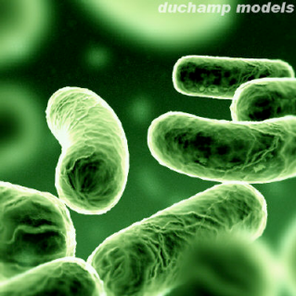

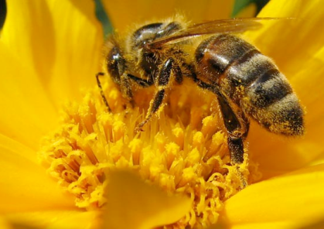
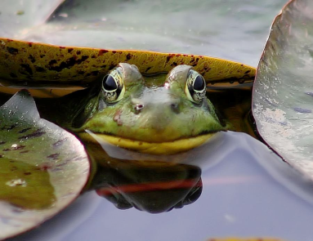
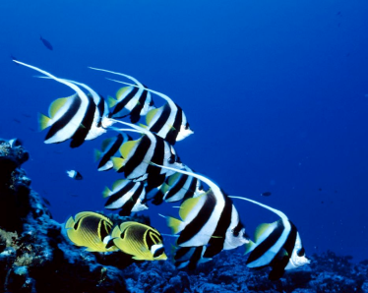
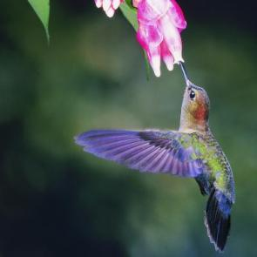




Evolution & climate change
IMSS BIOLOGY ~ SUMMER 2012

Slide 2
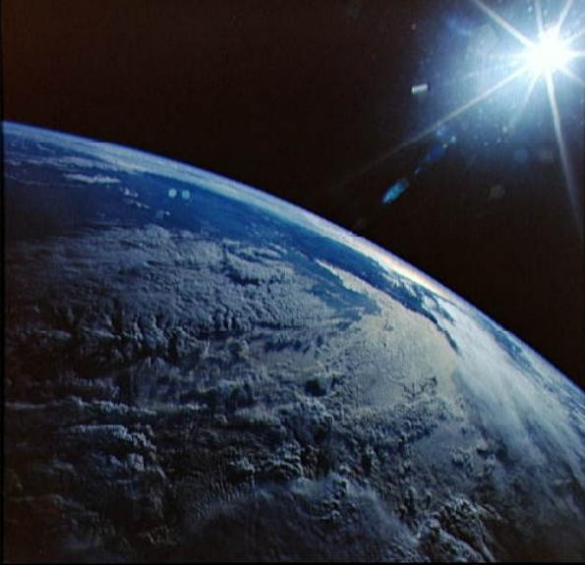

Anthropogenic Origin
Prevailing evidence suggests unprecedented rates of global climate change (GCC) due to human activities
Video clip from NASA (2009)
  http://climate.nasa.gov/warmingworld/
nasa.gov
Notes:
Don’t forget l

Slide 3
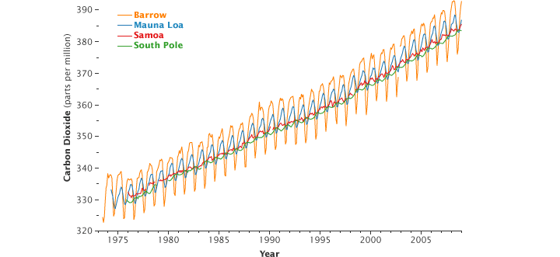
Many Lines of Evidence in Consensus
Direct sampling of atmospheric CO₂ levels from four stations around the world all show unprecedented, accelerated rise in CO₂.
These data are in agreement with samples taken from ice cores collected at several sites in the Antarctic.
earthobservatory.nasa.gov

Slide 4
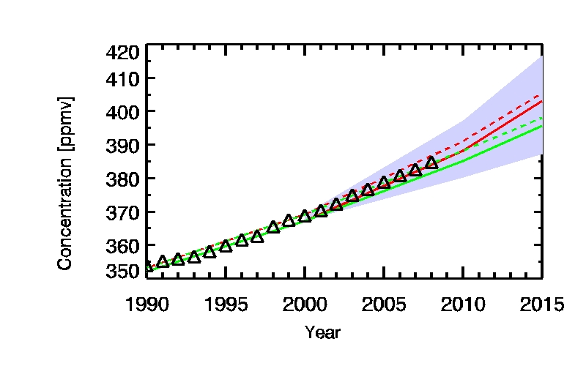
http://www.ipcc-data.org/ddc_co2.html
In 2008, global CO₂ emissions were found to have risen 9.9 x 10⁹ tons, 35% higher than predicted back in 1990.
Depending on “emission scenario,” atmospheric CO₂ levels could reach nearly 700 ppm by 2100
  Current level as of June 2013 = 398.58 ppm
  http://co2now.org/

Slide 5
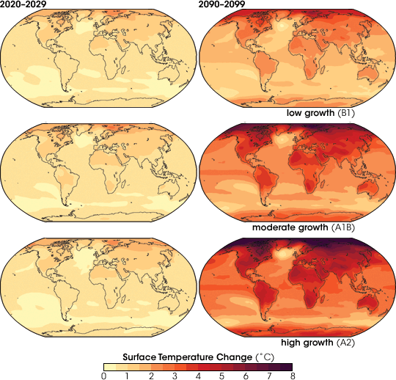
NASA’s Earth Observatory http://earthobservatory.nasa.gov/GlobalMaps/
http://www.youtube.com/watch?v=a2NLxlG4VsA&feature=related

Slide 6
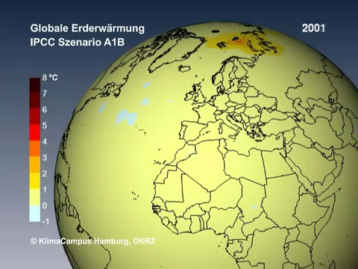

Slide 7
Climate Warming Predictions
Over past 100 yrs., global mean T has ↑ ∼0.6°C
IPCC (Intergovernmental Panel on Climate Change) 2007 AR4 (4th Assessment Report) provides projections for 2100 http://www.ipcc.ch/index.htm
  AR5 (5th Assessment Report) currently in final stages
Mean surface temperature likely to ↑ 2 - 11.5°F (1.1 - 6.4°C) depending on emission scenario
Warming will be unevenly distributed in space
  Land areas will warm more than oceans in part due to water's ability to store heat.
  Hi latitudes will warm more than low latitudes in part due to positive feedback effects from melting ice.
Warming will differ by seasons with winters warming more than summers in most places

Slide 8
Will populations be able to survive to reproduce in a rapidly changing environments?
  In 21st C., avg. rate of warming very likely to be more than 2x as fast as in 20th C.
  More than 50% of all extant species will be extirpated or extinct by the end of 21st C.
What biological evidence do we have that GCC has already impacted species?

Slide 9
IPCC AR4 (2007)
  Assess extent to which recent observed changes in natural biological systems have been caused by climate change
    Significant impact of global warming is discernable in animal & plant populations
    More than 89% (25,810) accounts of biological changes have occurred in direction predicted in response to GCC
      Most of these changes are phenological…

Slide 10
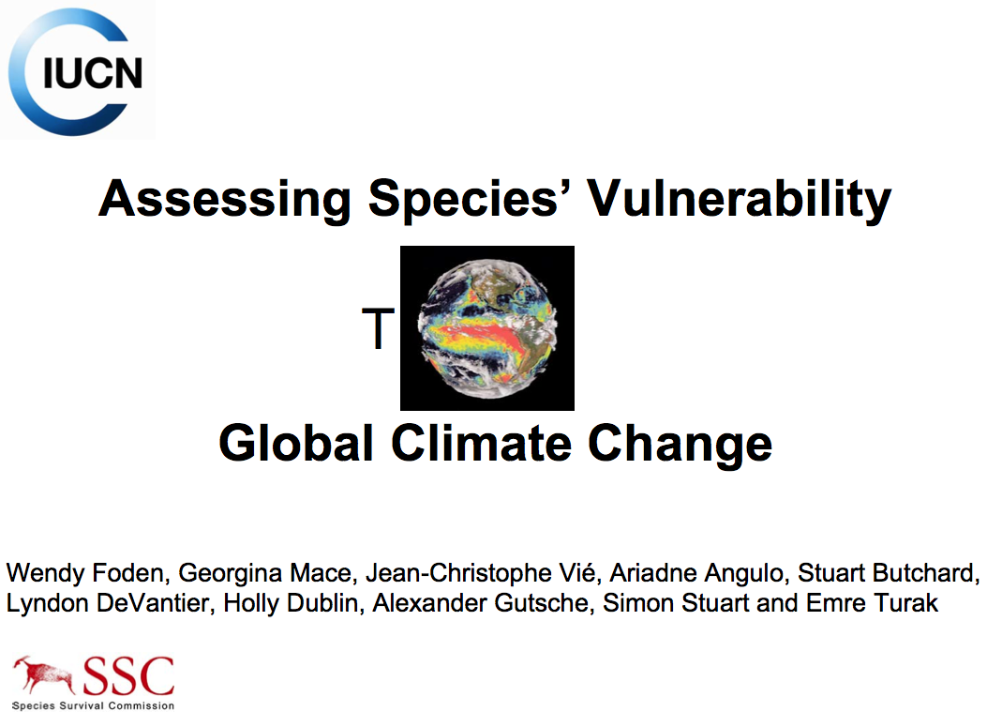
International Union for Conservation Nature (IUCN)
http://www.iucn.org/

Slide 11
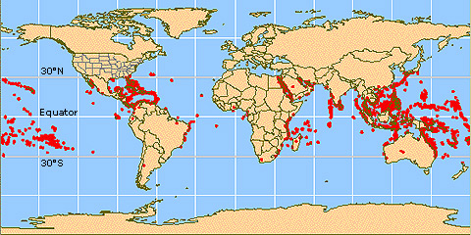
The IUCN has collected data related to these biological traits for the world’s
  birds (9,856 spp): 35% spp susceptible
  amphibians (6,222 spp): 52% susceptible
  warm-water reef-building corals (799 spp): 71% susceptible
Keep in mind that amphibians do not occur at hi (polar) latitudes, and global distribution of coral reefs typically occurs within tropical and subtropical waters between 30°N & 30°S latitudes.

Slide 12
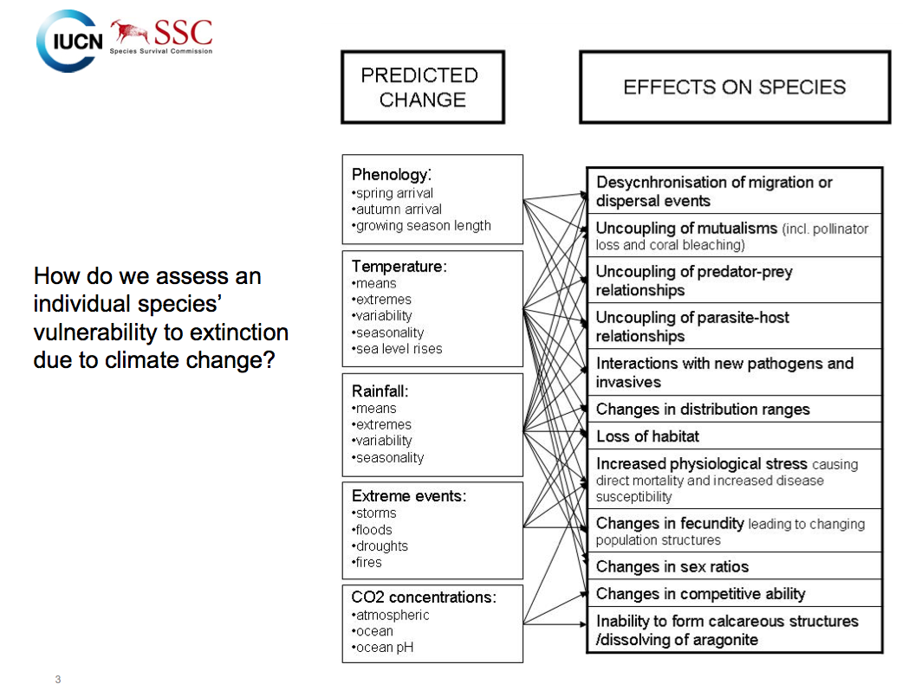

Slide 13
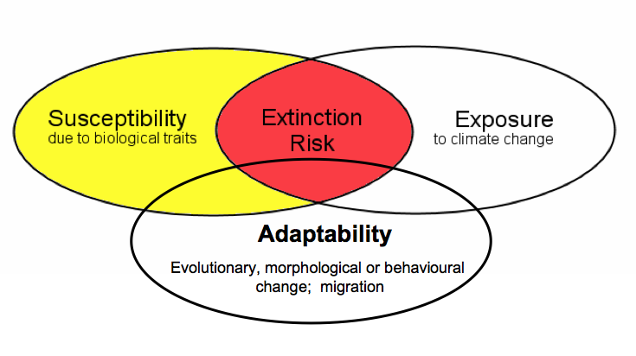
Increased risk of extinction due to climate change occurs where
species possess biological traits or characteristics that make them particularly susceptible to environmental change (SUSCEPTIBILITY)
climatic changes are most extreme (EXPOSURE)
species have reduced capacities to “adapt” to keep pace with climate change (ADAPTABILITY)

Slide 14
Climate Change Susceptibility Traits
Biological traits that make species most susceptible to climate change
  Specialized habitat and/or microhabitat requirements
  Narrow environmental tolerances or thresholds that are likely to be exceeded due to climate change at any stage in the life cycle
  Dependence on specific environmental triggers or cues that are likely to be disrupted by climate change
  Dependence on interspecific interactions which are likely to be disrupted by climate change
  Poor ability or limited opportunity to disperse to or colonize a new or more suitable range

Slide 15
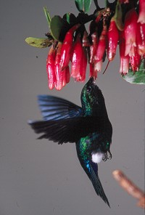
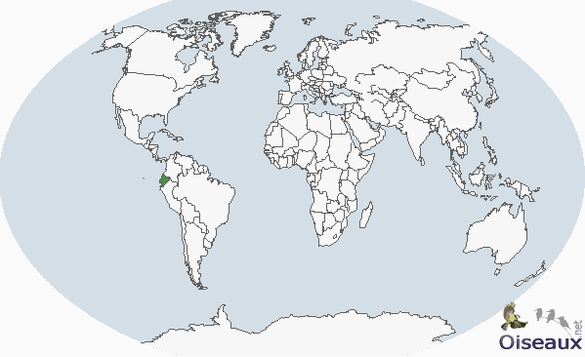
Black-breasted Puffleg (Eriocnemis nigrivestis) is both critically endangered (IUCN Red List) and climate change susceptible based on a combination of biological traits
  Highly restricted to a climate-change susceptible habitat (high montane rainforest) in northwest Ecuador
  A narrow and high altitude range
  Very short dispersal distances
  Extremely small population size
  Deforestation also contributing to ongoing declines

Slide 16
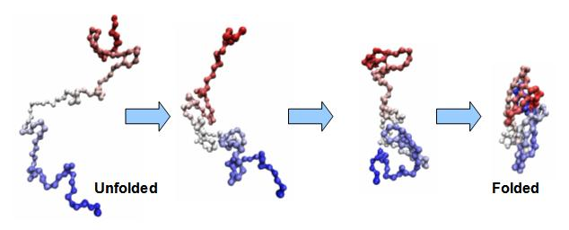
Narrow Environmental Tolerances
Physiology & ecology of many species tightly coupled to very specific ranges of climatic variables, e.g. temperature, precipitation, pH/CO₂ levels,
Spp with narrow tolerance ranges are particularly vulnerable to climate change
Even spp with broad environmental tolerances & unspecialized habitat requirements may already be close to thresholds beyond which ecology or physiological function quickly breaks down, e.g.
  Photosynthesis in plants
  Protein/enzyme function in animals
    All enzymes are proteins whose functionality is based on proper 3D structure, which requires proper folding

Slide 17
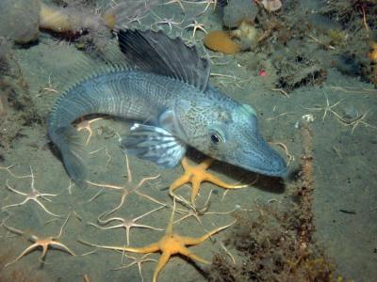
Genetic Variation
The larger the gene pool, the more genetic variation, and the lower the risk of extinction.
Thus, larger populations are less vulnerable, but must consider that other factors may be involved (e.g. how specialized the spp is, etc.).
One example of species particularly at risk for a number of reasons = Antarctic ice fishes (Notothenoids).
  This group has evolved in extremely cold & thermally stable waters with hi levels of dissolved O₂ for ca. 14 million years.
  Exhibit DNA decay – loss of protein-coding genes & temperature-responsive gene regulatory abilities → loss of heat-shock response.
    This has also been discovered in a number of Antarctic invertebrate species
Oceanic warming will
  reduce O₂ concentration in seawater & body fluid
  increase rates of O₂ consumption in the fishes
Many Antarctic ectotherms show behavioral impairment at 1- 3°C and upper lethal temp is commonly below 5-6°C

Slide 18
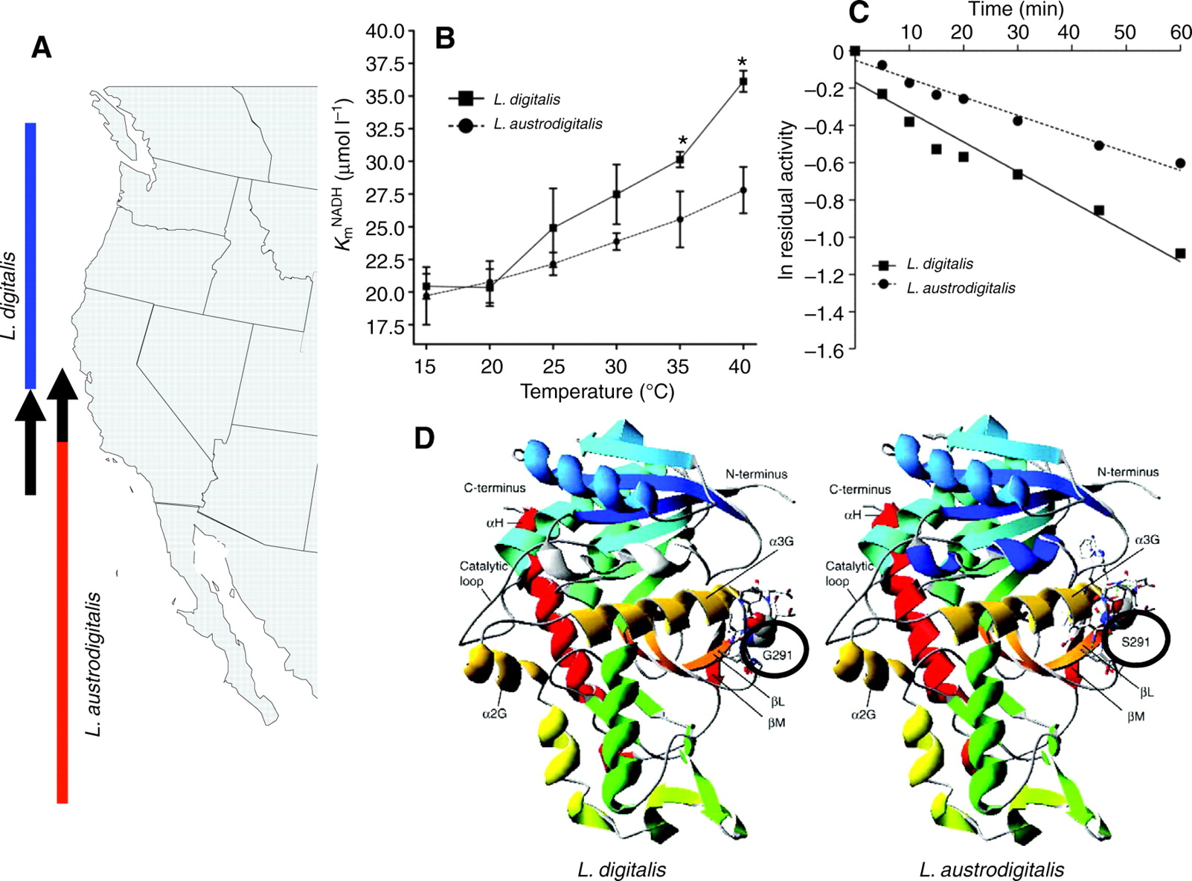
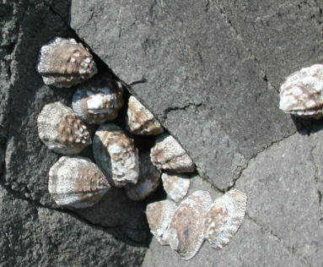
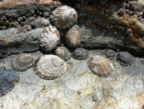

How much genetic change is needed?
There are a few examples in which a single amino acid substitution in a protein sequence can lead to temperature-adaptive modifications of protein kinetics
  The northward range extension of warm-adapted limpet Lottia austrodigitalis and contraction of the southern limit of a cold-adapted congener L. digitalis is marked by adaptive variations in a specific enzyme’s function & stability resulted from a single amino acid substitution
Notes:
Somero, G. N. J Exp Biol 2010;213:912-920

Slide 19
Phenology
  Study of recurring biological events and their relationship to climate, e.g. migration, breeding, flowering
  Linked to seasonal patterns, particularly in temperate regions
FYI: USA National Phenology Network
  Network of citizen scientists, government agencies, non-profits, educators, & students of all ages to monitor, collect, & share info on the impacts of climate change on plants & animals in the U.S., providing researchers with far more data than they can collect alone. http://www.usanpn.org/

Slide 20
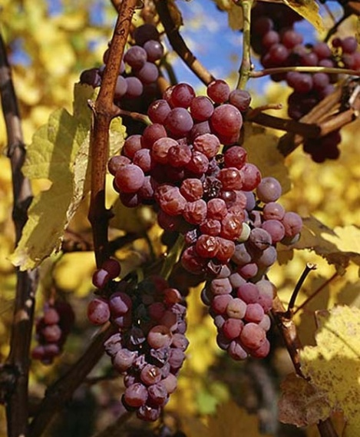
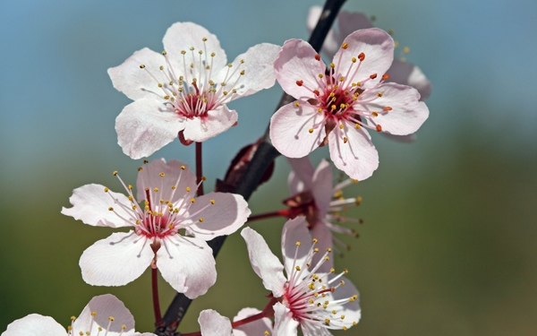
Examples of Historical Spring Indicators
Europe
  Domesticated food crop species senstive to climate, e.g. wine grapes
    Meticulous records of wine grape phenology kept for many centuries
    In western Europe, records for grape harvest time kept for over 500 yrs.; earliest season first recorded in 2003
Japan
  Records for cherry blossoms began in 1400
  Onset of bloom significantly advanced after 1900, tracking acceleration in use of fossil fuels

Slide 21
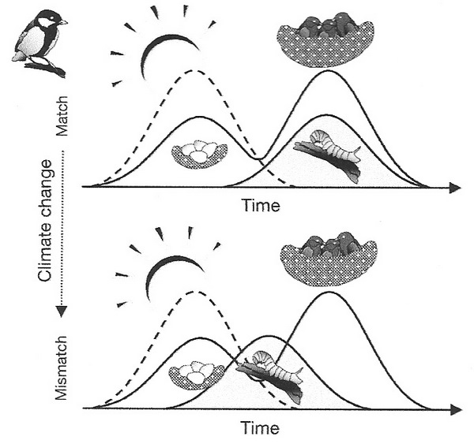
Notes:
http://people.eku.edu/ritchisong/migration.htm

Slide 22
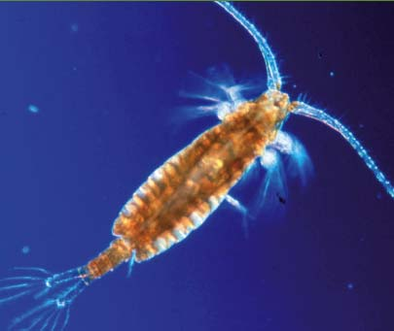
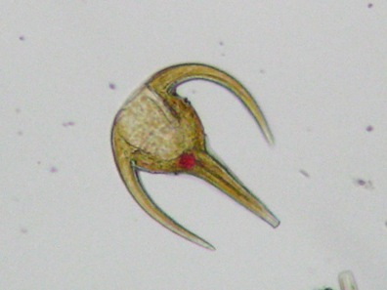
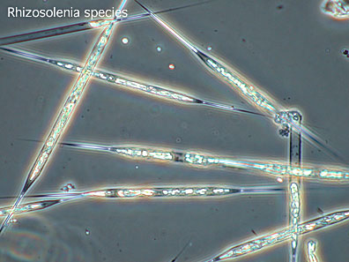
Marine Food Webs
Sea surface T’s warms earlier & sea ice breaks up earlier
Most profound effect in plankton abundance & distribution in time & space → repercussions up food web
  Phytoplankton bloom earlier, and zooplankton feeding on them may not change timing in peak abundance
  E.g. Over past 45 yrs., N. Atlantic copepod (Calanus finmarchicus) shifted peak abundance 11 d earlier, far less than its food sources, diatom Rhizosolenia alata (33 d earlier) & dingoflagellate Ceratium tripos (27 d earlier)
    www.seaturtle.org/PDF/Hays_2005_TrendEcolEvol.pdf
  Implication: Disruption in synchrony between trophic levels can have severe implications for energy flow to higher trophic levels
Calanus
Ceratium
http://oceandatacenter.ucsc.edu/PhytoGallery/

Slide 23
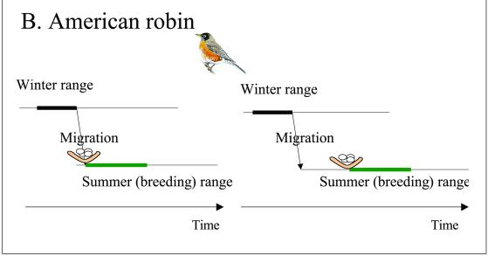
Laying date remains unchanged (photoperiod-dependent), but migration occurs earlier (T-dependent)
  Repercussion: arrival to breeding grounds too early → greatly reduced ability to feed & maintain pre-laying body condition

Slide 24
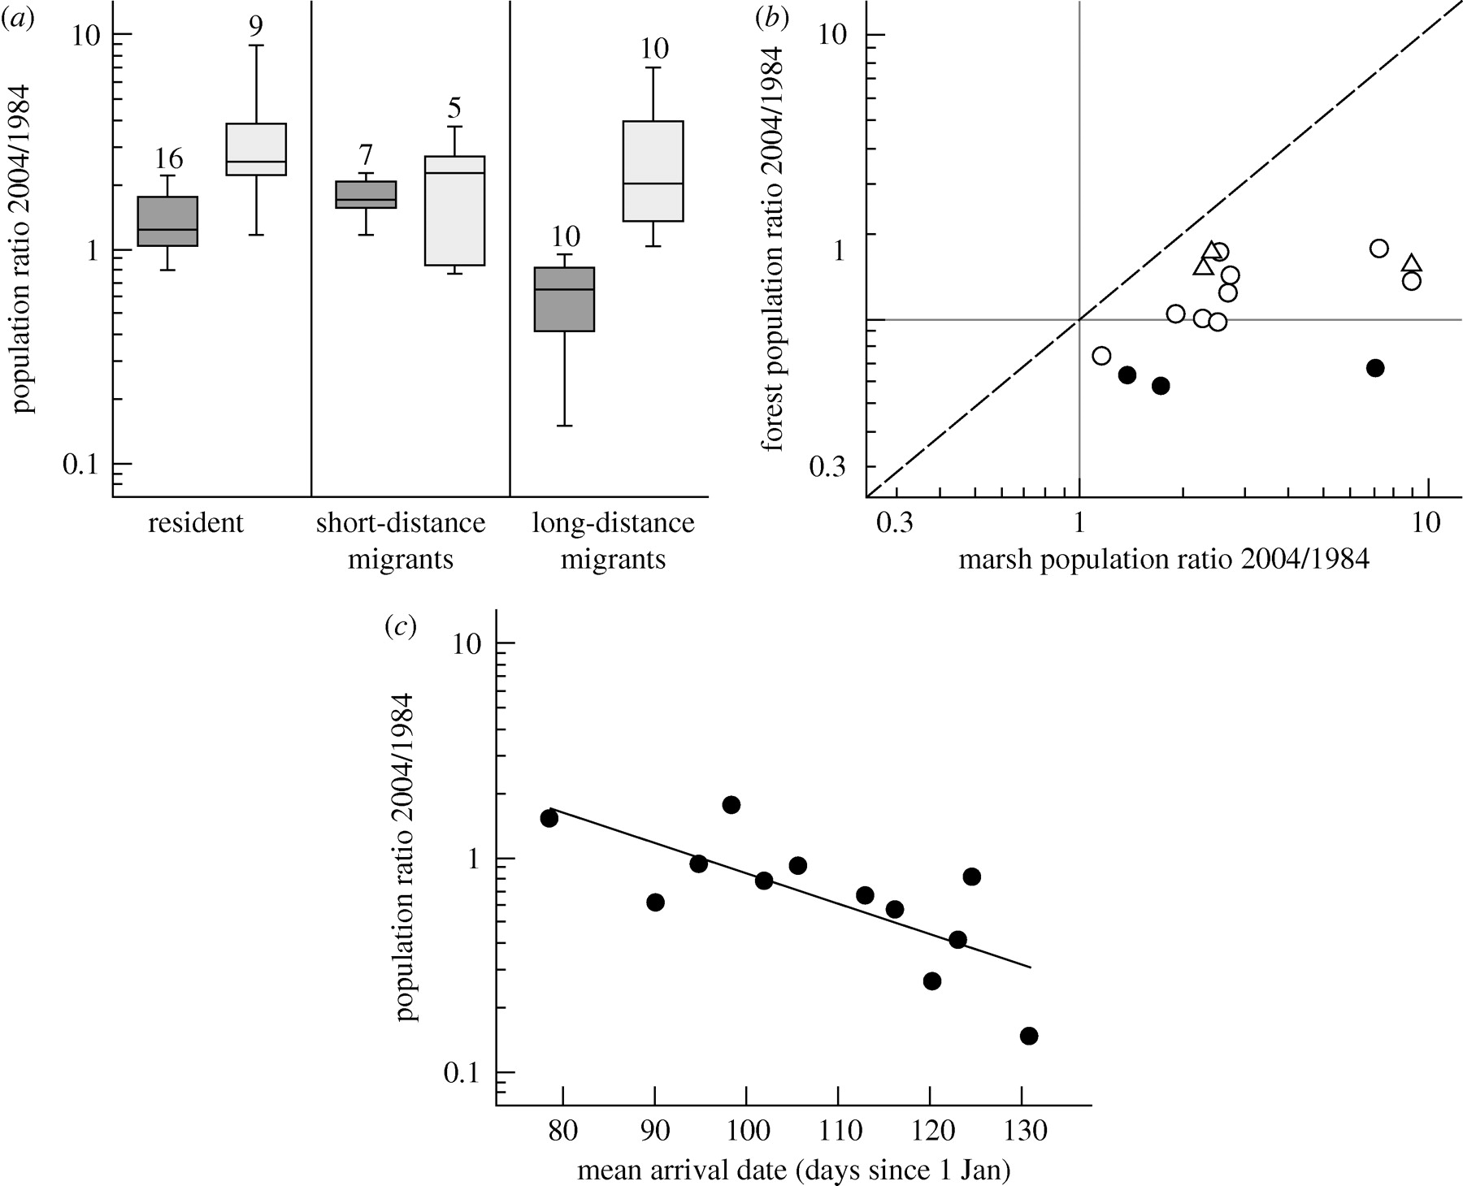
Long-distance Migrants
Departure from wintering grounds typically inflexible (tied to photoperiod)
The greater the distance migrated, the greater chance one or more aspects of annual cycle may become mistimed with local climate & food supplies on the breeding grounds
E.g. the Netherlands
  Significant declines in long-distance migrant bird species in 15 spp of seasonal forest-breeding passerines
  Hardest hit in areas with greatest
  amt. of spring warming & narrower
  windows of peak food abundances
  - Later arriving species declined the most
Both et al. 2010. Proc. R. Soc. B 277: 1259-66.

Slide 25
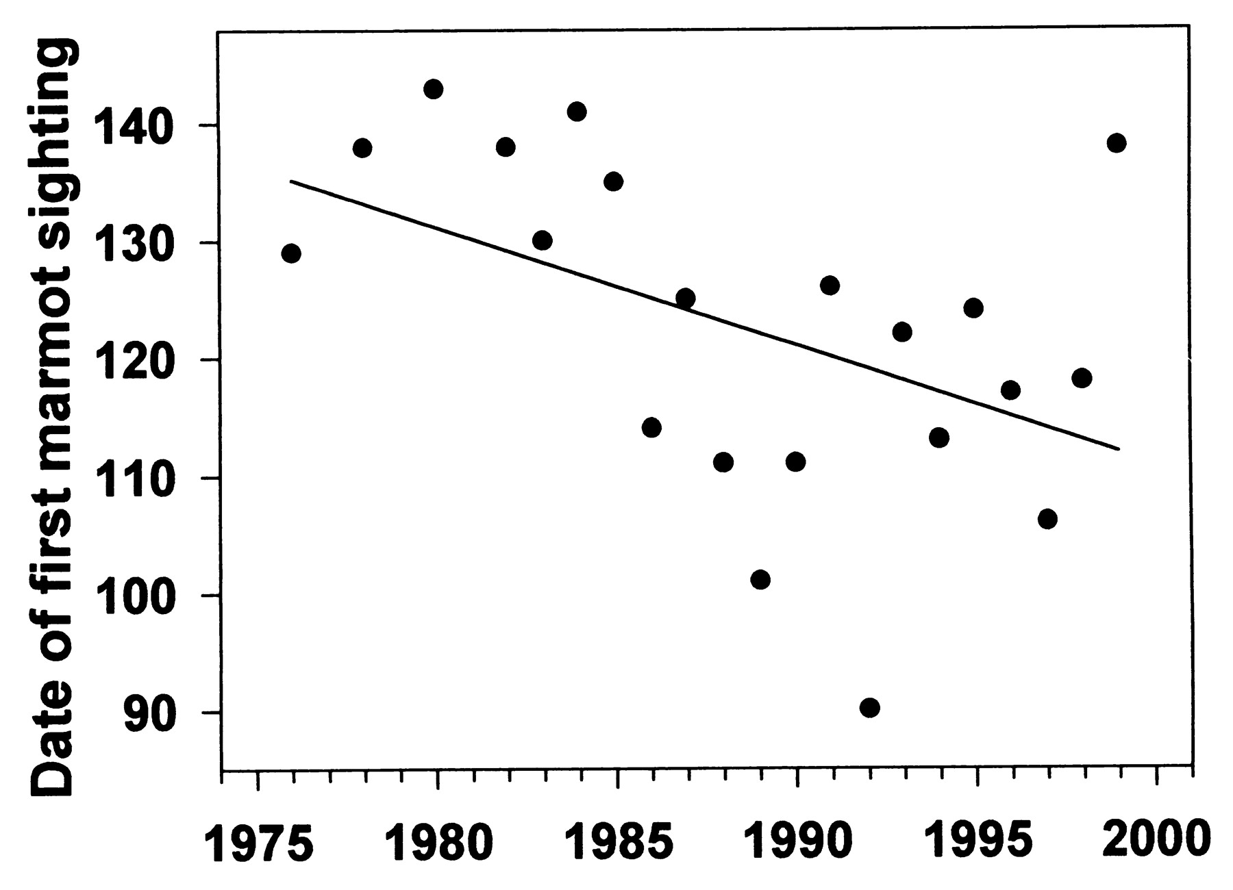
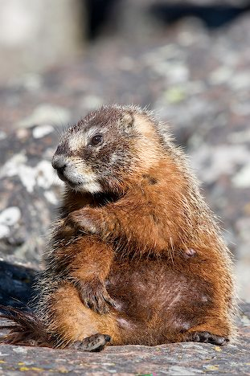
Hibernators
Mismatch between phenology of emergence and onset of spring
  E.g. Yellow-bellied Marmot emerge from hibernation 38 d earlier than 23 yrs. ago due to warmer spring air T’s → 23 d mismatch between emergence & food plant availability
Inouye D W et al. 2000. PNAS 97: 1630-1633
http://www.pnas.org/content/97/4/1630.full

Slide 26
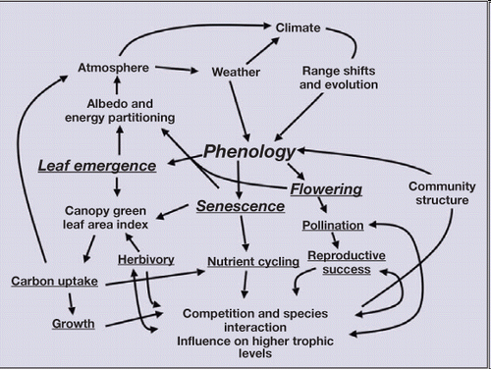
The Impact of Phenology
Morisette et al. 2009. Frontiers in Ecology and the Environment 5(7):253-260

Slide 27

Oceans
Two major categories of physical/chemical changes that have extensive biological impact
Increase in heat content
  Sea level rise
  Loss of sea ice
  Weakening of currents
  Intensification of storm systems
  Increase in atmospheric CO₂
    Acidification
    Hypercapnea

Slide 28

Increase in Atmospheric CO₂
Increase in ocean acidification
Notes:
http://www.springerlink.com/content/085g2151l3nlt871/

Slide 29
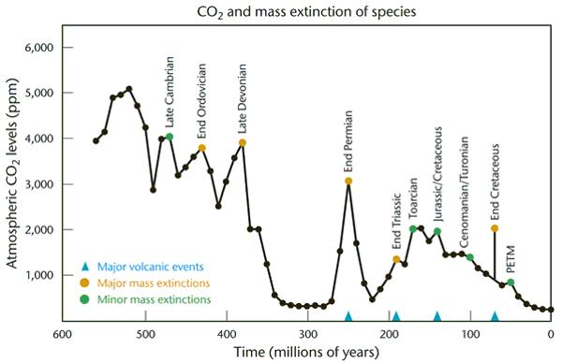
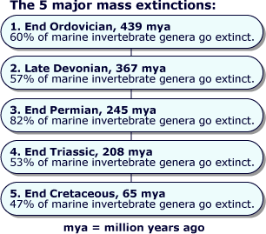
CO₂ and Mass Extinction
Mass extinction events have been characterized by high CO₂ levels throughout Earth’s history
  Detrimental role of ↑ oceanic CO₂ levels likely contributed to Permian mass extinction 250 mya (95% of all marine spp extinct)

Slide 30
A Sixth Mass Extinction?
“The prospect of ocean acidification is potentially the most serious of all predicted outcomes of anthropogenic carbon dioxide increase. This study concludes that acidification has the potential to trigger a sixth mass extinction event and to do so independently of anthropogenic extinctions that are currently taking place.”
  J.E.N. Veron. 2008. Coral Reefs 27: 459-472.
Watch video on ocean acidification (as part of BBC’s “Death of the Oceans”) at http://www.youtube.com/watch?v=nKPNcQyljds&feature=player_embedded#at=19
Notes:
http://www.springerlink.com/content/085g2151l3nlt871/

Slide 31
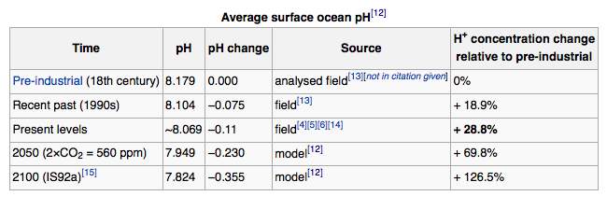

Slide 32
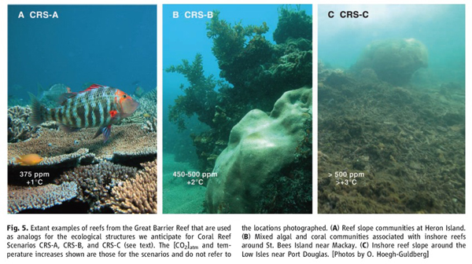
↑ CO₂ levels → ↓ pH of oceans (also, soil & FW) →
  ↓ [calcium carbonate] → ↓ calcification of marine organisms, e.g. coral
http://www.coralreefecosystems.org/

Slide 33
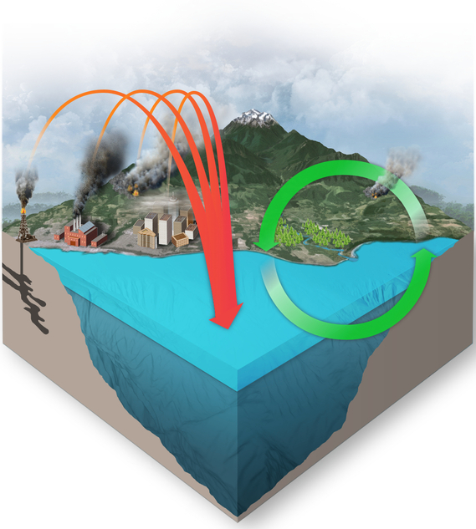
Takes about 1 yr. to equilibrate sea surface CO₂ with atmospheric CO₂
http://www.pmel.noaa.gov/co2/story/Ocean+Carbon+Uptake

Slide 34
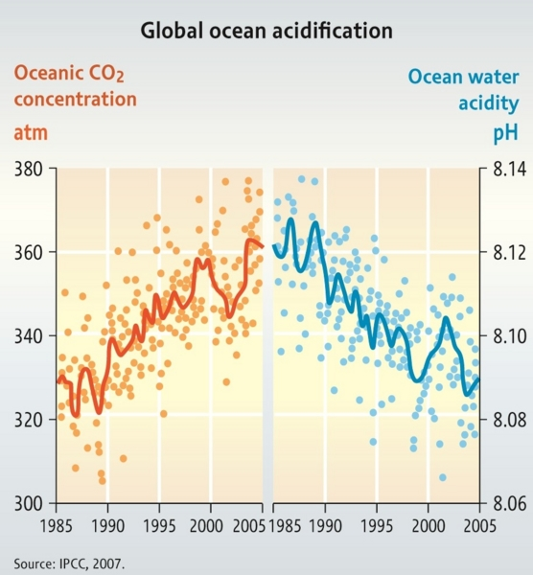

Slide 35
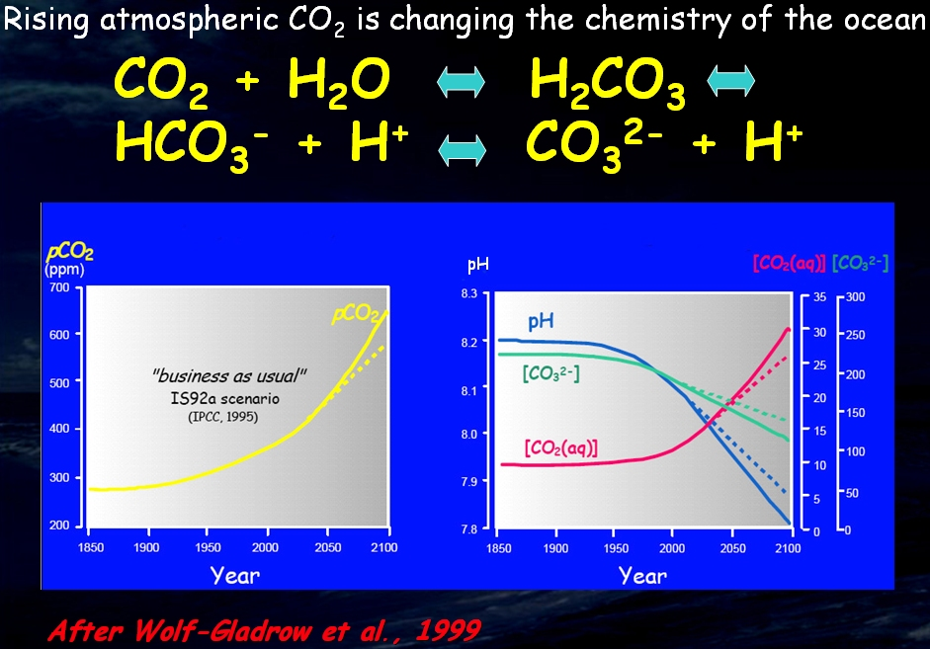

Slide 36
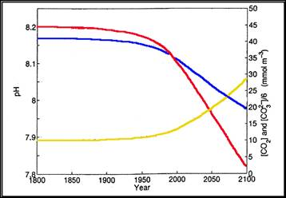
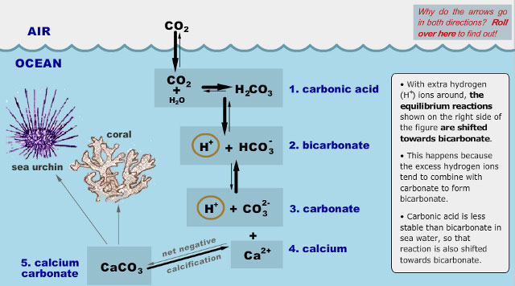
pH
CO₃⁻²
CO_{2(aq)}

Slide 37
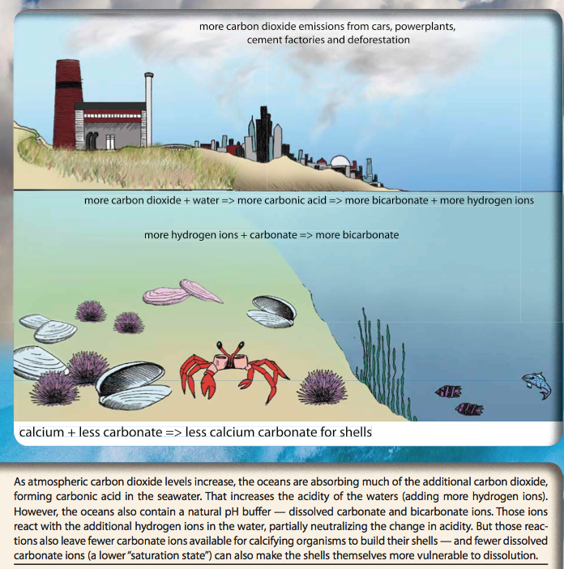

Slide 38
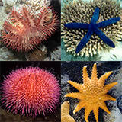
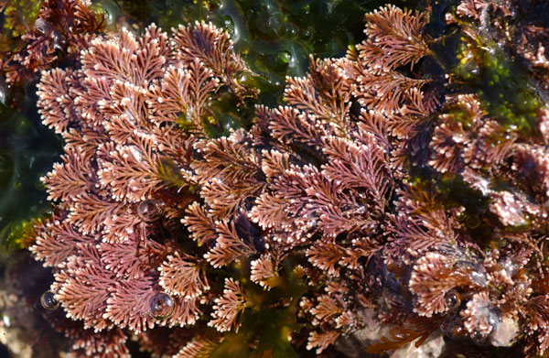
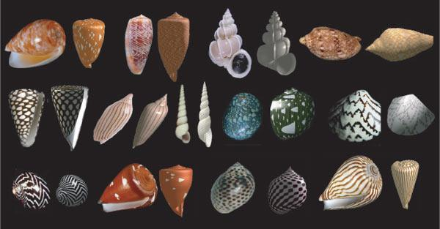
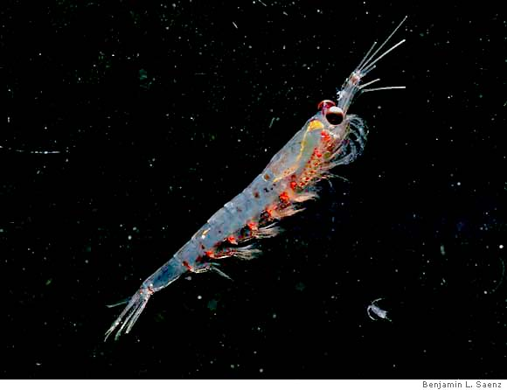
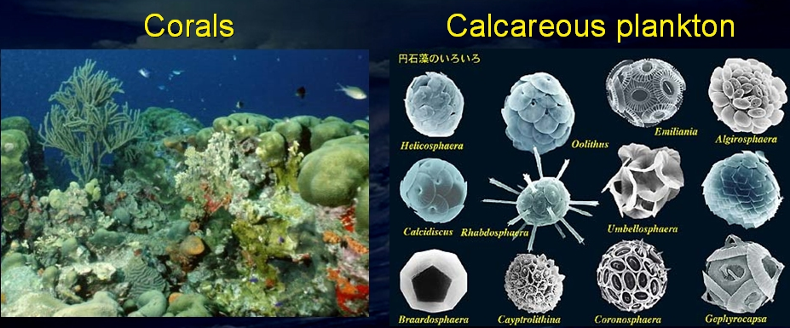
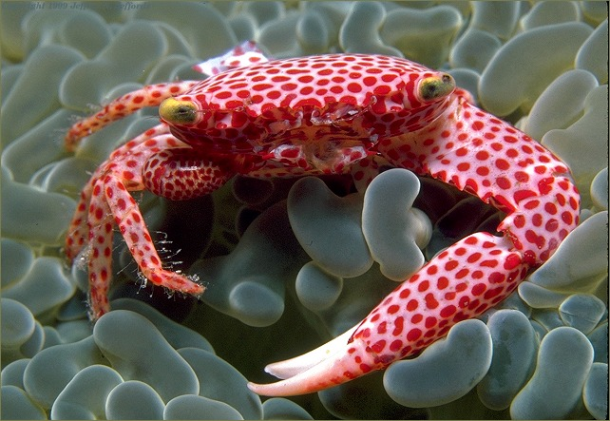
The Marine Calcifiers
Calcareous plankton
Calcareous seaweed
Shallow & deep water corals
Mollusks
Echinoderms
Crustaceans

Slide 39
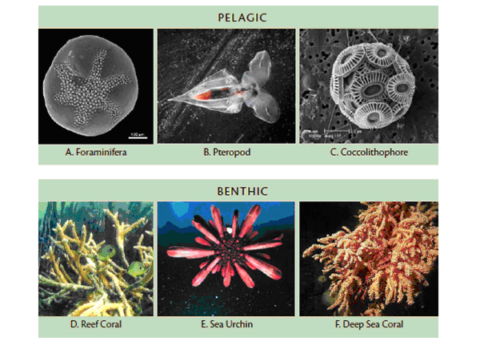

Slide 40
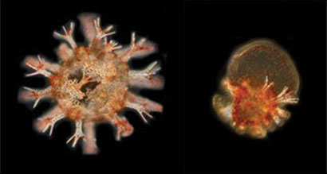

A 5-day-old sea urchin reared in present ocean conditions (left) compared to one reared in high temperature & low pH showing abnormal appearance and reduced spines (left). (Image: M. Byrne, published originally in Proceedings of the Royal Society B)
Abalone larva at 21 hours reared in present ocean conditions (left), compared with one reared in mildly acidic conditions showing absence of shell (right)

Slide 41


The pteropod, or “sea butterfly”, is a tiny sea creature about the size of a small pea.
Pteropods are eaten by organisms ranging in size from tiny krill to whales and are a major food source for North Pacific juvenile salmon.
The photos below show what happens to a pteropod’s shell when placed in sea water w/pH & carbonate levels projected for the year 2100.
Shell slowly dissolves after 45 days.
National Geographic Images

Slide 42



Fishery Impacts of Ocean Acidification
The high seas of the Gulf of Alaska is critical feeding & growth area for North American & Asian populations of Pacific salmon.
Pteropods – major food source of food for several of these species, e.g. sockeye, pink, & chum salmon, especially during winter months when other food is scarce.
A combined bioenergetcis/food web model predicts that the effects of a 10% ↓ in pteropod production → 20% ↓ in the weight of pink salmon returning to Prince William Sound.
This effect is magnified as reduced feeding in the winter months prevents salmon from growing large enough to feed on more nutritious fish & squid in the summer prior to returning to fisheries.

Slide 43

Ocean acidification will endanger “ecosystem services” – benefits to humans provided by healthy ecosystems, e.g. ecotourism, protection against flooding, erosion, fisheries, etc.
2007. % Revenues from U.S. commercial fisheries ≈ $4 billion
http://www.whoi.edu/oceanus/viewArticle.do?id=65266

Slide 44


Acidification Effects – Unpredictable (at best)
Organism response to elevated CO₂ levels is complex
Justin Ries & co-workers studied 18 spp of marine calcifiers under varying CO₂ scenarios
http://www.unc.edu/~jries/publications.html

Slide 45

Ocean Acidification (cont’d.)
↑ CO₂ levels → hypercapnia → acidosis →
  ↓ metabolic processes
  ↓ protein
  biosynthesis

Slide 46

BBC Horizon: the Death of the oceans?
http://www.youtube.com/watch?v=nKPNcQyljds
Notes:
Start video at 30 min.

Slide 47
Other impacts

Slide 48


Hypoxic Zones: “Dead Zones”
Oceanic dead zones have hypoxic (oxygen-deficient) conditions on sea floor (benthos)
These zones are increasing in coastal areas – #’s have doubled every decade since 1960’s
Typically surround major industrial & agricultural centers (eutrophication is also major contributor)
Diaz and Rosenberg (2008). Science
http://maps.grida.no/go/graphic/sites-with-dead-zones-oxygen-depletion-on-the-sea-bottom
Notes:
http://maps.grida.no/go/graphic/sites-with-dead-zones-oxygen-depletion-on-the-sea-bottom
http://gbo3.cbd.int/the-outlook/gbo3/biodiversity-in-2010/current-pressures-on-biodiversity-and-responses.aspx

Slide 49



Hypoxic waters spreading into the California Current
Massive die-offs of crab, fish, & other benthic organisms along Pacific coast benthic communities are worse than predicted

Slide 50


Harmful algal blooms increase in frequency & size
Causes: Sea T rise as well as eutrophication
http://www.grida.no/graphicslib/collection/global-environment-outlook-4-geo-4
Notes:
Noaa.gov

Slide 51
Biological Impacts of Increased Storm Intensity
Physical destruction of many coastal habitats (seagrass beds, mangroves, rocky shores, kelp beds, coral reef, etc.)
Increased erosion/terrestrial run-off
  ↑Sedimentation
  ↑ Eutrophication
Stormed forced upwelling – could force more organic material into deeper water → ↑hypoxic conditions
Freshwater flood events
  Esp. devastating to corals
  Alters spp zonation
Loss of eggs, chicks (turtles, seabirds)
Change in migration & foraging behaviors

Slide 52



Slide 53


Drought in the Amazon
http://earthobservatory.nasa.gov/IOTD/view.php?id=50136&src=eoa-iotd

Slide 54
Vegetation “greenness” (chlorophyll conc.) measured by MODIS on NASA’s Terra satellite
This image shows anomolous vegetation conditions in 2010 compared to 2000-2009 average (except other major drought in 2005) – shows low [chlorophyll] thus photosynthesis
This is the worst drought in recorded history of this area (> 100 yrs) (GCC & deforestation to blame for drought)
Far-reaching impact
  Tropical forests are great carbon sink.
  No carbon removed + carbon emitted from rotting wood further increases CO₂ emission problems

Slide 55
Overview: Climate Change & Human Health
The National Institute for Environmental Health Sciences (NIEHS), a subdivision of the NIH (National Institutes of Health) issued a comprehensive report in 2010 on the health implications for 11 categories of impacts of climate change
  Heat-related morbidity & mortality
  Weather-related morbidity & mortality
  Vectorborne & zoonotic diseases
  Asthma, respiratory allergies, & airway diseases
  Waterborne diseases
  Cancer
  Cardiovascular disease & stroke
  Foodborne diseases & nutrition
  Human developmental effects
  Mental health & stress-related disorders
  Neurological diseases & disorders
www.niehs.nih.gov/climatereport

Slide 56


Potential Health Effects of Climate Variability and Change:
Schematic of pathways through which climate change can affect multiple health outcomes
Haines et al. 2004. JAMA 291: 99-103
Notes:
Figure. Potential Health Effects of Climate Variability and Change Adapted from Patz et al.2 Schematic of pathways through which climate change can affect multiple health outcomes. Examples are also given of moderating factors and adaptive measures determining extent of adverse outcomes, as well as mitigating measures to prevent global warming.

Slide 57



As temperature rises, suitable habitat for insect & animal vectors also increases, and reintroductions of some diseases in areas where they had been previously eradicated are likely
MANY cases of recent expansions of VBZD
Of particular concern are arthropod-borne viruses (“arboviruses”)
  Viruses transmitted from arthropods to vertebrate hosts
  Variety of arthropod vectors, e.g. mosquitoes, ticks, fleas, sand fleas, black flies, biting midges
  Typically RNA viruses (only DNA arbovirus is African swine fever virus), >100 known to cause disease, e.g. West Nile Encephalitis, Yellow Fever, Dengue Fever
bioweb.uwlax.edu
Vector for tick-borne encephalitis as well as many other diseases: Ixodes sp.
Vector for West Nile Virus: Culex pipiens
Vector for Yellow & Dengue Fevers: Aedes aegypti

Slide 58
GCC and the Rapid Rise of VBZD
Spread of vectors to new geographic areas
Longer transmission seasons & shorter diapause periods in insect hosts
Environment supports an increase in vector population
Increase of vector-host contact
Changes in viral/parasite genetics & new virus/parasite strains
Increase in viral replication / shortened incubation period
Large-scale disruption & subsequent movement of people create conditions for wider distribution of pathogens & greater exposure to vector spp
Decline in biodiversity of marine & terrestrial ecosystems will alter the dynamics of predator-prey AND vector-reservoir pathogen populations → increased pathogen risks
Notes:
Spread of arthropods and arboviruses to new geographic areas due to human activities and/or temperature changes
Longer seasons and shorter diapause periods that will result in larger population of arthropods
Changes in viral genetics and the introduction of new virus strains
Virus replication increases as temperature increases (but will reach a tolerance level)
Increased flooding will be beneficial to some arthropods such as mosquitoes→ more water for egg distribution

Slide 59



Dengue Fever
Considered the most important vector-borne viral disease in the world.
Transmitted by the mosquito, Aedes aegypti
Limited to tropical & subtropical regions, because freezing temperatures kill overwintering larvae & eggs
# reported dengue cases significantly correlated with climate-induced variations in A. aegypti population size
# countries affected by dengue fever also on the rise
Models predict that 50-60% of the human population will be at risk of dengue infection, vs. 35% today.

Slide 60



Malaria
Afflicts 350-500 million people/yr, and these numbers of rising with recent expansions not only attributed to global warming but also increased pathogen resistance to antimalarial drugs & increased vector resistance to DDT
Complex epidemiology
  Parasitic protozoans from 4-5 spp of genus Plasmodium cause malaria
  Mosquitoes from 30-40 spp of genus Anopheles transmit it
Predicted to occur at higher altitudes as well as higher latitudes

Slide 61
Respiratory Problems
Global rise in asthma, respiratory allergies, & airway diseases
GCC affects air quality by increasing
  production & allergenicity of aeroallergens, e.g. pollens, mold spore (longer growing seasons)
  regional ambient concentrations of ozone
  fine particles
  dust

Slide 62

Aeroallergens
Airborne substances that cause an allergic reaction, e.g. pollen, mold spores
Global warming will worsen allergies for ca. 25 million Americans
Many spp of weeds & trees that cause allergies have been found to be affected by ↑ CO₂ levels by
  ↑ Growth rate
  ↑ Pollen production
  ↑ Allergenicity of pollen
Earlier onset of spring & longer growing seasons → larger plants (e.g. ragweeds) that produce more pollen later in the fall
More allergenic spp (e.g. oak & hickory) will expand their distributions northward, thus replace less allergenic spp (e.g. pine, spruce)
Mold growth is positively correlated w/ ambient T as well as heavy rainfall/flooding, so spore production will ↑ with GCC

Slide 63


Climate Change Increases Toxicity of Poisonous Plants
Biomass and toxicity of poisonous plants in the sumac family (Family Anacardiaceae, Toxicodendron spp.) have been shown to increase with elevated atmospheric CO₂
  Increased photosynthesis, water use efficiency, growth, population biomass, increased allergenic form of urushiol
  http://www.pnas.org/content/103/24/9086
Urushiol is active (oily) compound that causes severe allergic reaction
Poisonous plants: overview and U.S. geographic distribution
  http://www.cdc.gov/niosh/topics/plants/
Notes:
Photo from: http://justdogswithsherri.blogspot.com/2011/12/poison-ivy-oak-or-sumac.html

Slide 64

"We can't solve problems by using the same kind of thinking we used when we created them."
- Albert Einstein

