Slide 1
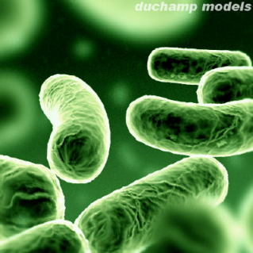
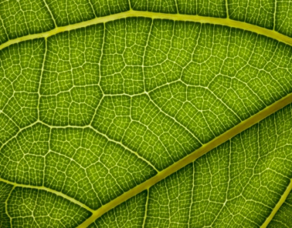
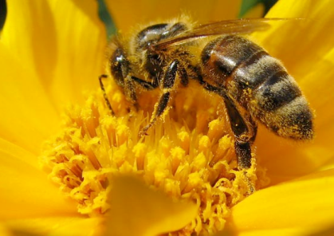
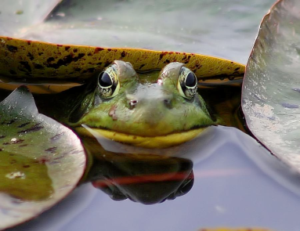
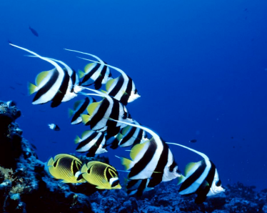
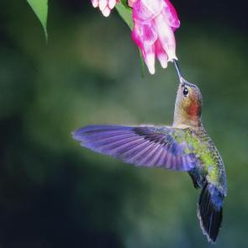
Mechanisms of evolution
IMSS BIOLOGY ~ SUMMER 2013

Slide 2
Fossil marsupials in northern Africa http://www.nature.com/nature/journal/v308/n5958/abs/308447a0.html
http://www.palaeontologyonline.com/articles/2012/fossil-focus-marsupials/

Slide 3
Misconception: individuals evolve.
Correct concept: Populations are the units of evolution.
Individuals do not have diversity from which to select.
Changes in an individual over time, e.g. muscle size due to increased workouts, are NOT passed on to offspring (this is Lamarckian evolution!)--we need to re-evaluate this statement in light of what we know about the inheritance of acquired epigenetic modifications; still, not all acquired phenotypic changes are heritable.

Slide 4
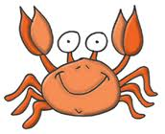
Is it a population?
Listed below are organisms that are considered to be a population and organisms that are not considered to be a population. Put an X next to each of the organisms that you consider to be a population.
___ a group of Dungeness Crabs in a eelgrass bed off the San Francisco Bay
___ all species of crabs in the Pacific ocean
___ all the different herds of animals gathering at a watering hole in Africa
___ all species of crabs in the ocean
___ all the humans at a mall
___ Grizzly Bears and Coho Salmon in a river
___ a school of Coho Salmon swimming in a river
___ all the humans on Earth
Explain your thinking. Describe your rule for justifying what a population is.

Slide 5
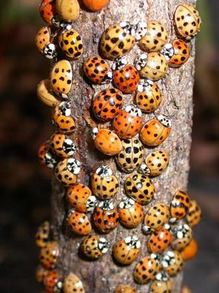
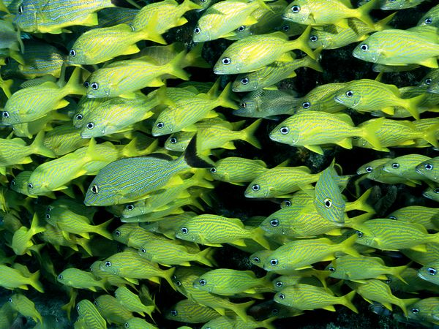
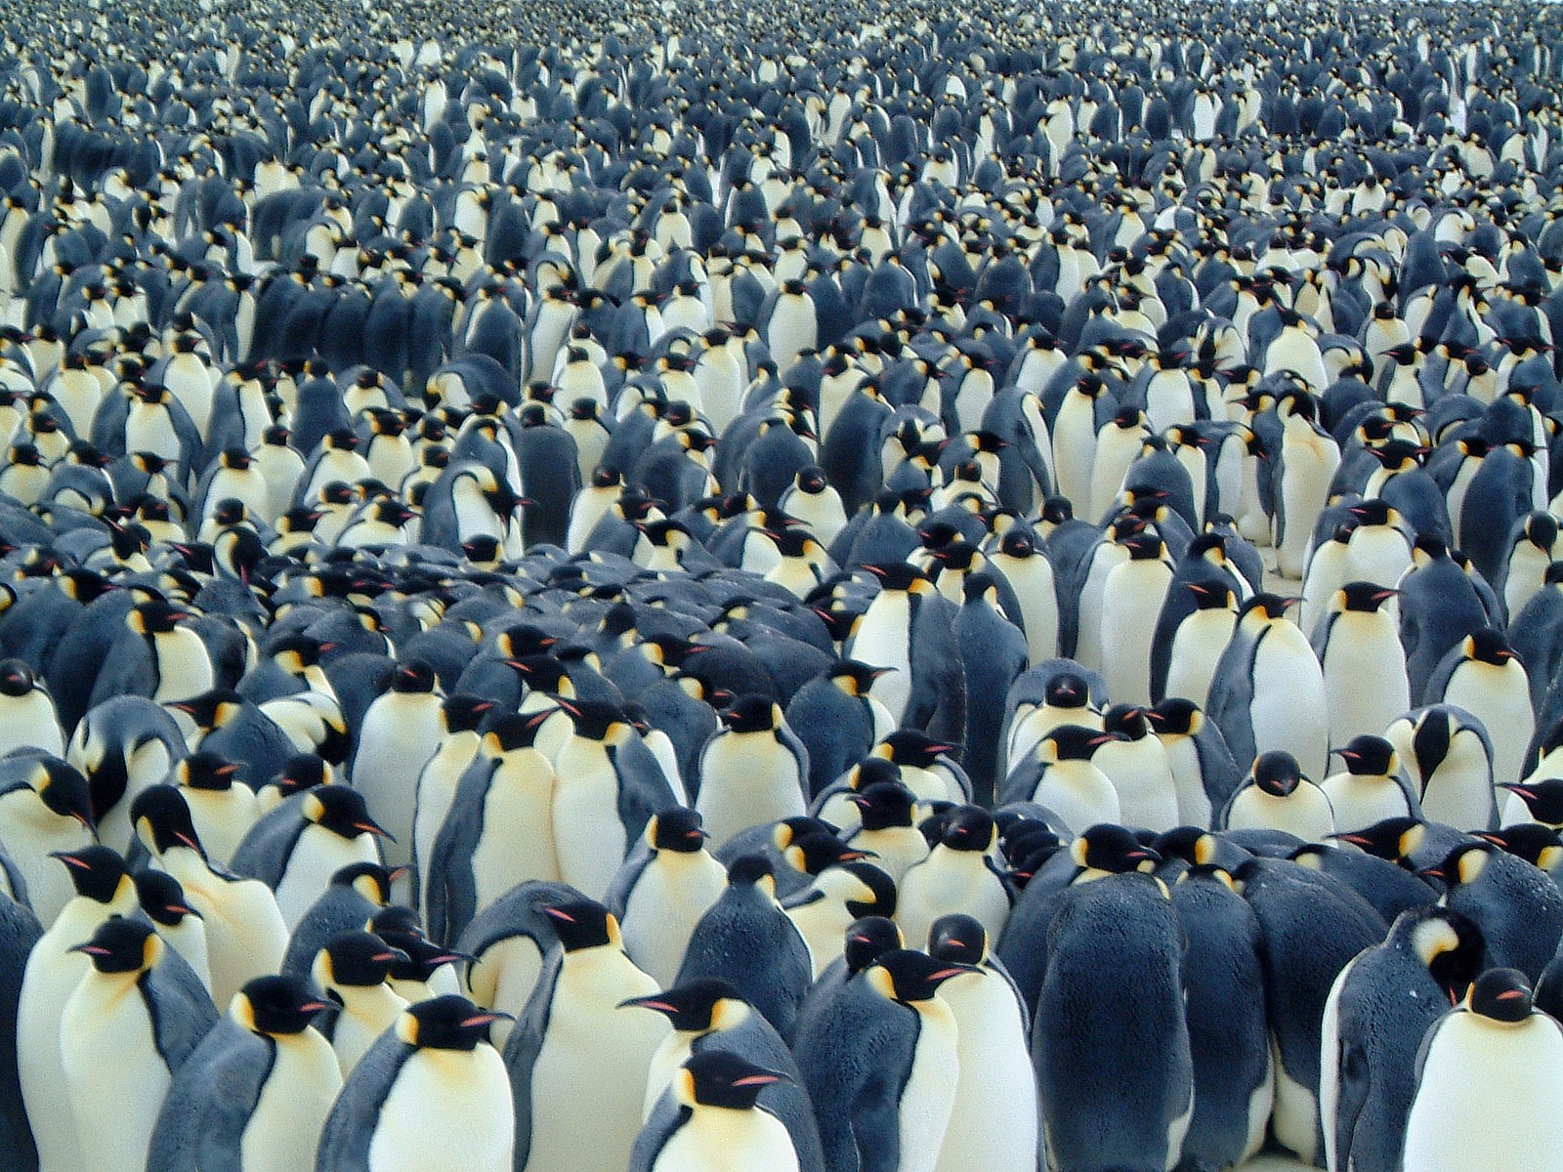
Defining “population”
A population is a
group of interbreeding individuals of the same species, living in the same place, at the same time
the smallest biological unit that can evolve
http://sglov.tripod.com/animal/
seattletimes.com/

Slide 6
The Gene Pool
The total collection of alleles in a population at any one time
Microevolution occurs when the relative frequency of alleles changes over a number of generations.
For many genes, there are 2 or more alleles in gene pool.
Can you imagine a scenario in which an environmental “pressure” could change allele frequencies in a population?
There is variation amongst individuals in a given population, but
not all variation in a population is heritable.
only the heritable component of variation is relevant to natural selection.

Slide 7
Evolution is defined as descent with modification from a common ancestor. What exactly has evolution modified over time?
(A) Homologous structures
(B) Any anatomical feature
(C) Individual organism’s genome
(D) Proportion of genes passed from generation to generation
(E) Gene frequency within a population
0
1 | 2 | 3 | 4 | 5 | 6 | 7 | 8 | 9 | 10 | 11 | 12 | 13 | 14 | 15 | 16 | 17 | 18 | 19 | 20
21 | 22 | 23 | 24 | 25 | 26 | 27 | 28 | 29 | 30

Slide 8
How Does evolution work?
The mechanisms of evolutionary change include
gene flow
genetic drift
natural selection
mutation
Cannot operate without genetic variation

Slide 9
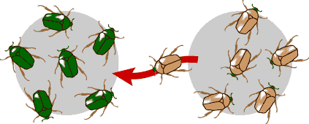
Gene flow
“Migration” of genes from one population to another, i.e., genetic exchange between populations
A population may gain or lose alleles as individuals (or gametes, e.g. pollen) move into (migrate) or out of (emigrate) the population.
Gene flow can be a very important source of genetic variation if genes are carried to a population where those genes previously did not exist.
http://evolution.berkeley.edu/evolibrary/

Slide 10
Gene flow tends to _____ genetic differences between populations.
(A) increase
(B) decrease
(C) have no effect on
(D) prevent
0
1 | 2 | 3 | 4 | 5 | 6 | 7 | 8 | 9 | 10 | 11 | 12 | 13 | 14 | 15 | 16 | 17 | 18 | 19 | 20
21 | 22 | 23 | 24 | 25 | 26 | 27 | 28 | 29 | 30

Slide 11
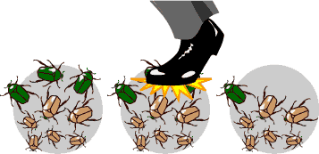
Genetic Drift
Change in gene pool of a population due to chance.
Although genetic drift is an evolutionary mechanism, it doesn’t result in adaptations.
In each generation, some individuals may, purely by chance, leave behind a few more descendants (thus genes) than other individuals.
The genes of the next generation will be the genes of the “lucky” individuals, not necessarily the healthier or “better” individuals.
http://evolution.berkeley.edu/evolibrary/

Slide 12
Genetic drift tends to ____ the amount of genetic variation in populations.
(A) increase
(B) decrease
(C) have minimal effect on
(D) prevent
0
1 | 2 | 3 | 4 | 5 | 6 | 7 | 8 | 9 | 10 | 11 | 12 | 13 | 14 | 15 | 16 | 17 | 18 | 19 | 20
21 | 22 | 23 | 24 | 25 | 26 | 27 | 28 | 29 | 30

Slide 13
How does genetic drift reduce genetic variation in populations?
Consider random draws from a marble bag resulted in the following ratios of brown:green marbles.
Draw #5 failed to produce any green marbles, so each draw thereafter will yield 10:0, representing the gene for green coloration drifting out of the population.
Green gene is gone for good, unless a mutation or gene flow reintroduces it.
With ⬇genetic variation, there’s less for natural selection to work with (selection cannot ⬆the frequency of the green gene if it’s gone from the population).
Selection cannot create variation – it can only act on what variation is already in a population.

Slide 14
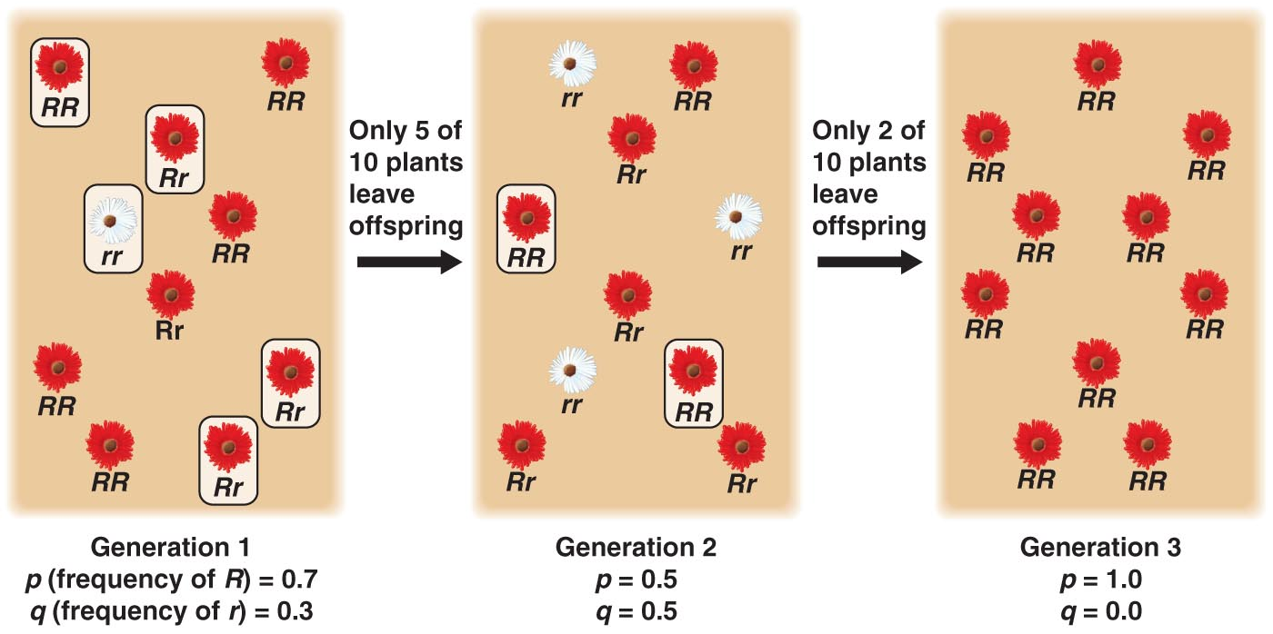
Genetic Drift (cont’d.)
Genetic drift happens to ALL populations, but its effects may be amplified in small populations
Genetic variation → inability to adapt to new selection pressures, e.g. climate change, shift in available resources, because genetic variation that selection would act on may have drifted out of the population.

Slide 15
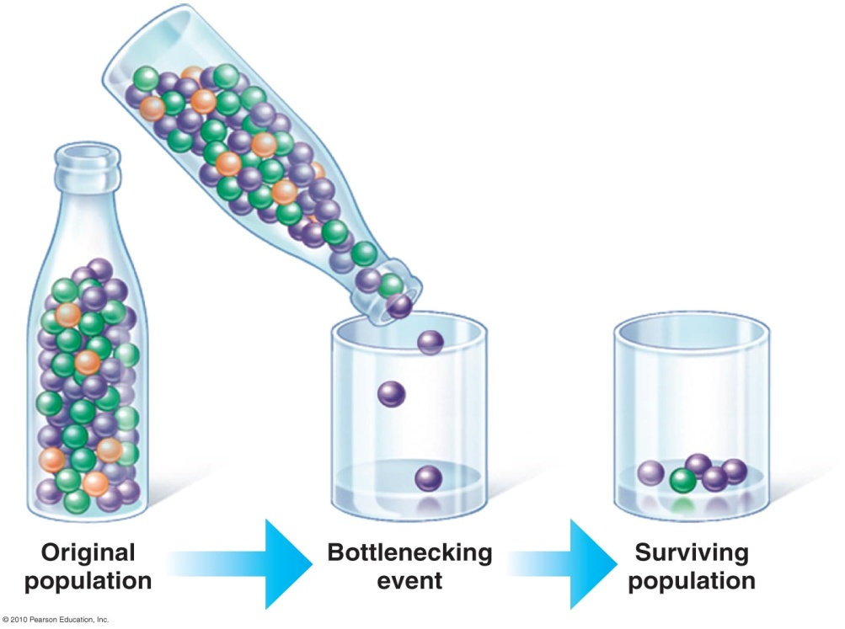
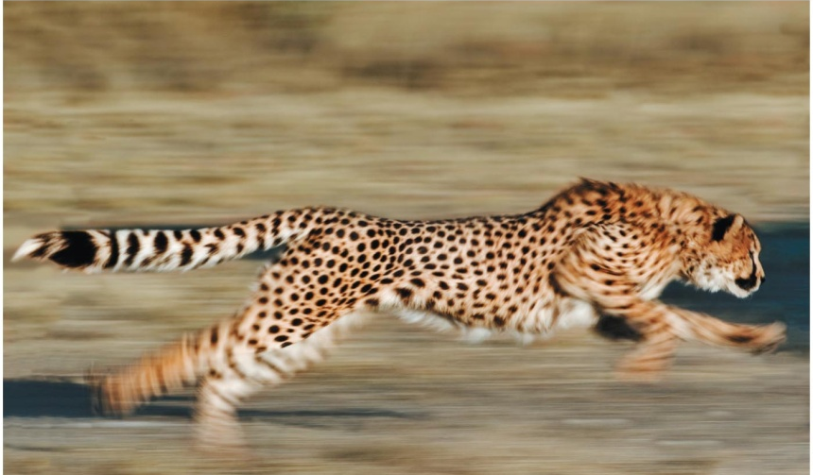
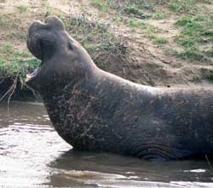
Bottleneck Effect
Is an example of genetic drift
Results from a drastic reduction in population size
Usually reduces genetic variation, because at least some alleles are likely to be lost from gene pool
E.g. cheetahs have experienced at least two genetic bottlenecks in past 10,000 yrs.; genetic variation is very low → ⬆risk of extinction
E.g. Northern elephant seals experienced bottleneck due to overhunting down to 20 individuals in the 1890s. Population now > 30,000 but have far less genetic variation than Southern elephant seals that were not so intensely hunted.

Slide 16
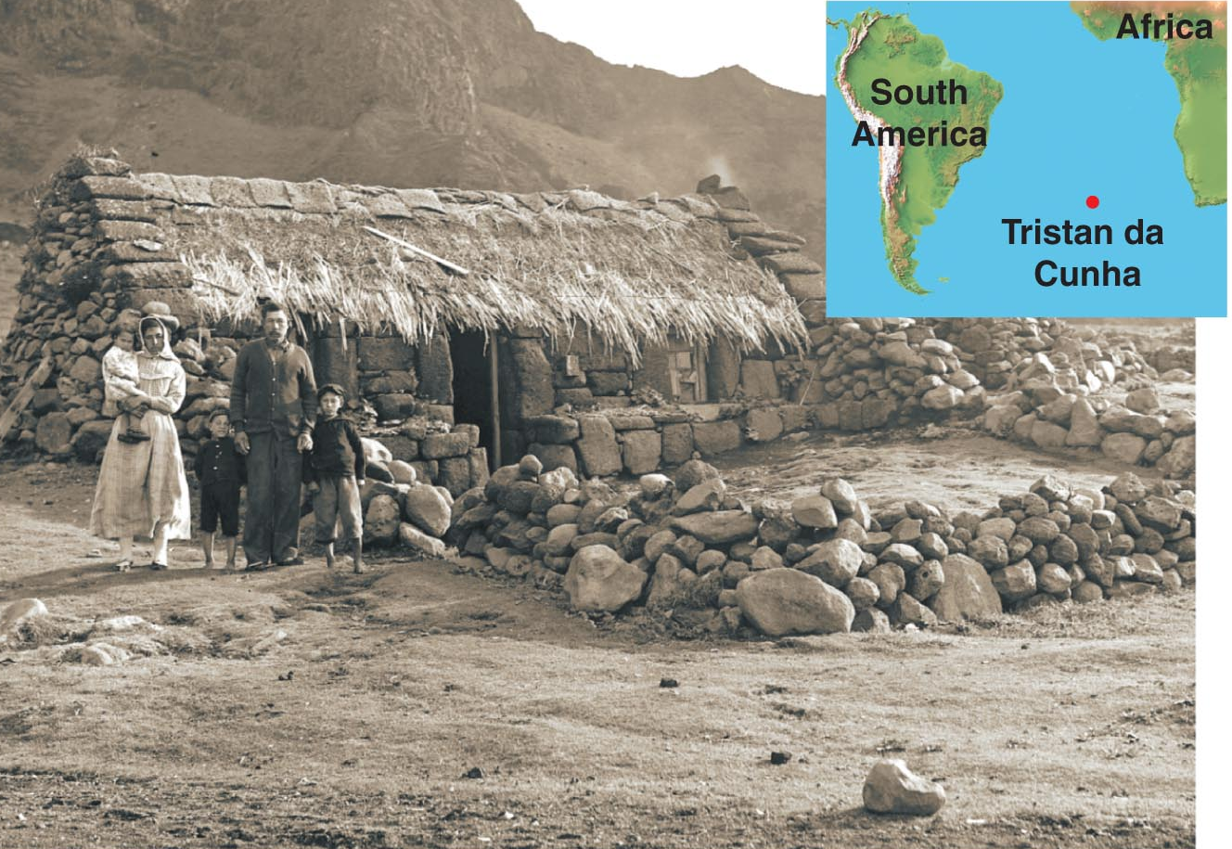
Founder Effect
Occurs when a few individuals from an original population colonize an isolated habitat.
Explains the relative hi frequency of certain inherited disorders among some small human populations
E.g. Tristan da Cunha – the world’s most remote inhabited island; genetic isolation resulted in disproportionately hi incidence of hereditary blindness

Slide 17
Natural selection
(A) enables organisms to evolve the structures they need
(B) eliminates non-heritable traits in a species.
(C) works on variation already present in a population.
(D) results in organisms that are perfectly adapted for their environments.
(E) does all of the above.
0
1 | 2 | 3 | 4 | 5 | 6 | 7 | 8 | 9 | 10 | 11 | 12 | 13 | 14 | 15 | 16 | 17 | 18 | 19 | 20
21 | 22 | 23 | 24 | 25 | 26 | 27 | 28 | 29 | 30

Slide 18
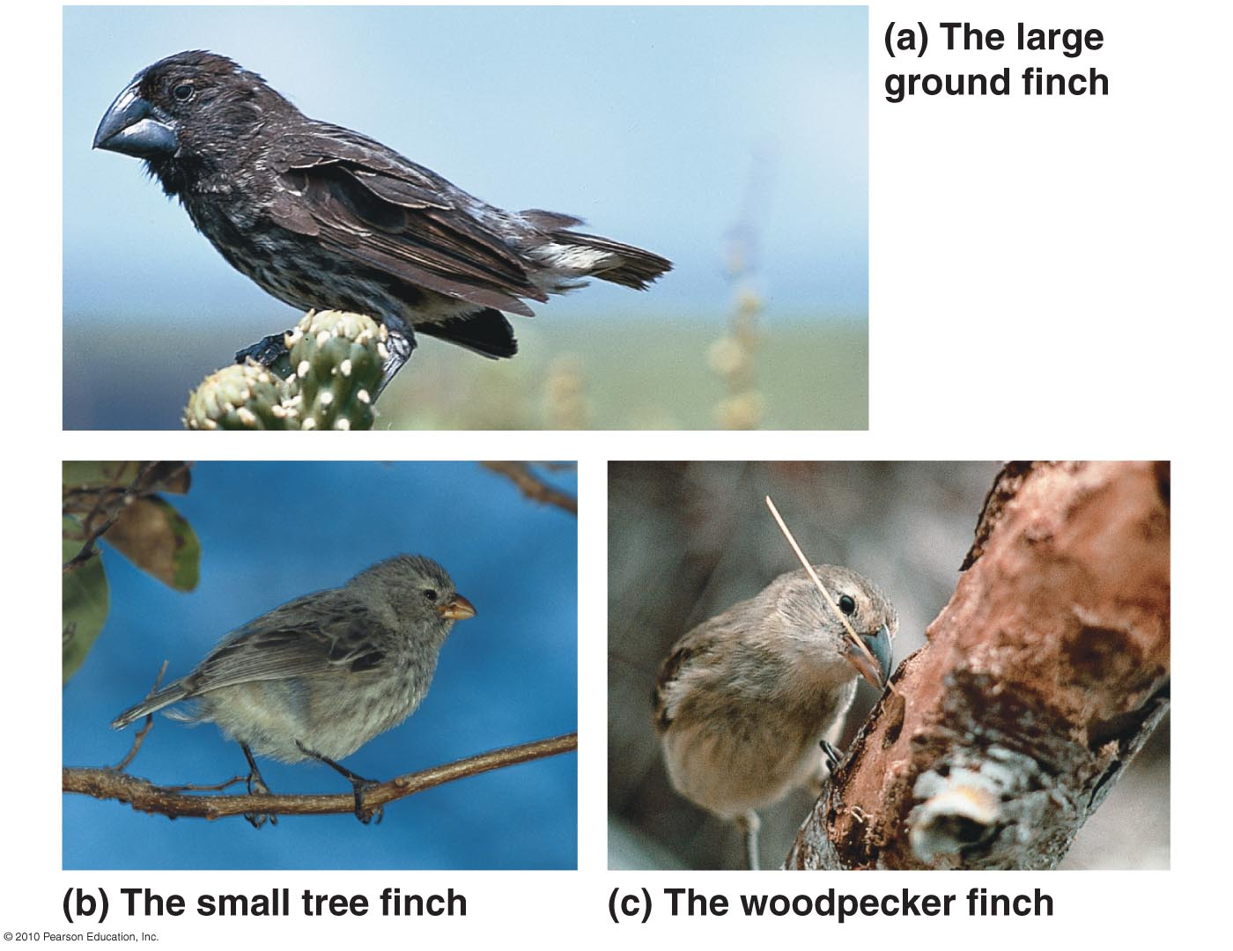
Natural Selection
Darwin noted the close relationship between adaptation to the environment and the origin of new species.
Prime e.g. finches on the Galapagos Islands – beak size & shape adapted for certain diets
a. large, seed- cracking bill
b. pincer-like bill
c. probing bill

Slide 19
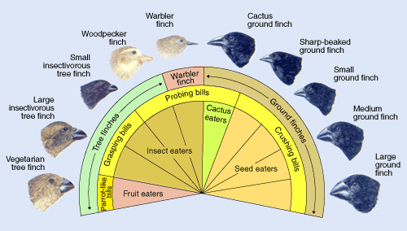
Darwin’s Finches
www.pbs.org
Darwin first described the 14 spp of closely related finches during his voyage on the HMS Beagle (1835). These spp show a remarkable degree of diversity in bill shape & size that are adapted for different food sources in an otherwise scarce environ.
These finches to this day remain the key example of many important evolutionary processes – niche partitioning, morphological adaptation, speciation, & species ecology

Slide 20
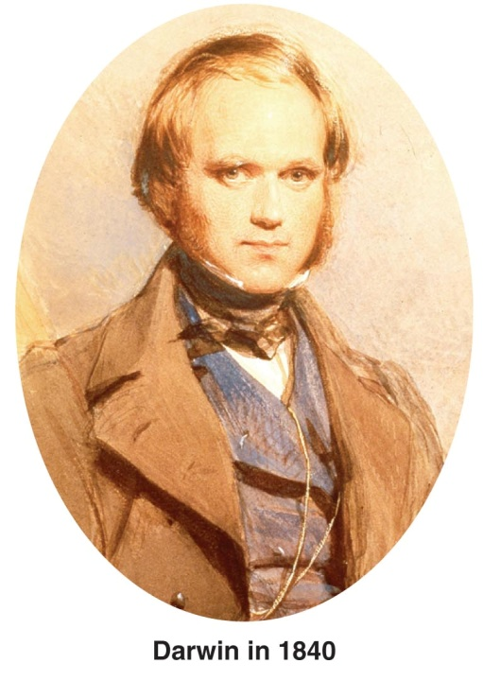
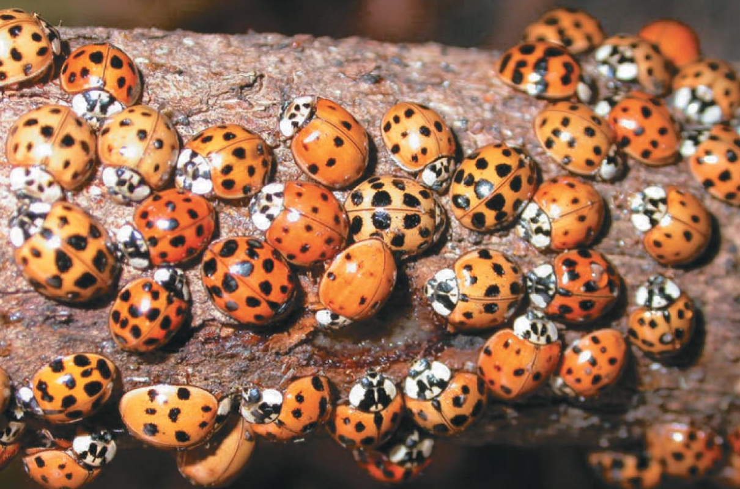
Darwin’s Theory
Darwin based his theory of natural selection on two key observations
Overproduction & competition
All species have potential to produce more offspring than can be supported in a given environment.
This overproduction is basis for competition (“struggle for existence”).
Individual variation
Individuals in a population
vary in many heritable traits.

Slide 21
Darwin’s Conclusion Defines Natural Selection
Differential survival & reproduction drives the evolution of species
Those individuals w/ heritable traits best suited to the local environment generally survive to reproduce, thus leave a larger share of surviving, fertile offpsring
Misconception: The environment does the selecting in natural selection. Species evolve due to “want” or “need.”

Slide 22
Misconceptions Dispelled
Biological diversity exists, and selective pressure from the environment determines who survives to reproduce.
Evolution is NOT goal directed and does NOT lead to perfectly adapted organisms.
Evolutionary change is consequence of immediate advantage NOT a distant goal.
Evolutionary change only reflects improvement in the context of the immediate environment (what is good today may not be so tomorrow).
Thus, species do not steadily get better, they respond evolutionarily to the environment or go extinct.

Slide 23
The “bad” gene
Why do deleterious alleles remain in some populations? What keeps natural selection from eliminating them?
Heterozygote advantage
Mutation
Gene flow
Don’t reduce fitness

Slide 24
Heterozygote advantage – real world
Found in recessive genetic diseases that have a higher than predicted occurrence in a population
Heterozygote individuals (“carriers”) have higher fitness than homozygotes.
Examples in humans
Cystic fibrosis
Sickle cell anemia
Thalassemia
Connexin 26 deafness

Slide 25
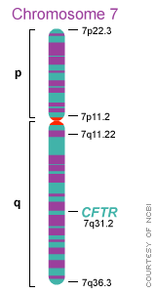
Cystic fibrosis
Caused by mutation in CFTR gene, responsible for transport of ions (thus water) into/out of cells.
Disease alters production of sweat, digestive juices, and mucus which lead to difficulty digesting food/pancreatic obstruction, thickened lung secretions/lung infections.
Highest prevalence in Ireland (1 in 19)
Heterozygotes don’t suffer from fluid loss caused by the diarrhea associated with typhoid and cholera.

Slide 26
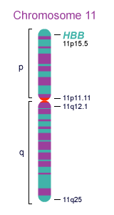
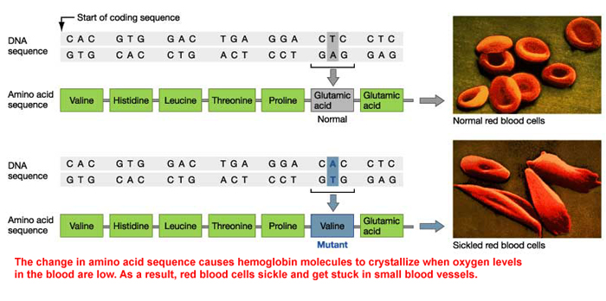
Sickle-cell anemia
Heterozygotes have greater resistance to malarial infection and greater chance of surviving to reproduce than either homozygote—exposure to pathogen triggers sickle cell reaction → rapid removal of infected cells.

Slide 27
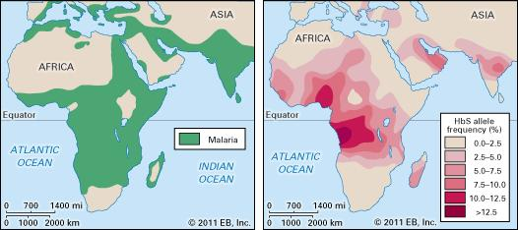
Sickle-cell anemia
Distribution of malaria and of sickle cell anemia overlap in areas of Africa, southern Asia, and the Mediterranean. HbS allele persists because heterozygous individuals are resistant to malaria.
Credit: Encyclopædia Britannica, Inc.

Slide 28
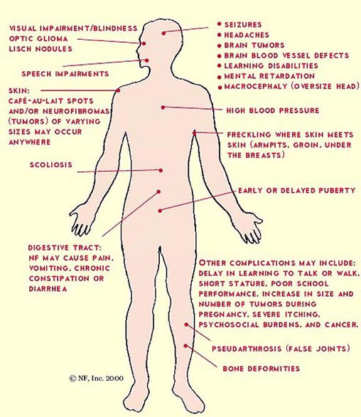
Mutation
Mutation producing deleterious alleles may keep appearing in a population, even if selection weeds it out
E.g. neurofibromatosis – genetic disorder causing tumors of the nervous system (actually affects all neural crest cells)
Has hi mutation rate: natural selection cannot completely get rid of the gene, because new mutations arise 1 in 4,000 gametes

Slide 29
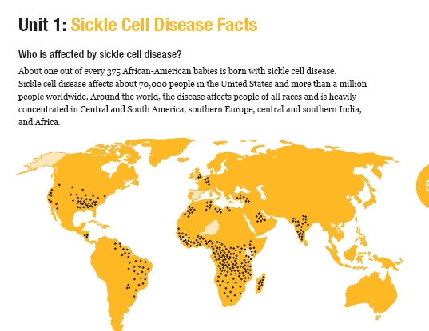
Gene flow
Allele may be common but not deleterious in a nearby habitat, and gene flow from this population is common
E.g. Sickle cell anemia allele is found in populations throughout the world due to gene flow

Slide 30
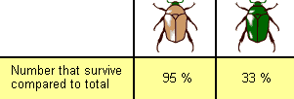
No effect on fitness
Some genetic disorders only exert effects late in life, after reproduction has occurred.
E.g. allele causing adult-onset Huntington’s disease – a degenerative brain disorder. Symptoms typically develop in mid-40’s.
Fitness: how good a particular genotype is at leaving offpsring in the next generation relative to other genotypes. Which beetle genotype has the greater fitness?

Slide 31
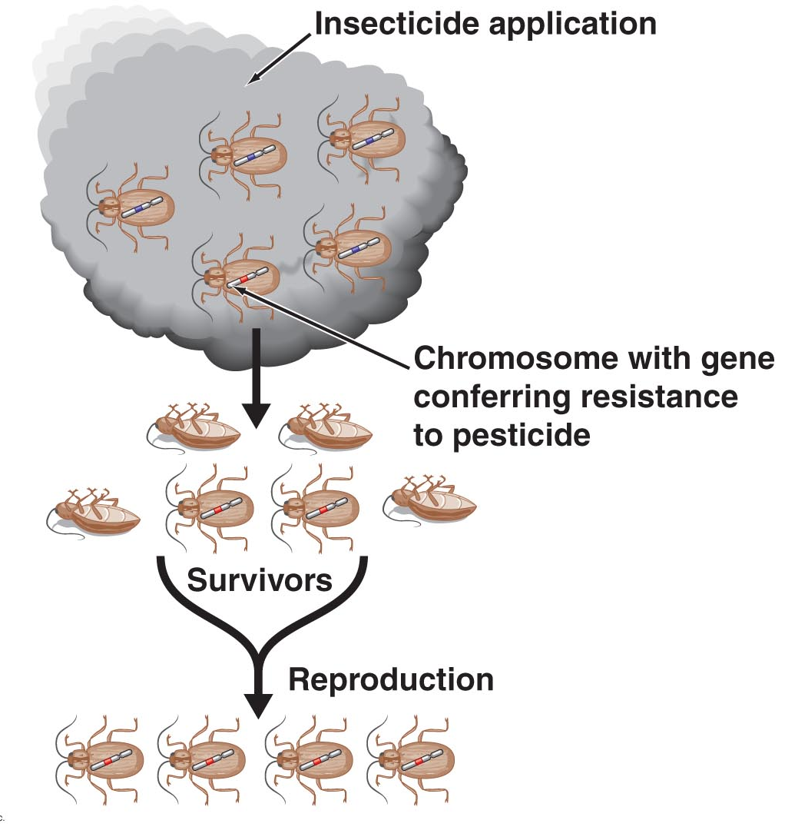
Natural Selection in Action
Examples of natural selection include the evolution of
Pesticide resistance in insects
Antibiotic resistance in bacteria
Drug resistance in strains of HIV

Slide 32
Natural selection is
(A) random
(B) non-random
0
1 | 2 | 3 | 4 | 5 | 6 | 7 | 8 | 9 | 10 | 11 | 12 | 13 | 14 | 15 | 16 | 17 | 18 | 19 | 20
21 | 22 | 23 | 24 | 25 | 26 | 27 | 28 | 29 | 30

Slide 33
Natural selection is not random
Misconception: natural selection is a random process.
Selection acts on genetic variation in a very non-random way
Genetic variants that aid survival & reproduction are much more likely to increase in frequency in a population than variants that don’t
A population of organisms undergoes random mutation and non-random selection. The result is non-random evolutionary change.

Slide 34
Which of the following can create new alleles?
(A) Sexual reproduction
(B) Mutation
(C) Natural selection
(D) Sexual recombination
(E) Genetic drift
0
1 | 2 | 3 | 4 | 5 | 6 | 7 | 8 | 9 | 10 | 11 | 12 | 13 | 14 | 15 | 16 | 17 | 18 | 19 | 20
21 | 22 | 23 | 24 | 25 | 26 | 27 | 28 | 29 | 30

Slide 35
Sources of genetic variation
Gene flow: already discussed
Mutation: random changes in DNA that can result in new alleles (more details later)
Sex: can introduce new gene combinations into a population (more details later)

Slide 36
Natural selection
(A) enables organisms to evolve structures that they need.
(B) eliminates non-heritable traits in a species.
(C) works on variation already present in a population.
(D) results in organisms that are perfectly adapted for their environments.
(E) does all of the above.
0
1 | 2 | 3 | 4 | 5 | 6 | 7 | 8 | 9 | 10 | 11 | 12 | 13 | 14 | 15 | 16 | 17 | 18 | 19 | 20
21 | 22 | 23 | 24 | 25 | 26 | 27 | 28 | 29 | 30

