Slide 1
Interactive notebooking
Demetrius Asekomeh

Slide 2
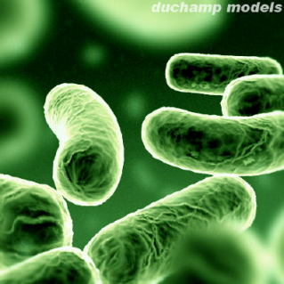
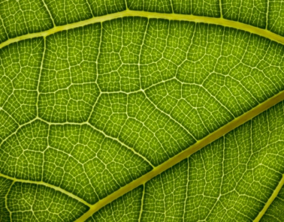
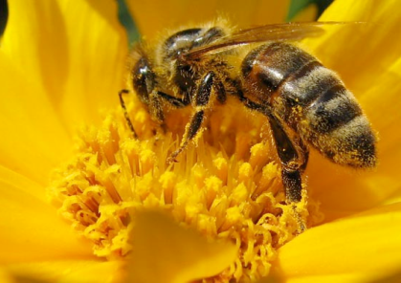
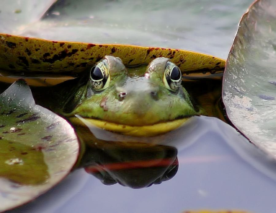
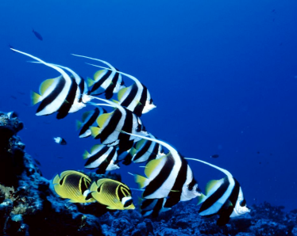
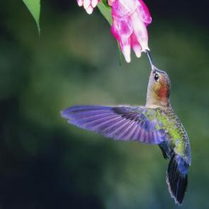
Week 1, Part 1 Evolutionary genetics overview
IMSS BIOLOGY ~ SUMMER 2013

Slide 3
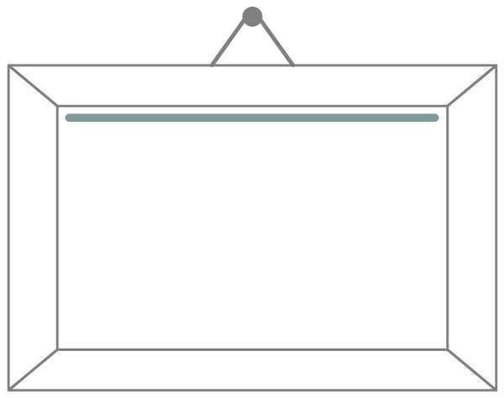
Framing the week
The integration of genetics with evolution (evolutionary genetics)
How to help students make the connection between evolution and genetics
How to approach student misconceptions about evolution and genetics
How to accurately assess student understanding of evolution and genetics

Slide 4
Proposed NGSS for California
Handout
References
CA Department of Educationhttp://www.cde.ca.gov/pd/ca/sc/ngssstandards.asp
NGSS Site http://www.nextgenscience.org/next-generation-science-standards

Slide 5
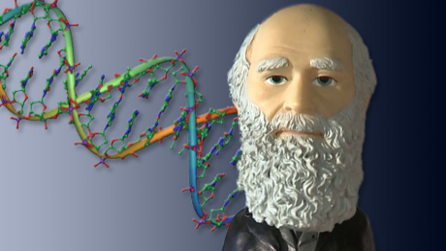
Evolutionary genetics
Integration of molecular genetics with evolutionary biology
Evolution is descent with modification from a common ancestor, i.e., change in inherited traits within a population over successive generations.
Genetics explains the process of trait inheritance.
https://www.coursera.org/course/geneticsevolution
Notes:
Image from https://www.coursera.org/course/geneticsevolution

Slide 6
Concept mapping
Tool of visual learning, type of graphic organizer http://www.inspiration.com/visual-learning/concept-mapping
Visual learning helps students see how concepts/ideas are connected (especially to prior knowledge) and organize large amounts of info
Integrated with verbal strategies, aligned with Common Core
Good assessment tool

Slide 7
Concept mapping – nuts & bolts
Start with main idea/topic/issue or focus question
Identify key concepts that connect/relate to main idea and rank them
More general, inclusive concepts come first, then link to smaller, more specific concepts
Finish by connecting concepts
Establish links and cross-links, and create linking phrases and words

Slide 8
Create an evolutionary genetics Concept map
Create a concept map that includes the core concepts/ideas that students need to understand to connect genetics with evolution.
Use the supplies provided (poster paper, sentence strips, sharpies, colored yarn).
You are welcome to modify/edit your map throughout the week.

Slide 9
Sample concept map for photosynthesis & respiration.

Slide 10
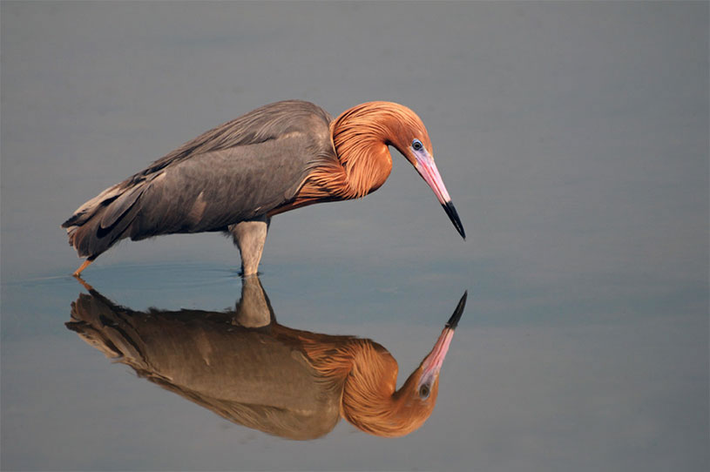
Quick write Reflection
How do you make the connections between evolution and genetics for your students?
Photo by Michael Skelton
Notes:
Photo by Michael Skelton http://scene360.com/main_news/18162/bird-mirage-reflections/#.Udir6FNcN4E

Slide 11
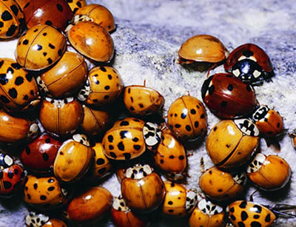
How do genes drive biological diversity?
Evolution accounts for diversity over long periods of time.
Without genetic variation, mechanisms of evolutionary change cannot operate.
Natural selection and genetic drift act on variation that exists in populations.
Amount of genetic variation in a population may affect the likelihood of survival of the population--less diversity, less likely population will survive environmental change

Slide 12
Which of the following does not contribute to genetic variation in populations?
(A) Mutation
(B) Genetic recombination
(C) Gene flow
(D) Genetic drift
0
1 | 2 | 3 | 4 | 5 | 6 | 7 | 8 | 9 | 10 | 11 | 12 | 13 | 14 | 15 | 16 | 17 | 18 | 19 | 20
21 | 22 | 23 | 24 | 25 | 26 | 27 | 28 | 29 | 30

Slide 13
key principle: mechanisms of evolution
Populations have genetic variation that continuously arises by chance events (mutation and recombination) as well as gene flow.
Populations evolve by changes in population allele frequencies via
Genetic drift
Gene flow
Natural selection
Mutation

Slide 14
Selective pressure from the environment acts directly on
(A) the population gene pool
(B) phenotypes
(C) an individual’s genotype
(D) allele frequencies in a species
This is because____________...
(Write answer in your notebook.)
0
1 | 2 | 3 | 4 | 5 | 6 | 7 | 8 | 9 | 10 | 11 | 12 | 13 | 14 | 15 | 16 | 17 | 18 | 19 | 20
21 | 22 | 23 | 24 | 25 | 26 | 27 | 28 | 29 | 30

Slide 15
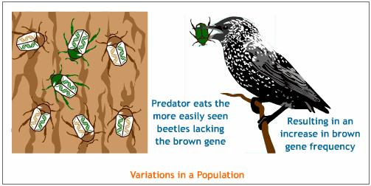
Selection acts on the phenotype
Evolution occurs as result of selection pressures.
Biotic and abiotic factors within the environment put selection pressure on the phenotype.
Phenotype is the physical expression of the genotype and the environment.
Environmental factors acting on phenotypes result in certain phenotypes with higher reproductive success (fitness) than others, thus the corresponding genotypes ultimately change → gene pool changes.
allele
allele

Slide 16
How do we define phenotype?
Phenotype is the physical expression of a trait.
Such physical expression of traits depends on the genotype and the organism’s interactions with the environment.
How would you categorize phenotypic traits? What are some examples?
Categories
Examples
Notes:
Gene products—proteins
Structures at all levels (molecules, cells, tissues, organs, whole organism)
Physiological mechanisms
Behaviors

Slide 17
Focus: the interplay between genotype & phenotype
Genotype
Phenotype

Slide 18
natural selection
Mechanism of evolutionary change that generates biological adaptation.
Natural selection drives changes in the heritable components of phenotype that are mediated by differences in individual fitness
Phenotypes (thus genotypes) with the greatest reproductive success (highest fitness) are “favored” and become more common in the population.

Slide 19
The concept of fitness
An individual’s fitness is the contribution that individual makes to the gene pool of next generation so depends on that individual’s survival and reproduction.
The reproductive success of an individual indicates its fitness but is often difficult to measure, so proxies are more typically used, e.g., # matings, # offspring surviving to maturity.

Slide 20
Natural selection ____ genetic variation in populations.
(A) reduces
(B) increases
(C) maintains
(D) can do all of the above to
This is because____________...
(Write answer in your notebook.)
0
1 | 2 | 3 | 4 | 5 | 6 | 7 | 8 | 9 | 10 | 11 | 12 | 13 | 14 | 15 | 16 | 17 | 18 | 19 | 20
21 | 22 | 23 | 24 | 25 | 26 | 27 | 28 | 29 | 30

Slide 21
Natural selection can act on population variation in different ways
Depending on the nature of the trait(s) being selected, natural selection can increase, decrease, or maintain the variation of the trait(s) in the population.
There are different types of natural selection
Directional selection
Stabilizing selection
Disruptive selection
Balancing selection
Sexual selection

Slide 22
Directional selection
Occurs when individuals with one extreme value for a trait are favored (or alternatively, selected against), shifting the average value of the trait in one direction over many generations.
This reduces genetic variation for that trait in the population

Slide 23
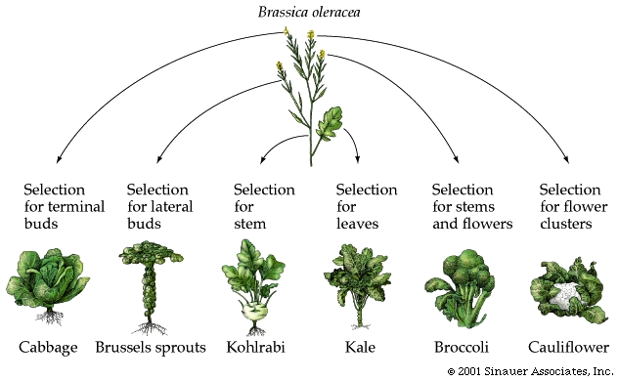
Directional selection – real world
Numerous examples
Evolution of mimicry, camouflage, warning coloration, etc.
The evolution of drug resistance in bacteria and other microorganisms
Artificial selection
Notes:
Farmers cultivated wild mustard and selected for desired traits to produce the crops we rely on today. Image from http://evolution.berkeley.edu/evolibrary/article/_0_0/evo_30

Slide 24
Stabilizing selection
Occurs when the extremes of a trait are selected against.
This reduces genetic variation for that trait in the population

Slide 25
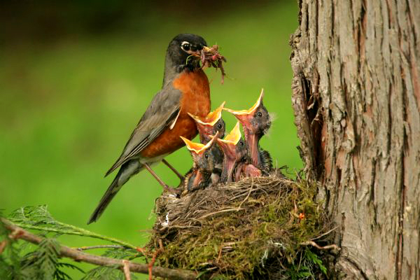
Stabilizing selection – real world
Birth weight in humans – early mortality highest in babies with extreme birth weights
Too small – can’t keep warm, more susceptible to infections
Too large – more difficult to deliver through pelvis
Clutch size in some birds – females that lay intermediate numbers of eggs have highest reproductive success
Too many – offspring starve, more predation
Too few – not enough survive to reproduce

Slide 26
Disruptive selection
Occurs when selection favors the extremes for a trait rather than the central tendency, which is selected against (i.e., individuals with intermediate values of the trait are eliminated).
This increases (or maintains) genetic variation for that trait in the population and can lead to divergence into two populations (and speciation).

Slide 27
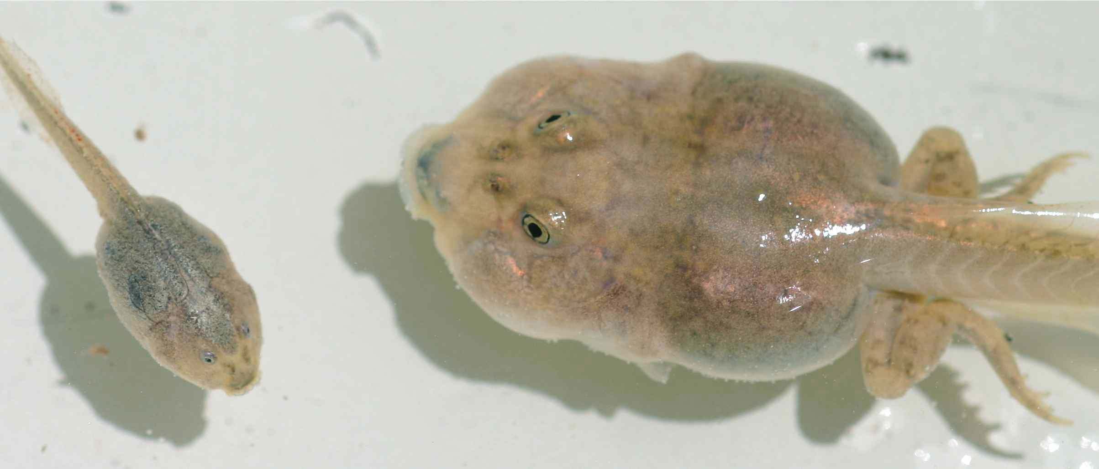
Disruptive selection – real world
Documented in growing number of wild populations
Most notably in populations experiencing intense intraspecific competition for resources
E.g. Mexican spadefoot toad tadpoles
Omnivore morph (left) and carnivore morph (right)
From http://bio.unc.edu/people/faculty/pfennig/

Slide 28
Balancing selection
Involves a number of selective processes that maintains the presence of multiple alleles at a particular gene locus in the population’s gene pool, so functions to conserve genetic polymorphisms.
One of the major mechanisms of maintaining polymorphisms is heterozygote advantage.

Slide 29
Heterozygote advantage – real world
Found in recessive genetic diseases that have a higher than predicted occurrence in a population
Heterozygote individuals (“carriers”) have higher fitness than homozygotes.
Examples in humans
Cystic fibrosis
Sickle cell anemia
Thalassemia
Connexin 26 deafness

Slide 30
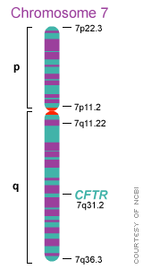
Cystic fibrosis
Caused by mutation in CFTR gene, responsible for transport of ions (thus water) into/out of cells.
Disease alters production of sweat, digestive juices, and mucus which lead to difficulty digesting food/pancreatic obstruction, thickened lung secretions/lung infections.
Highest prevalence in Ireland (1 in 19)
Heterozygotes don’t suffer from fluid loss caused by the diarrhea associated with typhoid and cholera.

Slide 31
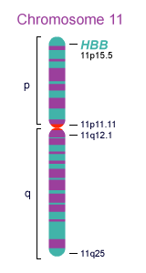
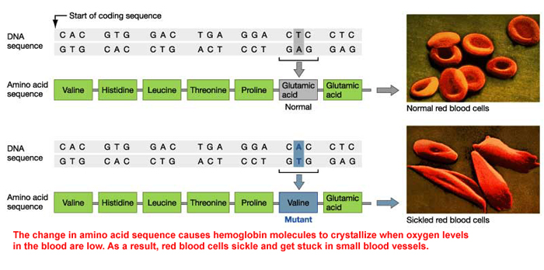
Sickle-cell anemia
Heterozygotes have greater resistance to malarial infection and greater chance of surviving to reproduce than either homozygote—exposure to pathogen triggers sickle cell reaction → rapid removal of infected cells.

Slide 32
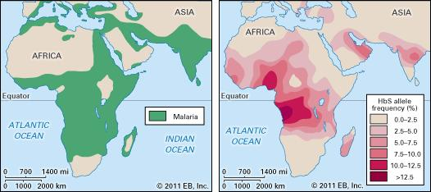
Sickle-cell anemia
Distribution of malaria and of sickle cell anemia overlap in areas of Africa, southern Asia, and the Mediterranean. HbS allele persists because heterozygous individuals are resistant to malaria.
Credit: Encyclopædia Britannica, Inc.

Slide 33
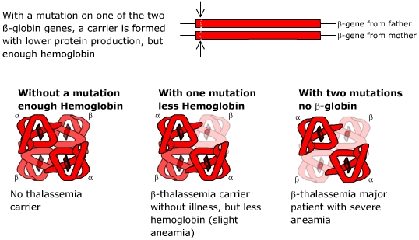
β-thalassemia
Carriers resistant to malaria and to coronary heart disease (due to lower blood pressure)
http://www.hbpinfo.com/en/mainframe/id/beta.htm

Slide 34
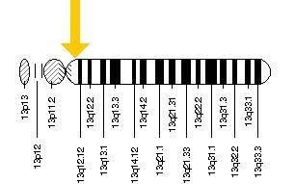
Connexin 26 deafness
Caused by mutation in GJB2 gene, responsible for production of gap junction protein (connexin 26) that permits transport of ions between adjacent cells (in e.g., inner ear, skin).
Up to 1/30 carriers in U.S.
Heterozygotes have thickened epidermis and increased cell repair capacity so increased barrier to infection.

Slide 35
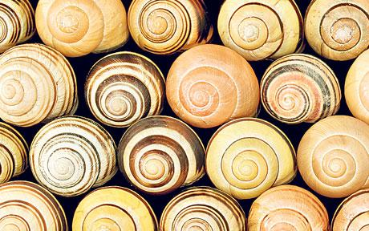
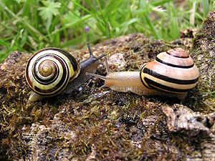
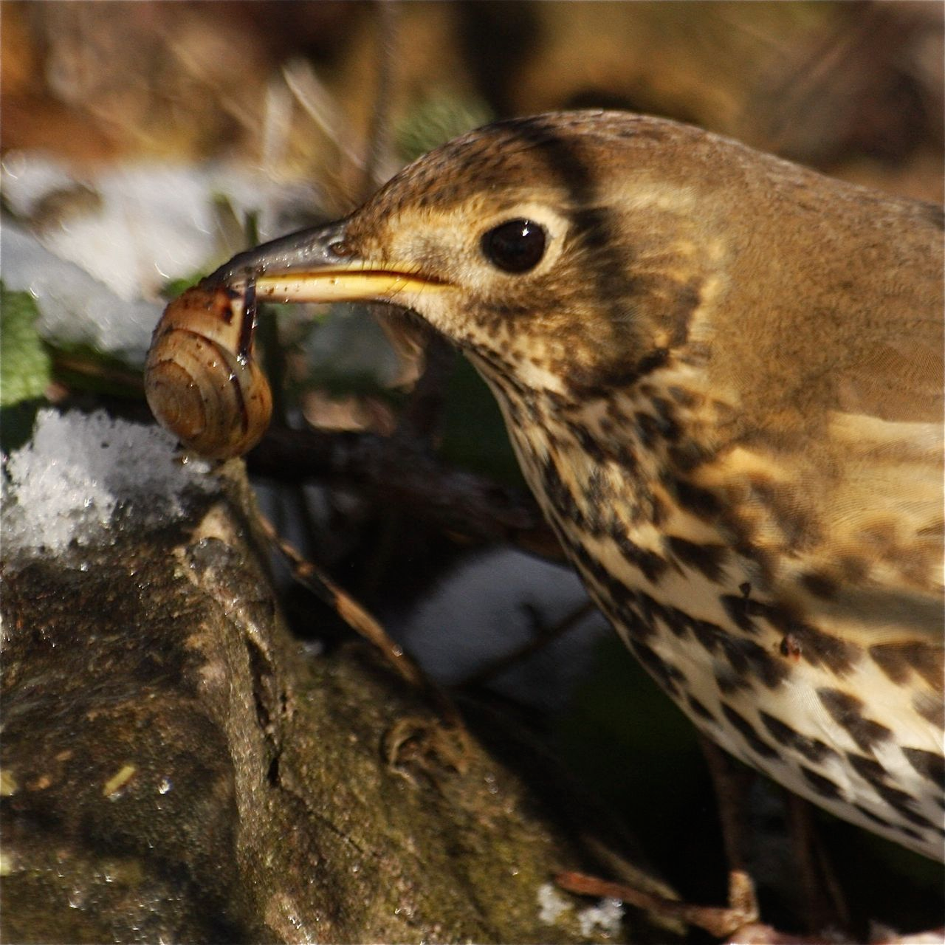
Heterozygote advantage – real world
Grove snail
Shows polymorphism in shell color controlled by multiple alleles— individuals heterozygous for “super-gene” controlling these alleles have physiological advantage over homozygotes.
Primary predator (Song Thrush) selectively captures snails that stand out from background, but background is very heterogeneous
http://www.arkive.org/song-thrush/turdus-philomelos/video-00.html
www.telegraph.co.uk/
http://molluscs.at/gastropoda/terrestrial.html?/gastropoda/terrestrial/banded_snails.html

Slide 36
Figure 1 : Different types of selection
The red area denotes the current frequency distribution of a trait that is carried by individuals in a population. The yellow area denotes the same distribution for a past generation. If there is enough time, the frequency will follow changes in the fitness values associated with a particular trait value, so these figures also depict caricatures of relevant parts of the adaptive landscape. The arrows indicate where the optimum is (or where it is moving) and thus the trait values that will be positively selected. All other trait values are under negative selection.
© 2008 Nature Education All rights reserved. View Terms of Use

Slide 37
Sexual selection
A special case of natural selection in which selection acts traits that affect individual’s ability to obtain mates.
Can lead to physical and behavioral differences between sexes (sexual dimorphism); sometimes the sexually selected traits are harmful to survival.
Mate chooses trait associated with “good genes” that will be passed on to offspring.

Slide 38
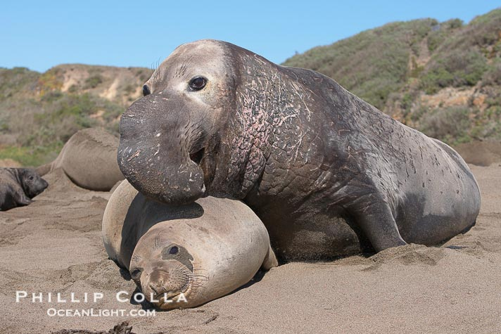
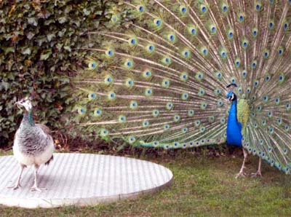
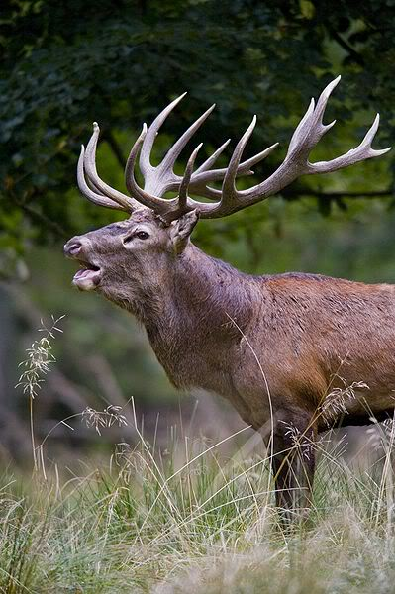
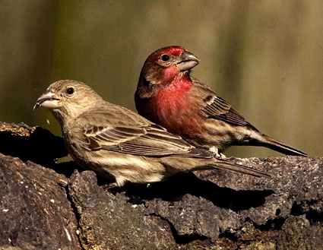
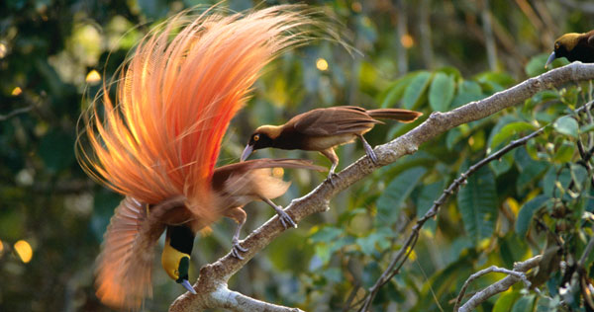
Sexual selection – real world
Many examples, most commonly female choice driving evolution of exaggerated male traits.

Slide 39
Resources/references
Understanding Evolution: one-stop resource for information and resources on evolution from UC Berkeley’s Museum of Paleontology http://evolution.berkeley.edu/
Scitable by NatureEducation: a collaborative learning space/library for science with emphasis on genetics and cell biology (also containing resources related to ecology and scientific communication) http://www.nature.com/scitable

